Slide 1
ReMA’s ESG Series: Employee Trends & Engaging Employees in ESG Strategy & Implementation
August 29, 2024

Slide 2
2024 ESG Webinar Series
Up Next: November 21- ESG Policies & Regulations
Past workshops and webinars available: https://videos.isri.org/category/video-library/esg-workshops/
ReMA Anti-Trust Policy in Effect: isri.org/antitrust

Slide 3
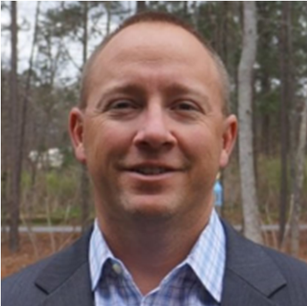
Presenters
Natalie Betts
ReMA
Jessie Miller
Novata
Shawn State
Pratt Industries
Kristin Kinder
Kristin Kinder Consulting
Susan Robinson
ReMA Consultant
Notes:
Jessie –
Jessie Miller is a Senior Manager of ESG Advisory at Novata, a sustainability management platform built for ESG data collection, carbon measurement, and regulatory reporting. In her current role on the Advisory team, Jessie helps companies develop and refine their ESG strategy while aligning to leading international standards, frameworks, and regulations. She specializes in creating ESG processes, uncovering data-driven insights, and developing action plans while considering how ESG can serve as a lever for value creation and risk mitigation. Prior to joining Novata, Jessie held several other roles in the sustainability and corporate responsibility space and received her MPA in Social Impact, Innovation, and Investment from NYU Wagner Graduate School of Public Service
Shawn - Shawn State has worked in the Corrugated Packaging and Recycling Industries for over 30 years. Prior to joining Pratt’s Recycling Division 17 years ago, Shawn held various General Mgt., Operational Mgt. and Sales Mgt. positions in the Corrugated Packaging Industry. Within the Recycling Division, Shawn has held positions of National Business Development Manager, Division Operations Manager, Division Procurement Manager, and Area VP.
Shawn is currently the President of Pratt’s Recycling Division, with his team having responsibility for operations and procurement in 20 recycling facilities across the U.S. Shawn’s team is also responsible for procurement into Pratt’s six 100% Recycled Fiber Paper mills located in Conyers, GA, Shreveport, La., Valparaiso, Indiana, Wapakoneta, Ohio, Henderson, Ky, and Staten Island, NY. These 6 Containerboard mills combined consume over 2.3MM tons of recovered fiber annually.
Kristin - Inspired by living in Germany, Kristin Kinder's 15 years in the waste industry with Waste Management and ENGIE Impact focused on recycling education, recycling tours, behavior change, operations, product management, and in-the-field waste audits for Fortune 500 companies. Most recently, as the Vice President of Research and Waste Stream Sustainability, Kristin has been building the authentic, data-based sustainability program at Wastequip, a $1B manufacturer to the waste industry. Her 2017 TEDx talk on circular economy has inspired tens of thousands; Waste360 honored her with 2019's 40 Under 40; she holds a B.S. from Santa Clara University and a U.S. patent; and she serves on the Environmental Research and Education Foundation's Board of Directors.
She is now starting her own business to bring authentic sustainability programs to more companies.

Slide 4
Agenda
Introduction
The “S” in ESG
Employee Engagement & Program Examples
Jessie Miller - Novata
Shawn State – Pratt Industries
Kristin Kinder - Consultant
ReMA Upcoming Events

Slide 5
ReMA Resources: ESG & Sustainability
Quarterly Sustainability Network Meetings
Email nbetts@recycledmaterials.org to join
ESG Toolkit- 7 Modules of Information, Tools, and Resources
What is ESG
Strategy, Goals & Materiality
Environment
Social
Governance
Reporting
Value Creation
esgtoolkit.isri.org
Notes:
Our speakers today will be providing an overview how they set emissions reduction goals, gathered data, implemented the projects.

Slide 6
ReMA Resources: Workforce
Workforce Management Toolkit
Recruiting and retention guidance developed by and for ReMA members, including a 90 day on-boarding plan, sourcing tips, and guidelines for writing job descriptions.
Career Pathways Program
ReMA has internship and fellowship candidates that can be delivered straight to your inbox. We recruit and vet top entry-level talent for our members to source all for FREE!
Figuring out if interns are a right fit for your company? Not sure where to start? ReMA offers an internship guide.
Compensation and Benefits Study
This tailored study contains the most up-to-date compensation and benefits data for the recycling industry, covering over 80 different job codes for both salaried and hourly workers.
Inclusion Cohort
Employer training and candidate sourcing for hiring individuals with disabilities to fill your vacant roles in operations or administration.
isri.org/workforce-development-programs
Notes:
Work in progress

Slide 7
ReMA Resources: Safety
Safety Trainings
Train the Trainer
Weekly EHS Update
Safety Data Sheets
Recommended Safety Practices
Circle of Safety Excellence
isri.org/safety
Notes:
Work in progress

Slide 8
The “S” (Social) in ESG
The “S” in ESG is more than just doing good for your surroundings.
It includes all the topics connected to how a company relates to people within and outside its walls. It examines the company’s relationships with the other businesses and communities, as well as how the companies treat their employees.
Notes:
.
The “S” in ESG is how a company manages its relationship with its employees, the societies in which it operates, and the political environment.
Today we are going to talk about employee engagement, which is a key element of the social component of ESG. It can feel big and broad and can messy. I suppose that is because its about people – and people are messy.
The S in Social is about companies taking care of their employees and their communities.
It is about helping ensure that your employees and neighbors are as healthy and comfortable as possible.
It means supporting local businesses, causes, charities and building better communities.
Its about improving society in general.
And – it is about your employees.
How do your support their growth?
How do you engage them in your programs?
How do you engage them in your sustainability goals and efforts?
Chances are that your companies are already doing a lot – both from an employee and a community perspective. And – chances are that you could do more.

Slide 9
Social
The financial world defines the “S/Social” in ESG as how a company manages its relationships with its workforce, the societies in which it operates, and the political environment.
It is also often equated with DEI, or diversity, equity and inclusion (gender, race, religion, geography, age, sexual preference and other identity markers).
It includes:
The supply chains we participate in
The people we employ
How staff are treated
Engagement with neighbors and local communities; and
The working conditions organizations create to bring out their human best.
Companies are being held accountable for all aspects of their business: Corporate governance, policies, goals, transparent reporting and community relations
Notes:
Sticking with the broader ESG category, it’s interesting that the investor community is all over the Social element of ESG. They’ve figure out that well-run companies with good employee relations and community programs that take care of the environment are much lower risk and better partners.
So –investors are very interested in a companies’ employee programs and they want more information on them.
Our speakers today will talk about some of their broader employee efforts such as education and employee relations policies.
They will also give some insight into their very specific efforts to enlist employees in their sustainability goals and efforts.

Slide 10
Key ESG Categories
Environmental (E)
Governance
Social
Social (S)
Governance (G)
Equipment & Fuel | Electricity
Safety | Products & Services
Community Programs | Health & Safety
Employment | DEI
Company Activities | Financial | Structure & Employees
Sustainability Strategy | Stakeholder Engagement | Compliance
While the social element is essential to ESG, the interdependency between “environment, social & governance” cannot be understated. It is the delivery and foundation of strong social movements that have supported and contributed to the success of shifting the climate discussion towards positive action.
Notes:
Here are some of the categories that fall under the Social Rubric.
Community programs
Health and Safety
Employment
DEI
Again – the span of social topics is broad with boundaries that touch on other ESG categories. Safety is part of social and environment.

Slide 11
Social Impact: Employee Engagement
The “S” in ESG covers the relationship that a company has with all of its stakeholders: Customers, community and employees, as well as regulators and policy makers.
A focus on social impact topics such as labor and benefits, safety and training can increase profits and corporate responsibility.
In our toolkit we cover each of these stakeholders at a high level. Today we are going to go deeper into employee engagement.
How can a company manage its relationships with its workforce?
How does a company engage employees in its broader sustainability efforts? What are the benefits?
What programs are offered to support employees: benefits, education, safety, ongoing training and other topics?
How does this impact a company?
Social factors can affect a company’s overall performance.
Notes:
Within the social category, the lines can be blurry. Example, there aren’t firm lines separating employee engagement and community involvement since your employees are part of the community, and may want for the company to be involved in community activities.
Something I’ve been thinking about recently is the trends that we see in how far companies should go on social issues. Safety, training, DEI, educational opportunities, benefits, labor relations. Those are pretty clear.
But what about the push during recent years for companies to engage in political dialogues – taking a stand or speaking. After some mis-fires on this, we are seeing more companies stick to a focus on tactical programs and services that impact their employees and their company directly.
There are many different ways of doing this – a few of which we will hear about today as we focus on employee engagement.

Slide 12
Employee Engagement is a Two-way Street
How does a company’s employee relations efforts tie to its overall corporate health?
Employee programs are important to create engagement – which translates into other customer satisfaction and operational benefits.
Employee benefits will determine whether your company is an employer of choice, which is important for hiring efforts in a difficult labor market.
Diversity, equity and inclusion, employee training and education support are all important aspects of employee engagement.
Getting ahead of these trends through programs and policy development makes good business sense.
Engaging employees in a company’s ESG process and programs helps employee moral while bringing fresh ideas and a commitment to achieving the company’s ESG goals.
Notes:
There is increasing scrutiny on the details of this.
Whether it is employee benefits – which do make a difference in hiring and retaining good employees, DEI policies, or other employee programs - getting ahead of these trends makes good business sense.
Do you have good labor practices?
Do you have programs to build a healthy culture and engaged employees?
What about employee Training programs? Do you provide or offer regular safety training classes? Computer classes? Other skill development.
Support for further education? Whether it’s on on-line college degree, a certificate program or a masters degree, these all matter.
Do you invest in your employees? Family wages, Health care? Retirement plans? The new EPR plans being implemented now in states require that MRFs pay a living wage in order to receive funding and to participate in the EPR programs.
These are all part of the two-way street between a company and its employees. The more the employees are engaged, the better of the company is.
And – the most that employees are engaged in the company’s sustainability efforts, the higher the chances are that you will succeed.

Slide 13
Jessie Miller
Novata

Slide 14
ESG: Employees & the Workforce
Jessie Miller
Senior Manager, Novata Advisory

Slide 15
About Novata

Slide 16
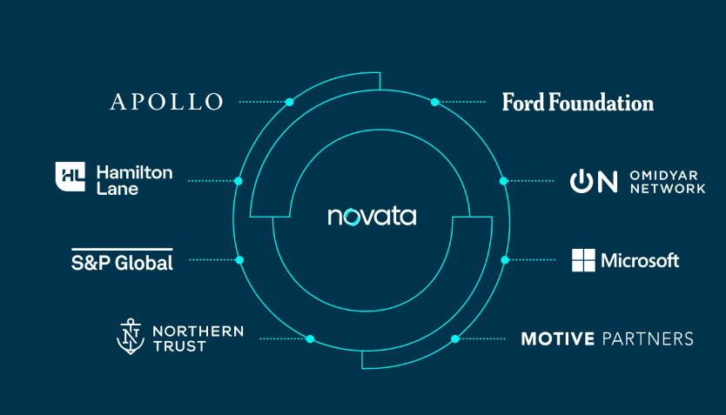
WHO WE ARE
Novata makes it easy for companies to collect, analyze, and report the metrics that matter.
We are a public benefit corporation created by a unique consortium of non-profit and for-profit organizations that are experts in financial data, private markets, and social justice.
Our investor consortium, along with the Leadership Team, Sustainability Board, and GP Advisory Committee bring deep subject matter expertise to enable the private markets to navigate the challenges of ESG and accelerate the journey to a more sustainable and inclusive capitalism.

Slide 17
What Makes Us Unique
Independent and Objective
Measure and showcase your specific ESG priorities, without being subject to ”outside-in” scoring. Benchmark the metrics that matter to you most and chart your own path to greater impact.
Connected Journey
Our secure, open-architecture platform and partner relationships continue to expand to address private markets’ challenges, offering a full-service approach to supporting your ESG journey.
Deep Expertise
Our in-house ESG experts, in coordination with insights from leading private equity firms and ESG practitioners, ensure that we’re building an accessible and relevant on-ramp to ESG reporting and guidance for the private markets.
Built for the Long-Term
We are a public-benefit corporation created by a unique consortium of the Ford Foundation, Hamilton Lane, Microsoft Corporation, Omidyar Network, and S&P Global. The backing of these not-profit and for-profit institutions ensures that Novata’s platform will continue to accelerate progress to manage the metrics that matter.
©2023 Novata Inc. • All rights reserved • 17

Slide 18
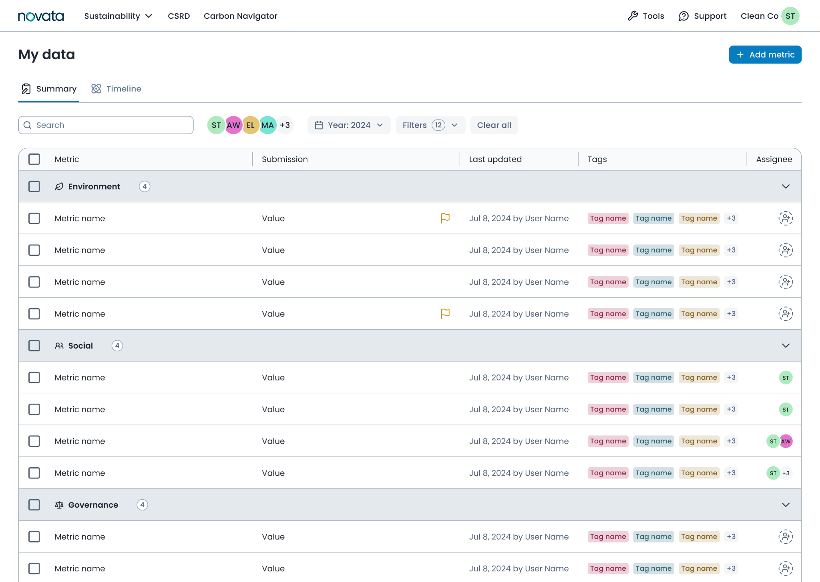
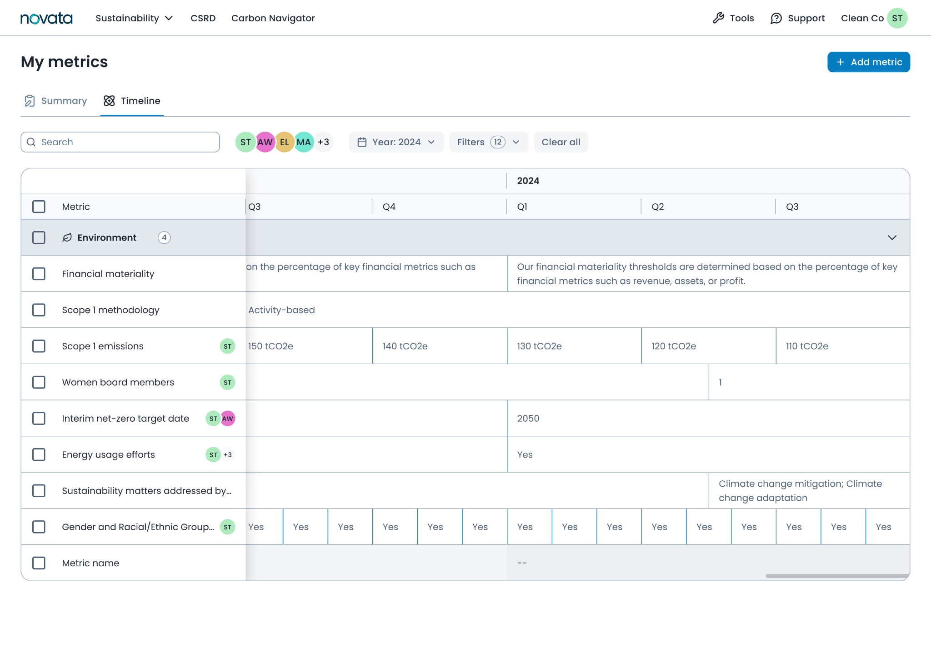
Data Workspace
A flexible workspace and single source of truth, for you to store all of your sustainability data over time
FLEXIBLE
Use tags to filter and slice and dice your data
COLLABORATIVE
Work with colleagues across departments, assign owners, assign tasks, make comments
DETAILED
Dive into specific metrics to drill deeper and see performance over time

Slide 19
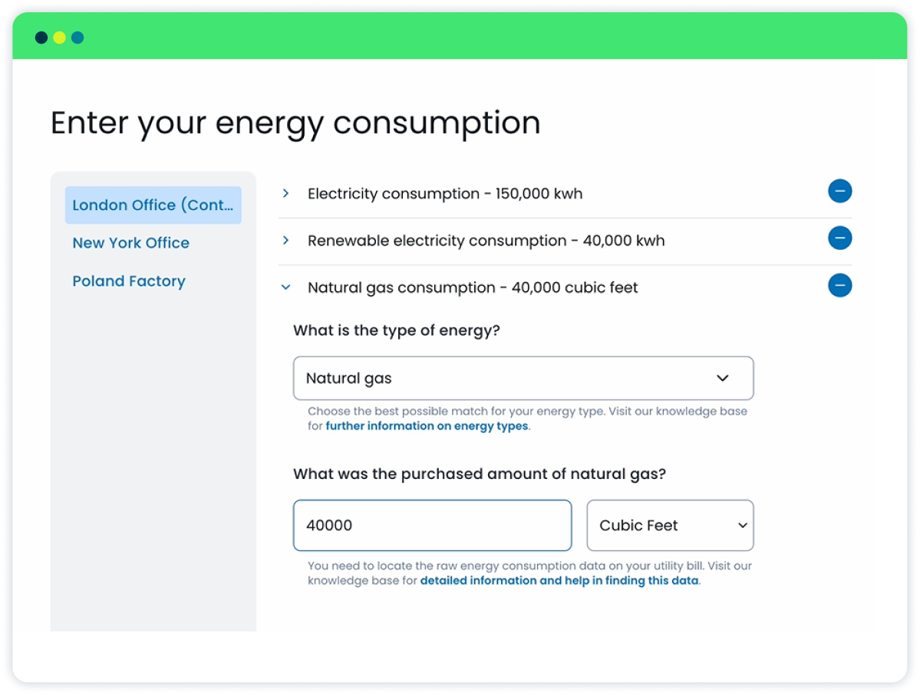
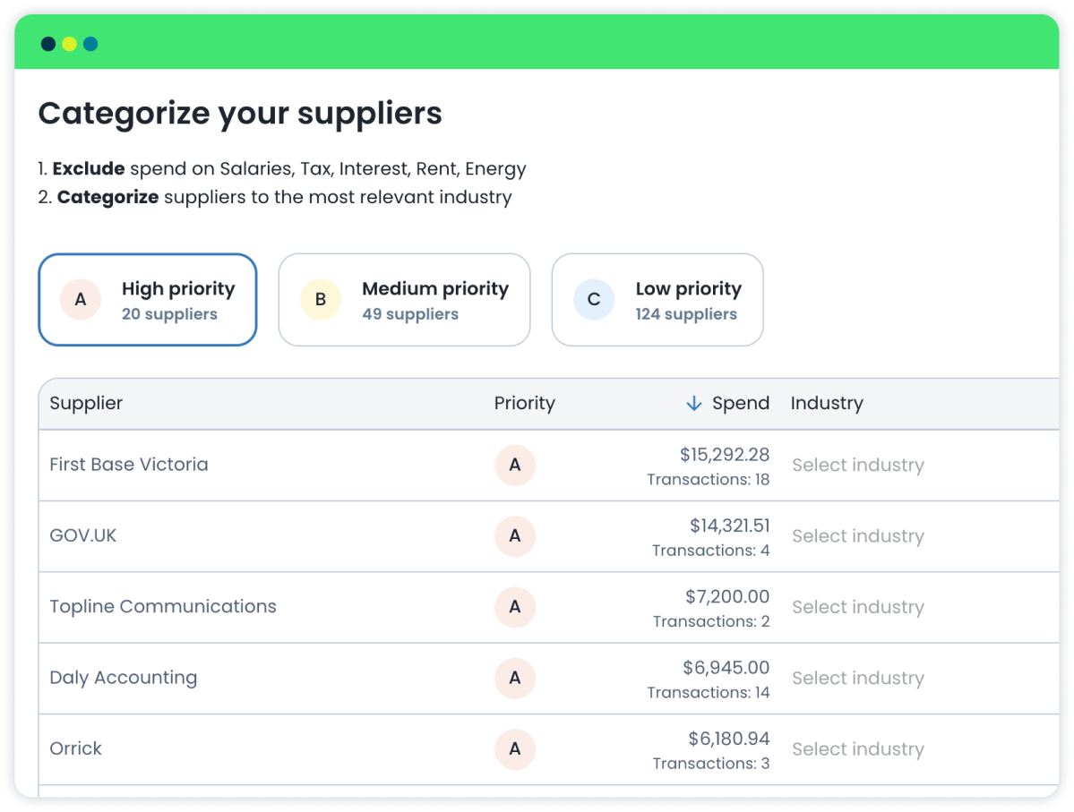
Carbon Navigator
Understand your carbon footprint, identify hotspots, and set targets.
We have built the tool to be:
AFFORDABLE
Designed with the typical company in mind, it is affordable and easy to use
EASY TO USE
Intuitive UX with definitions and guidance throughout plus educational support from experts
COMPLIANT
Built to meet assurance and regulatory requirements - full audit trail to show GHG Protocol alignment

Slide 20
Employees & the Workforce

Slide 21
What is ESG?
Environmental
Social
Governance
Greenhouse Gas Emissions
Energy Management
Ecological Impacts
Air Quality
Waste
Materials Sourcing
Supply Chain
Product Design & Life Cycle Management
Diversity, Equity, and Inclusion
Wages and Benefits
Health and Safety
Community Stewardship
Human Rights
Customer Privacy
Community Impact
Risk Management
Business Model Resilience
Ethics, Corruption, and Bribery
Long-term Value Creation
Security Practices
Board Strategy
Organizational Policy

Slide 22
What does SASB consider material?
SASB identifies the following social topics as material to the waste management industry:
Labor Practices
Workforce Health & Safety
In the waste management industry, many workers are covered by collective bargaining agreements– or unions—that are designed to protect their rights and wages.
Companies need to properly manage relationships with these groups to avoid costly risks such as shutdowns and strikes that can impact productivity and reputation.
SASB recommends that companies maintain a long-term perspective on balancing workers’ rights and productivity.
Safety is a critical issue in this industry due to the potentially hazardous working conditions and impact on workers. This includes fatalities and injuries due to machinery incidents hazardous equipment, and harmful substances.
High rates of worker injuries and fatalities can result in fines, regulatory compliance costs, and reputational damage.
Companies should ensure that all employees have proper safety training, machinery is well-maintained and all sites have safety management plans.
Sample Performance Metrics
Number of work stoppages
Total days idle
Percentage of active workforce employed under collective agreements
Sample Performance Metrics
Total Recordable Incident Rate
Fatality Rate
Near miss frequency rate
Percentage of employees trained
©2023 Novata Inc. • All rights reserved • 22

Slide 23
What trends is Novata seeing?
How are companies currently thinking about and reporting on employee-related social metrics? Novata is currently seeing a focus on the following themes:
Worker Health & Safety
Employee Engagement
Diversity, Equity, & Inclusion
Human Rights
Number of Work-related Injuries
Number of Work-related Fatalities
Total Recordable Incident Rate (TRIR)
Days Lost due to Injury
Workplace Safety Training
Days Away, Restricted, or Transferred
Employee engagement survey & response rate
Annual Percent Turnover
Average Upskilling Hours per Employee
Employee Living Wage
Labor Law Violations
Number of Employees Promoted during Tenure
Turnover Number
Percentage of Employees Receiving Professional Development
DEI Trainings
Incidents of Discrimination
Fines Associated with Discrimination Incidents
Fines Associated with Harassment Incidents
Number of Harassment Incidents
Racial pay gap by job category
Unadjusted Gender Pay Gap
Supervisors Trained on DEI
Board, C-Suite, and Employee Diversity
Allegations of Human Rights Incidents
Human Rights in Supplier Contracts
Workforce Receiving Human Rights Training
Number of identified cases of severe human rights issues and incidents
Operations with Community Development Programs
Operations and Suppliers at Significant Risk of Incidents of Child Labor/Compulsory Labor

Slide 24
What are the key risks and opportunities?
A key strategic use of collecting ESG data is related to risk management and the ability to identify and leverage opportunities.
Category | Theme | Risks | Opportunities
Social | Worker Health & Safety | Legal liabilities and costs Reputational damage Increased healthcare costs Lost productivity and working hours | Improved productivity Cost savings from talent retention Stronger employee morale
Social | Employee Engagement | Discrimination claims and lawsuits Reputational damage Difficulties attracting and retaining talents Lost productivity High turnover costs | Improved productivity Cost savings from talent retention Reputational value
Social | Diversity, Equity, & Inclusion | Discrimination claims and lawsuits Reputational damage Lack of diverse workplace High turnover costs | Enhanced corporate reputation and brand value Increased innovation from diverse teams Access to diverse markets and customer bases
Social | Human Rights | Legal liabilities and costs Reputational damage | Enhanced corporate reputation and brand value Appeal to investors and customers Value chain transparency
©2023 Novata Inc. • All rights reserved • 24

Slide 25
Thank you!
Through 2024, ReMA members will receive a 20% for the Novata platform.
Contact Kristin Thompson to schedule a demo: kristin.thompson@novata.com or book online at www.novata.com
Jessie Miller, Novata Advisory
Jessie.miller@novata.com

Slide 26
Shawn State
Pratt Industries

Slide 27
Sustainability & Employee Engagement

Slide 28
Employee Engagement
Key Performance Indicators / Continuous Improvement
Education
Code of Conduct
Diversity and Inclusion
Auditing

Slide 29
Key Performance Indicators (KPIs)
Begun in 2019, KPIs track facility-specific sustainability indicators including:
Electricity usage (kWh)
Natural gas usage (MMBtu)
Water usage (gallons)
Waste to landfill (tons)
Waste recycled (tons)

Slide 30
Education
Employee education reimbursement program
Pratt U
Maintenance apprenticeship program - Currently have 16 apprentices across 9 plants
Summer internships - 36 interns during the summer of 2024
PU online classes - Total lessons online = 2100 of that 400 are Internal Pratt made lessons. FY 2024 14,000 lessons completed online.

Slide 31
Education
Supervisor Training
Management Training
Topics around leaderships and employee develop delivered as workshops or on-site
Management 101 is orientation for new managers. Pratt U Masters in Business and Leadership extended training through UNC
Customized Training
Pratt U at a glance
Sales Training
Plants or organizations reach out to develop training tailored to their specific needs
Box 101 is orientation for new Sales Reps. Pratt Professional Selling partners with Carew International for advance sales training.
LMS / On-line
Maintenance Apprenticeship Program
Hundreds of topics available online through our ADP site
Support Corrugator division in partnering with local tech schools to develop pipeline of skilled, trained mechanics
Regional Training
Language Learning
Pratt Professional Communication and Supervisor Workshops are delivered around the country to provide increased accessibility
Pratt U has partnered with Rosetta-Stone to offer language learning
Hourly Employee
Internship Program
Topics such as One Common Goal, Respect For All, Building Trust, and more are delivered on-site
In partnership with HR, Pratt U provides support for supervisors and interns

Slide 32
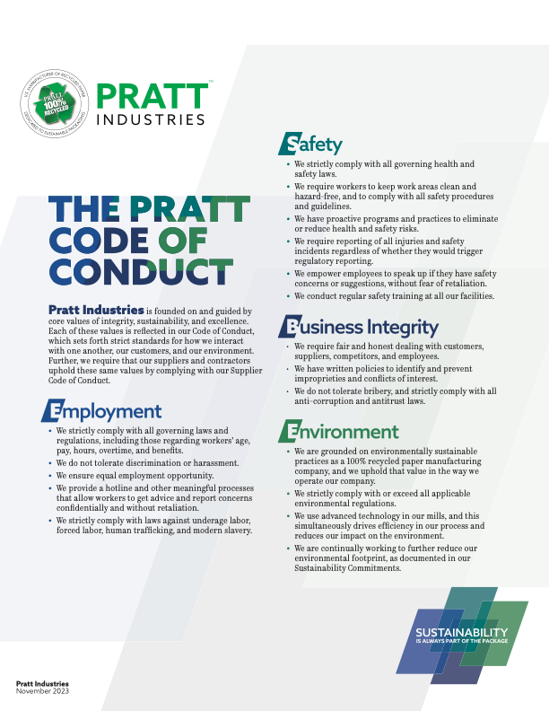

Slide 33
Diversity & Inclusion Statement
Pratt Industries is founded on and guided by core values of integrity, sustainability and excellence. These values direct the ways that we interact with one another, our customers and our environment. They are at the heart of who we are.
In keeping with those values, we foster an environment of diversity and inclusion. We believe that diverse perspectives make us a stronger company, better able to serve our customers and communities. We value the unique background and experience of each of our employees. We treat people fairly and with respect. We strive to maintain an environment that encourages our people to develop their talents and achieve superior performance. .
Pratt Industries is also an EEO employer and provides equal employment opportunities to applicants and employees without regard to race, color, religion, sex, sexual orientation, gender identity, national origin, protected
veteran status or disability or any other characteristic protected by law.

Slide 34
SMETA (Corporate Social Responsibility)
Independent third-party auditor conducts audit to inspect a company’s site, its processes, documentation, and systems against the Ethical Trading Initiative (ETI) Base Code and local laws.

Slide 35
Ethical Trading Initiative (ETI)
Examples of ETI
Working conditions are safe and hygienic.
Child Labor shall not be used.
Employment is freely chosen.
Working hours are not excessive.
No discrimination is practiced.
Regular employment is provided.
No harsh or human treatment is allowed.

Slide 36
QUESTIONS?

Slide 37
Kristin Kinder

Slide 38
Engaging Employees in People & Planet (with Profit)
Notes:
Looking at it from a top-down perspective;
There can be a lot of opportunity to capture from a bottom-up perspective as well;

Slide 39
Tie to company values
We delight in the rigor of the details—no matter ​what our job is.
We excel when we assume the best in each other.
We value speed, a bias for learning and action.
We are humble when searching for the best ideas. We take time to help others succeed.
We are not bound by convention. Our success—and much of the fun—lies in developing new ways to do things.
Notes:
What’s going to speak to the majority of people working at your company is going to align with the company values;
Lots of benefits to defining company values - Sharing values helps people connect and gives employees purpose; improves retention;
I believe that companies can make the world a better place and make money
Also connects customers to your company
Values often relate to the company’s industry
Snowball effect – you tie to the company values to strengthen your program, but your program also strengthens your company values;
Tangible progress you can see
At WQ, we didn’t have a sustainability program, but we had company values;
Showing some well-known company values to show you that they can be different; culture can be differen
You see these from the very first interactions employees have with the company - in job descriptions, etc.
No two sustainability transformations are alike. Even within the organization, the integration process may require different strategies for different business units.
That’s why it’s important to be honest about where your business is on the transformation journey - How to Integrate Sustainability into Business Strategy: 5 Key Steps - WSJ
I’m focusing more on how you then use those values
People have already agreed to working there; most likely they value the same values as the company or they wouldn’t be there
Important to embrace company values at every level – so I think this can work both ways
WQ Values:
Improve what matters most
Most likely, your company values point to where you can make progress already;

Slide 40
Start small
Working on only what you can achieve helps
Helps overcome overwhelm,
Strengthens collaboration, and
Builds trust
Employees begin to see progress
Notes:
Easy to feel competitive
Easy to be overwhelmed
Easy to not start
Ex: I got to see Kevin O’Leary speak just before we started our sustainability program; One of the biggest differences he noticed between start ups that were in the red 3 years later and start ups that were in the black was that -------------------.
Compare to hiking – you just start and put one foot in front of the other; before you know it you’re halfway up! If you focused only on how big the mountain is, you’d never leave the parking lot;
The whole point of setting goals is to leverage the strength of a team – to work in the same direction, but having too many priorities can dilute that
Be intentional with how and when you involve employee groups – at WQ started small; and expanded the ripple; some companies might have good reason to start with a more-inclusive sustainability champions type program;

Slide 41
Communicate with Data
Fosters collaboration through a common language
Helps set context to balance priorities for the company
Notes:
Story of Sandra Noonan at JustSalad
It’s the difference between – “I think we should leverage renewable energy.” and “Renewable energy will cost 46% more in the first year, but we will be able to pay it back by year 4, saving -----------------.” 50% renewable energy will lower our carbon emissions 42%”

Slide 42
Integrate into the Business
Incorporating People and Planet priorities with business processes exposes many to sustainability
Multi-departmental steering committee
Employee goals
Executive bonuses
Funding approval processes (budget reviews, CapEx, etc.)
Job descriptions, interviews
Employee engagement programs
Performance metrics (operational KPIs, financial reviews, etc.)
Progress reports at Board meetings
Notes:
Exposes more departments to people and planet through their daily work
Aligns with existing decision-making and accountability – more efficient;
Allows the experts to do what they’re good at – you don’t want the sustainability team doing all of the work – deciding what engineering should do, or marketing, or ----------------------------; integrating into the business, enables the right tasks to go to the right people;
Story of the cardboard boxes and Emily;
Performance metrics – KPIs team members see every day
Does anyone else have other ways their company has done this;
Employees start to learn from their coworkers about the program; that’s much more powerful than learning about it
50% Training employees on climate change actions and impacts – Deloite CxO study 2023 2023-deloitte-cxo-sustainability-report.pdf
To help drive governance over sustainability data and accounting, some companies are assigning sustainability information disclosure to the CFO. “Finance teams have the capabilities to put strong controls in place, build systems that capture data once and reuse it for multiple purpose” - How to Integrate Sustainability into Business Strategy: 5 Key Steps – WSJ

Slide 43
Kristin Kinder
Kristin@kristinkinder.com
Kristinkinder.com

Slide 44
Q&A

Slide 45
ReMA Fall Calendar
Virtual Events
Sept. 4, Sept. 18, Oct. 9, Nov. 20- National Election Impacts on the Recycled Materials Industry Webinar Series
October 2: Safe Hands, Safe Machines Webinar Sponsored by KPA
November 5: Sustainability Network Quarterly Meeting with Carbon Credits Presentation
November 21: ESG Webinar Series- Policy & Regulatory Update

Slide 46
ReMA Fall Calendar
In-Person Events
September 16-18: Packaging Recycling Summit in Anaheim, CA
September 17-18: ScrapExpo in Louisville, KY
September 23-25: ReMA Roundtables in Chicago, IL
October 10-11: EV Safety Technician Course in Columbus, OH
October 14-16: ReMA Fall Meeting in Portland, ME
October 20-24: MRF Operations Forum & PPRC in Chicago, IL
November 3-6: Pack Expo International in Chicago, IL
November 11-13: Safety & Operations Forum in San Antonio, TX

Slide 47
Thank You
Natalie Betts
Assistant Vice President of Sustainability
nbetts@recycledmaterials.org

