Slide 1


Strategy and Goal-Setting July 2023
Workshop #2
Notes:
With that quick stage-setting, lets dive into our first topic today:
Developing ESG Goals and Strategy.
Chances are, your organization already has some level o goals or a Corporate Vision and Mission.
Today we are going to talk specifically about creating an ESG Strategy – including setting ESG Goals, creating strategy statements for those goals, and developing your tactics for achieving your goals.
This is a fun process, and one that can really pull your team together as you move through the planning process.

Slide 2
ESG Strategic Planning Steps
A Conversation with our Stakeholders
Goals
Strategy
Tactics
Reporting
Conduct a materiality assessment
Establish your baseline
Set ESG Goals
Analyze Performance Gaps and revise goals as necessary
Create Strategy Statements for each Goals
Develop tactics for achieving your goals
Track goals quarterly and report annually
Goals + Strategy for Each Goal + Tactics + Reporting
=
ESG Strategic Planning
Notes:
As we move through the steps of creating an ESG Strategy, think about whether this is likely to be in addition to your company’s business strategy – our whether it might ultimately become one in the same, depending on the services that you provide. These may be one and the same.
The steps that we’ll talk through today include:
First - Goals Setting. We’ll talk a bit about the “Why” and “What” of setting goals, then will work through some steps to create them:
We’ll start with the role of your materiality assessment
Then, its time to establishing your baseline.. Sort of the adage that you have to measure performance ion order to manage it.
We’ll spend time talk about actually setting your goals – we’ll really dig in to this today.
Then you’ll need to analyzing gaps between your base line and your goals, and the nuances of this process. This may result in adjusting your goals.
Once you have your goals, it’s time to develop your strategy for each one. Each of your goals will have a Strategy Statement. This is a key element in your overall strategic plan.
After all of this, we will move to developing tactics.
And last but not least – you need to report on your progress.
While some of the steps may be interchangeable or fluid – as you may find that you will need to revisit early steps as we move through the entire process – I’d like to point out that we want to keep the tactics at the end. The other parts of the process play a key role in getting us to that point. While our industry tends to be “tactics and implementation” focused, for this exercise we need to wait to go there until we’ve done everything else.
I think you will see the rational for as move forward.

Slide 3
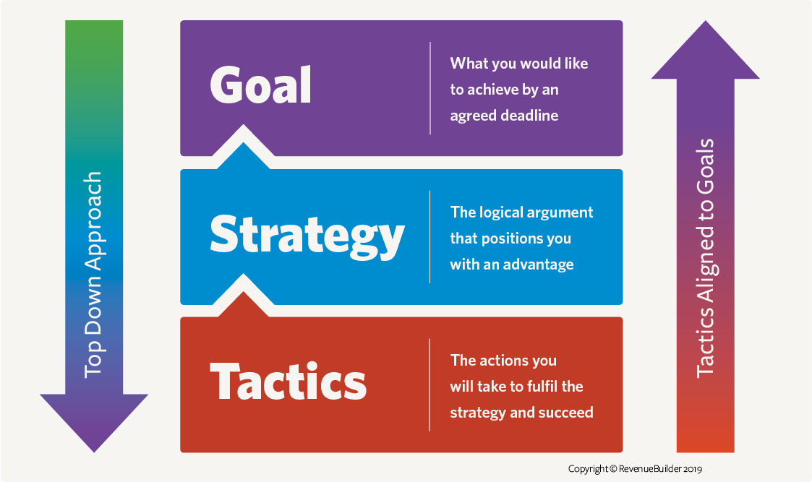
Strategic Planning Process*
A Conversation with our Stakeholders
Goals: What would you like to achieve by an agreed deadline?
Strategy: The logical argument that positions you with an advantage
Tactics: The actions you will take to fulfill the strategy and to succeed.
* Reporting is an assumed function in this process
Notes:
Here are the BIG IDEAS for our strategic planning process today.
We will try to keep it simple, starting with establishing ESG Goals. These goals will serve as our guiding light for our ESG efforts.
Then for each of our goals, we’ll create a strategy statement that positions the company around that goal.
Finally, we’ll talk about the very specific tactics, or actions, that we will implement to achieve each goal.
And of course reporting on your progress, which is one of the reasons for doing all of this.

Slide 4
What does strategic planning look like?
A Conversation with our Stakeholders
Everyday Example
Goal: Where You Want to Go
Strategy: How you will get there (preceded by research/knowledge on why that’s how you want to go)
Tactics: The actions you will take, by when, and with what resources.
Goal: Get to Chicago This Month
Strategy: I will drive there.
  Why: I want to be able to arrive and depart at a flexible time, I am a skilled driver, I live within a drivable distance, and I don’t like airports.
Tactics: I will achieve my goal by:
Renting a car the day before my trip.
Saving enough money for gas and one night in a hotel for my stop along the way, before July 21
Drive 8 hours on Day 1, stop in St. Louis and stay in a hotel.
Drive 4 hours on Day 2.
Arrive no later than July 28.
Notes:
Here is a non ESG example of what a strategic planning process might look like.
In our example – we want get to Chicago this month.
The goal is “the End Game” – what you want to achieve, or in this case, where you want to go and by when. In this example, we want to go to Chicago this month.
The Strategy is how you will get there based on the research that you do. The strategy for reaching your goals is to drive because your research and knowledge determines that is the best option for your specific needs and skills.
And the tactics are the specific actions you will take, by when, and with what resources.
So – your tactics to get to Chicago include renting a car, saving money, driving a specified number of hours each day and arriving by a certain date.
If you go straight to the tactics, you will miss research you did and thus the reasons by you are driving, and run the risk of not achieving your goal.

Slide 5
Sample Goals, Strategies and Tactics
A Conversation with our Stakeholders
Goal: Reduce GHG emissions by 30% by 2035
Strategy: We will be a leader in employing technology solutions to reduce emissions associated with our industry
Tactics: We will achieve our goal by using renewable electricity, zero emissions vehicles, and by helping our customers achieve their GHG emissions reduction goals
Purchase 100% renewable sources electricity by 2027
Purchase 10% renewable fuel vehicles each year, so that 100% will be replaced by 2034.
Goal: Improve Safety Performance 2% YOY
Strategy: We will invest in industry-leading health and safety programs to ensure the heath and safety of our employees and communities
Tactics: We will achieve our goal by:
Hiring external consultant to identify and implement new programs
Providing consistent training programs to all employees
Goal: Improve the lives of our local communities
Strategy: We will partner with our local communities to identify and implement programs
Tactics: We will achieve our goal by:
Donating 1% of profits to local community organizations
Continue monthly volunteer work with Habitat for Humanity
Notes:
Let’s now try this for examples in our industry. Here are three ESG goals for our industry type, and a strategy and tactics for each goal.
Each goal serves as a guiding light for your company’s ESG efforts. It is not only a key topic for your company, but the goal itself must offer meaningful benefits to your stakeholders.
The goals here are reducing GHG emissions by 30% by 2035
2% YOY safety improvement performance; and
Improving the lives of your employees and communities.
The strategy statement is a high level statement, or your ambition, to get you to your goal. It is the statement that positions you with an advantage to achieving your goal.
Strategy for GHG Goals: To be a leader in employing technology solutions to reduce your emissions. You will use renewable energy to reduce your emissions
Strategy for safety goals: Invest in industry-leading safety programs to improve safety performance
Strategy for community goal is to partner with local communities to identify and implement programs.
Finally, as in the Chicago example, the Tactics are the details or the actions you will implement to achieve your goal.
If you miss the strategy section, you run the risk of implementing tactics that won’t get you to your goal, or that aren’t a good fit for your business’ specific strengths, or your available resources.

Slide 6
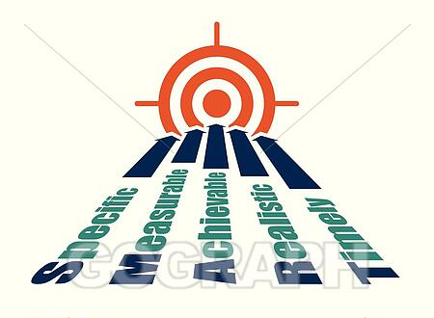
Goals
SMART Goals
Notes:
Let’s get started with our goals development process. You may have heard the term SMART Goals.
Specific
Measurable
Achievable
Realistic
Timely
Keep this in mind as we go through the process. We’ll be using the concept of developing SMART goals as part of our ESG Strategic planning process.

Slide 7
ESG Strategic Planning Process
A Conversation with our Stakeholders
Goals: What would you like to achieve by an agreed deadline?
Strategy: The logical argument that positions you with an advantage
Tactics: The actions you will take to fulfill the strategy and to succeed.
Notes:
Definition: A goal is an outcome that you want to achieve by a specific time or date.
Our process today identifies specific goals that we would like to achieve by agreed upon deadlines.

Slide 8

Why Create Goals?
A Conversation with our Stakeholders
Why should a company develop ESG Goals?
Goals communicate intention to a company’s stakeholders
Goals (and reporting on progress) drive action
Establishing goals is the first step in creating an ESG Strategy.
Notes:
Of course, not all companies have established goals at all, let alone ESG Goals.
Why should a company develop ESG goals?
1. Well, just like other goals, ESG goals communicate intention to a companies stakeholders. And – as we know, more and more of your stakeholders are asking about your ESG intentions. Establishing thoughtful ESG goals lets your stakeholders know that this is an issue that is important you and that you are spending time planning for.
2. Also, there is evidence that goals - and reporting on them – drive action. When an organization publicly reports on its progress to goals each year, that transparency drives action.
Finally, ESG goals are the first step in creating an ESG strategy. How can you know what ESG projects to focus on if you haven’t established priority projects and mapped out where you want to go with them and how you will get there?

Slide 9


Developing Goals
A Conversation with our Stakeholders
Think Big!
Develop a few key goals as your guiding light
ESG Goal Development
Select a few key goals – not a long laundry list of detailed goals
Focus on 3-5 high-level goals that you can build your company’s ESG strategy around
Spend time on meaningful research and analysis behind your goal setting
Achieve zero waste to landfill in Canada, Japan, U.K and the U.S.
Be powered by 50 percent renewable energy sources under a plan designed to achieve science-based targets
Double sales of locally grown produce
Expand sustainable sourcing to cover 20 key commodities, including bananas, grapes, coffee and tea
Use 100 percent recyclable packaging for all private-label brands
Goals are your guiding light.
Based on your materiality review, they may look something like this:
GHG emissions reduction/climate change (reduce by 50% by 2035)
Safety (improve by 2% each year)
Community Engagement (donate 2% of revenue)
Notes:
How does an organization go about identifying potential goals topics?
Where we used to see long laundry lists of sustainability goals, companies are beginning to focus on a few very high level, big goals, with the details in the tactics.
I like how Walmart has done this. As big as they are, they have 5 ESG goals. Then – the details behind them are exhaustive.
I recommend select a few key goals –
Focus on 3-5 high-level goals that you can build your company’s ESG strategy around
Spend time on meaningful research and analysis behind your goal setting
Your goals are guiding lights for your company.

Slide 10
All Goals are not Created Equal
A Conversation with our Stakeholders
Goals are broad, long-term outcomes that are reasonable to achieve within a time frame and with available resources.
Goals should be measurable and are your guiding principles for your company in regards to ESG.
ESG Goals can be Aspirational (e.g. eliminate GHG emissions by 2050) or carefully researched to ensure achievability (reduce GHG emissions by 25% by 2030).
  Aspirational Goals set high benchmarks but may not be realistically achievable.
  Realistic goals built by research may not sound as impressive but allow the opportunity for success.
Aspirational or Fact-based? What is the best approach? Your company will need to decide but goals should be backed up by analysis.
Notes:
In the world of ESG, all goals are not created equal.
Aspirational goals. Setting really aspiration goals such as “Zero Waste by 2025” sounds great, doesn’t it? But do many organizations really think that they will get there?
From my perspective, once an organization misses its goals it I hard to take them seriously. As goal dates are passed, a company’s integrity may be questioned. And who wants to report failure each year?
Also, if a company doesn’t meet its goal, it may be accused of greenwashing. We used to see a lot more wild aspirational goals; however, companies are starting to move away from these lofty goals as they experience the backlash of failure.
Realistic Goals. The risk here is that stakeholders may think you didn’t aim high enough.
SMART goals will help guide you to the right balance. Again: your goals should be specific, measurable, actionable, realistic and timely.
Importantly, the type of goals you create could affect your ESG strategy and will certainly impact your tactics.

Slide 11
How do Goals Influence Tactics?
A Conversation with our Stakeholders
Aspirational Goal
Realistic Goal
Goal: Become the second oldest woman to climb Mt. Everest
Strategy: I will commit the time and resources necessary to summit Mt. Everest.
Tactics: I will achieve my goal by:
Taking mountaineering classes to learn technical climbing skills
Setting aside sufficient time to train, including follow a regimented cardio and strength building routine, and climbing local mountains each week
Researching and select a qualified guide company for the trip.
Setting aside funds to purchase the necessary gear.
Goal: Hike to Mt. Everest Base Camp
Strategy: I will commit the time and resources necessary to hike to Mt Everest Base Camp.
Tactics: I will achieve my goal by:
Setting aside sufficient time to train, including follow a regimented cardio and strength building routine, and climbing local mountains each week
Researching and selecting a qualified guide company for the trip.
Setting aside funds to purchase the necessary gear.
Notes:
Here is a personal example.
I am a big climber. About a decade ago, I decided to climb Mt Everest. Given that fact that I was over 50 at the time, and had no technical climbing experience, hiking to the top would have been an aspirational goal.
Although I was fairly confident that I was a strong enough hiker to get to the top, I was working full time with a demanding job, and am afraid of heights (Kumbu Ice Fall). I decided that climbing to the top was not a realistic goal for me.
So, instead of setting an aspirational goal of climbing to the summit of Mt Everest, I decided to go to Base Camp which is still a significant investment of training time, travel time and resources.
So – my strategy statement was to commit the time and resources necessary to achieve my goal. The HOW was committing the time and resources to achieve my goal.
Next, note that the tactics are very different between the two goal options – they are much more aggressive for the aspirational goals. Unless I was committed to the time, training and resources in my strategy of climbing to the summit, there was no way I would reach that goal.
This was a realistic goal, rather than an aspirational goal. It took let money, less time and a very realistic commitment. And – I achieved my goal in 2014 and feel great and proud of my accomplishment. And am pretty sure that I never would have made it to the top of Mt Everest – and – IMPORTANTLY - if that had been my goal, I may not have even made it to Base Camp.

Slide 12
Step 1: Tap into your Materiality Assessment
A Conversation with our Stakeholders
Getting Started:
Use your Materiality Assessment to identify key topics for goals.
From our review of our industry’s materiality in Workshop #1, we identified the following broad key topics as Material for our industry.
Environment
Climate Impact / Climate Change
Air Quality
Environmental Compliance
GHG emissions
Recycling
Social
Human Rights
Community Relations
Employee Training
Community Investment
Health & Safety
Talent Recruitment & Retention
Supply Chain
Vendor Training
Governance
Business Ethics
Competitive Behavior
Legal & Environmental Management
Systemic Risk Management
Critical Incident Risk Management
Your materiality assessment is important for establishing the topics that are important to your stakeholders. Use the result of your materiality review to guide your organization in the development of its ESG Goals.
Notes:
Okay – Now let’s jump into the process itself for how to establish specific goals for your organization.
We’re going to start by tapping into the materiality assessment that we talked about in the first Workshop.
No worries if you weren’t on that call.
Here is the concept:
- Start by identifying the key topics that your stakeholder identify as important to your company
- Use these to create broad topics for your goal discussion

Slide 13
Select Your Key Topics
A Conversation with our Stakeholders
Materiality identifies key stakeholder issues, priorities them and informs goal setting
Using your Materiality results, select key topics for your goals.
Use team meetings to discuss and determine key topics for goal setting
Reduce GHG Emissions | Improve Health & Safety | Increase Recycling | Improve Diversity, Equity & Inclusion | Improve/grow Community Relations Activities
A well-done materiality assessment links the business of the company to its significant ESG impacts.
Notes:
The key issues from your materiality work will help create priority topics for your goal setting. They should link the business of the company to significant ESG impacts. Not all of these example these topics are all relevant for our industry.
.
Be sure to really talk this over with your internal team to make sure that folks buy into the key topics. If you don’t get their right now, you will potentially waste a lot of time and effort going down the wrong path.
I’ve seen leaders make changes to the basic key topics late in the process, and its really hard to have to work through the process again.

Slide 14
Step 2: Establish your Baseline for Key Topics
A Conversation with our Stakeholders
Use your data and reporting information to assess your current performance regarding your interim goals.
Your current status becomes the foundation for improvement. Review and analyze available data and information to establish specific goals.
You need to know where you are in order to determine where you want to go.
For example: If you ultimately create a goal is to reduce your emissions by 30%, you need to know what your current emissions and where they come from.
Notes:
Step 2:
After you’ve identified key topics, but BEFORE creating your goals, make sure that you have, or complete an assessment of your baseline for them.
Basically - What is your performance now for each issues?
This will influence what your goals will look like.
For example - if you are thinking about creating a goal to reduce your emissions by 30%, you’ll need to know what your current emissions are before you start.

Slide 15
Step 3: Create Initial Goal Statements
Next, determine the company’s ambition and create initial goal statements for each key topic
Examples of broad statements without specifics yet:
We will reduce GHG emissions by X% by XXX
We will increase diversity among company’s leadership by XX% in XXX
We will increase tons recycled by X% by XXX
We will improve community relations
Once you create these goals statement, your leadership team can discuss whether they are the right fit for your company, or whether they need to be modified.
* Interim goal statements are broad statements that convey the concept to goal without including specifics of time or magnitude
Notes:
We are already at Step #3.
It is time to create initial, or draft, goal statements. You are going to spend a lot of time poking and prodding at these, so don’t be surprised if they change as your work through them.
Use your priority topics start to play with your goals statements. The numbers come later. Get the concepts right first.
Again – before you go too far down the path to build these out, engage your leadership team to discuss whether they are the right fit for the company and whether they will support them. You don’t need the specifies numbers and dates for your goals yet, but you do need to settle on the statements.
Some of your internal discussion might look like this:
We want to reduce our emissions. By a percentage or a specific number of metric tons?
We want to increase diversity. For the entire company? Or subgroups?
We want to improve safety performance. What does that look like for our company?
We want to improve community relations. Do we donate money, or do we want to develop new programs?
We want to increase recycling. What is realistic for us?

Slide 16
Establish Specific Goals
A Conversation with our Stakeholders
After agreeing on broad goal statements and establishing your baseline it is time to create your goals
Your current status becomes the foundation for improvement. Review and analyze available data and information to establish specific goals
Include internal subject matter expert for each goal in your goal discussion.
Benchmark peer companies as a reality check
Review with leaders and adjust as necessary.
Reduce GHG Emissions by % by XXX
Specific Target Goal
We will reduce our GHG emissions by 30% by 2030
Select Priority Material Issue
Interim goal statement
Reduce GHG Emissions
Notes:
Considering all those previous questions, getting to the actual goal statement may take some time.
Getting to specific numbers may take longer.
One of the reasons by the process is so important is that you will need information to inform your recommendations and decisions.
Take time to benchmark other companies. This helps a lot!!! What are your peer, or adjacent industries’ doing? What do you think of their goals?
Review with internal SMEs. Listen to your experts!
Review proposed goals in context of the company’s current baselines. Are your proposed goals too high? Too low? Realistic? Aspirational?
This is not an easy or quick internal process. Take the time to benchmark, to discuss, and make changes.
It is a great process, and your leadership team will learn a lot along the way – which also create ownership and buy in as you develop and implement you plans.

Slide 17
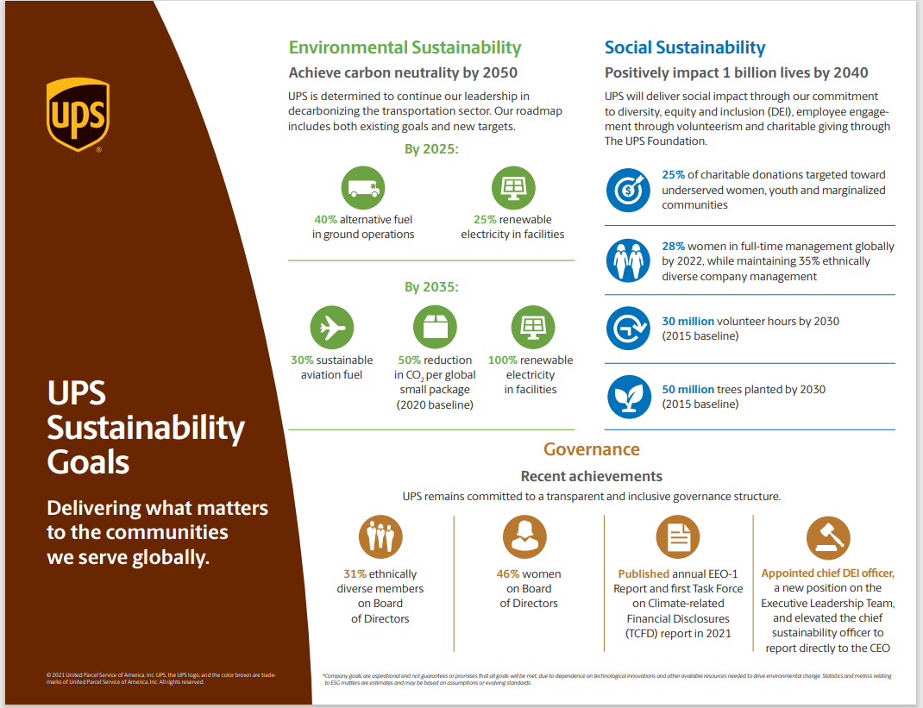
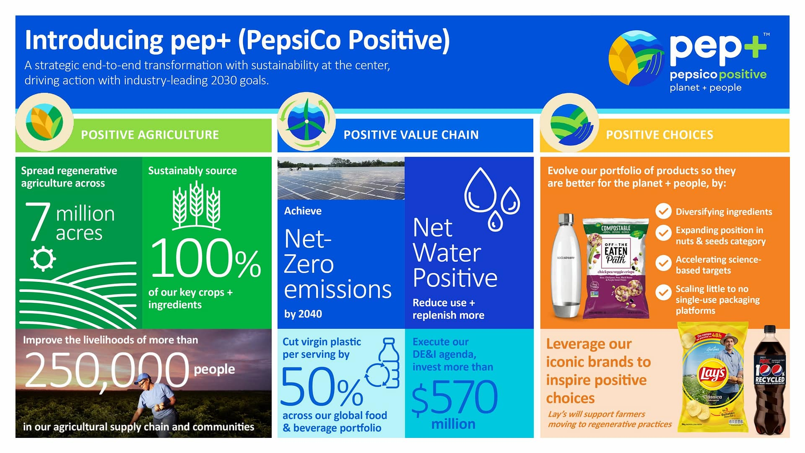
Sample Corporate Goals
A Conversation with our Stakeholders
Notes:
Here are some examples of goals:
UPS is interesting since they are in an adjacent business.
Pepsi – it is just so large, you can see the magnitude of their goals.
Starting with goals. You’ve likely seen corporations goals by now.

Slide 18
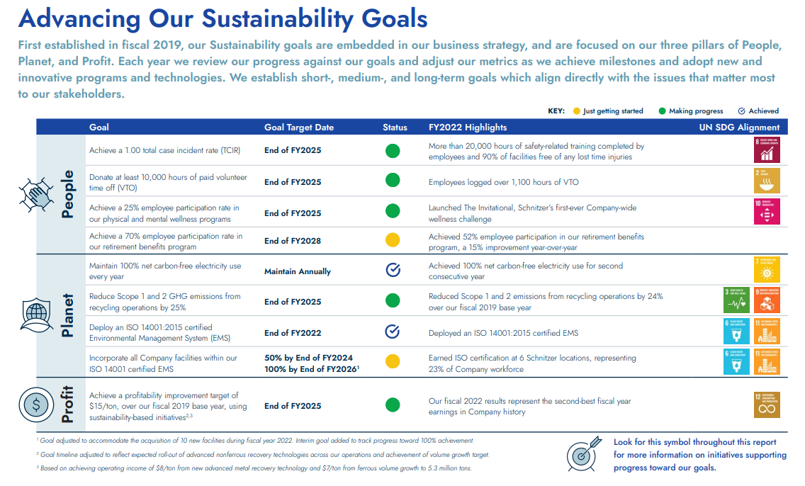

Schnitzer Steel ESG Goals
A Conversation with our Stakeholders
Notes:
Schnitzer has specific goals identified for the E, the S, and G (People, Planet, Profit).

Slide 19
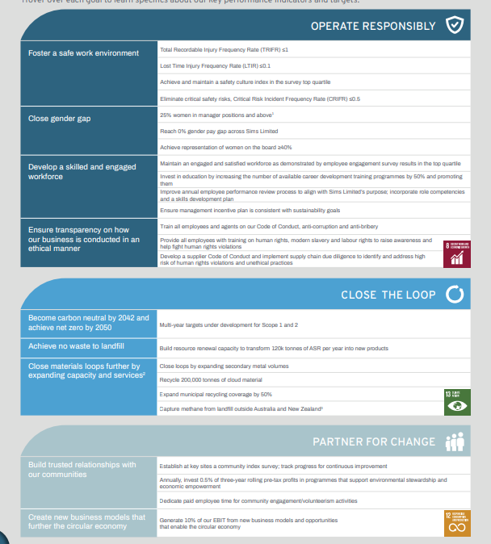

SIMS Metal’s ESG Ambitions & Goals
A Conversation with our Stakeholders
SIMS Metal’s 2025 Sustainability Goals: Our sustainability ambitions reflect where we want to arrive by 2025 and point to longer-term growth opportunities. Because “what gets measured gets done,” we have created discreet goals under each of our ambitions. We will measure and report on our progress toward achieving these goals.
Notes:
Sims does as well.

Slide 20
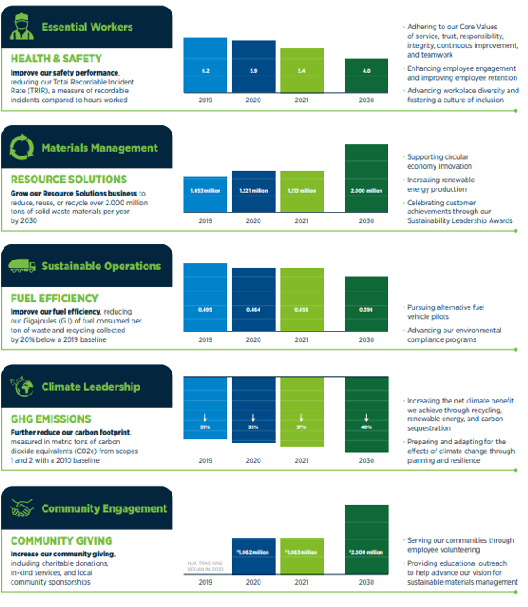
Goal Development: Casella
A Conversation with our Stakeholders
Casella’s sustainability program is built around 5 primary goals for the year 2030
Each was selected via their Materiality Assessment process and is aligned with the Company’s core business strengths and financial goals
They are all consistent with the goals of their customers and communities.
Notes:
Casella does a nice job of highlighting how they’ve tied their goals to their business and stakeholders.

Slide 21
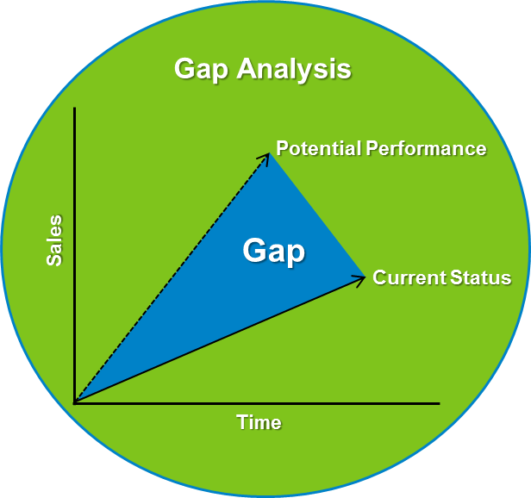
Step 4: Analyze Performance Gaps
A Conversation with our Stakeholders
The Gap Analysis is a good point for checking your goals statements:
As you review the difference between your baseline and your goals, you may decide that the gap is too great to realistically achieve, or that this it not aggressive enough
This will be a good point at which to review previous work to assess your goal statements
It’s okay to be flexible – and to make adjustments to your goal statements based on your analysis.
The ESG Strategy Process is a Journey!
Your team will be learning along the way and may need to adjust previous steps depending on the direction that you take and the result of your analysis.
Notes:
Now that you have agreed on your goal topics, your proposed specific goals, and have your baseline for each of them, its time to analyze the gaps between current and goals, so you can start planning for how you will reach your goals.
After you complete this analysis, you can decide if the goal is too aggressive, or not aggressive enough.
It may simply be too heavy of a lift and you may decide to reduce the goal at this point.
Your team will be analyzing data and learning through this process. They will be learning a lot about new topics and will likely be evolving in their thinking about what they want to do.
Candid team meetings will help inform your decisions and this is the time for this. Your team is in control of the process and can modify as needed.

Slide 22

Developing Strategy Statements
ESG Strategy
ESG Strategy Statements are Ambitions to Support ESG Goal Statements
Notes:
Okay - now we are going to assume that you have your goals pretty much nailed down.
So the next thing we will do in our ESG Strategic planning process is create strategy statements for each of our goals. These statement are ambitions that will inform how will support each goal.

Slide 23
Strategic Planning Process
A Conversation with our Stakeholders
Goals: What would you like to achieve by an agreed deadline?
Strategy: The logical argument that positions you with an advantage
Tactics: The actions you will take to fulfill the strategy and to succeed.
Notes:
Why do we need this strategy statements effort for our goals?
I’ll confess, while I like to think of my self as a strategic thinker, I am not. I am 100% tactical.
I am really comfortable living in the “get it done” space and I would guess that there a lot of people like me in our industry.
I really only started to understand this concept of strategic statements for separate goals after going through this process and by looking at what other companies have done.
I am hoping that my learning process can help you.

Slide 24
Strategy Statements
A Conversation with our Stakeholders
Reduce GHG emissions by 30% by 2030
Our company will be the industry leader in reducing emissions by transitioning to renewable energy
By 2025, we will purchase only renewable electricity
By 2030, 100% of our fleet will use renewable fuel.
Goal
Strategy (Ambition)
Tactics
Once you’ve developed your goals, its time to build your ESG Strategy statements.
Strategy statements are ambitions to support goal statements
What currently stands in the way of your goal? What needs to change to achieve your goal?
Companies often rely too much on tactics without a comprehensive strategy, making it difficult to accomplish their business goals.
Your goals are your “North Star”.
Your Strategy Statements sets your ambition for how you will achieve each goal.
Notes:
So - it’s time to develop the strategy statements that will guide HOW you will achieve each goal.
Strategy statements are ambitions to support how you will achieve each of your goals.
You will need to step back and ask what is currently standing in the way of achieving your goal? What needs to change to achieve your goal?
Companies often rely too much on tactics without a comprehensive strategy, making it difficult to accomplish their business goals.
In the example above, the goal is to reduce emissions by 30% by 2030. Through the company’s goal setting research, they’ve established that they need to transition to renewable energy in order to achieve their goal. By establishing a strategy of becoming an industry leader in renewable energy, they set the stage for making a commitment to developing tactics to support their strategy to achieve their goal.
Remember your overarching goals are your high level, “North Star” Goals. Your strategy statement guides HOW you will get there, for each goal. If you only had one goal, you would only need one strategy statement. However, when comes to ESG goals, you will have 3-5 goals, and each needs a strategy statement to set your ambition for how you will achieve your goal.

Slide 25
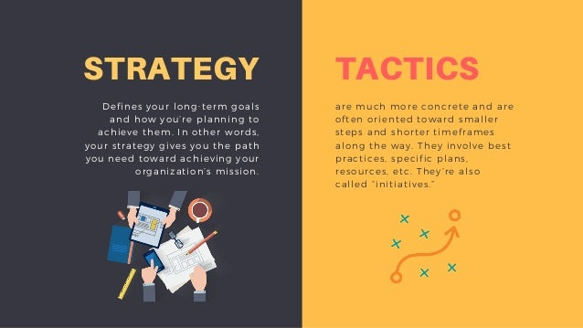
Strategy vs Tactics
A Conversation with our Stakeholders
Strategic Planning requires:
Taking a step back to identify your main objectives (goals)
Creating a strategy statement for you goal(s)
Developing a strategy statement for your goals provides a broader perspective, or an ambition.
This ambition will help in case you adjust your tactics to achieve your goal.
Without a strategy statement, it is more difficult to pivot if your tactics are not working.
You can run a business based only on tactics, but you need a strategy to underpin your tactics to maximize your effectiveness.
Notes:
Strategic Planning requires:
Taking a step back to identify your main objectives (goals)
Creating a strategy statement for each goal that gives you the ambition for HOW you will achieve your goal
Developing a strategy statement for your goals will give you a 360-degree perspective and equip you with the ability to see the chess pieces and to adjust your moves accordingly.
Without a strategy, it is difficult to pivot if your tactics are not working.

Slide 26
Examples of Strategy Statements
A Conversation with our Stakeholders
Goal: Reduce GHG emissions by 30% by 2035
Strategy: We will be a leader in employing technologies solutions to reduce emissions associated with our industry
Tactics: We will achieve our goal by using renewable electricity, zero emissions vehicles, and by helping our customers achieve their GHG emissions reduction goals
Purchase 100% renewable sources electricity by 2027
Purchase 10% renewable fuel vehicles each year, so that 100% will be replaced by 2034.
Goal: Improve Safety Performance 2% YOY
Strategy: We will invest in industry-leading health and safety programs to ensure the heath and safety of our employees and communities
Tactics: We will achieve our goal by:
Hiring external consultant to identify and implement new programs
Providing consistent training programs to all employees
Goal: Improve the lives of our local communities
Strategy: We will partner with our local communities to identify and implement programs
Tactics: We will achieve our goal by:
Donating 1% of profits to local community organizations
Continue monthly volunteer work with Habitat for Humanity
Notes:
We saw this slide earlier in the presentation.
Now look at focusing on the strategy statement perspective.
This example highlights three ESG goals for our industry type, and a strategy and tactics for each goal.
Each goal serves as a guiding light for your company’s ESG efforts.
The strategy statement is a high level statement, or your ambition, to get you to your goal.
GHG: You will use renewable energy to reduce your emissions
SAFETY: You will invest in industry-leading safety programs to improve safety performance
COMMUNITY: You will partner with local communities to improve their live
These strategy statement are VALUE CREATION for your company. We will work on Value Creation with Whole Works in September, but your strategy statements are what set you aside and give you the ESG commitment that your stakeholders are looking for.
Finally, the Tactics are the details of the actions you will implement to achieve your goal. …. Which takes us to our next topic.

Slide 27

Tactics
Identify how you will implement and achieve your goals
Tactics are the specific actions your company will take to implement and achieve its goals.
Notes:
I’ll say it again. I love tactics.
Tactics are programs.
Tactics are building investments.
Tactics are equipment.
Tactics are ACTION
It is the meat and potatoes of our industry.
And/but – they are only really effective if they support our companies strategy and goals.

Slide 28
Tactics: Getting it Done!
A Conversation with our Stakeholders
Example #2
Reduce GHG emissions by 30% by 2030
By 2024, the company will purchase on board computers for all collection and delivery vehicles.
By 2025, the company implement routing technology and training to optimize all on-route activities.
Goal
Tactics
Strategy
Our company will be a leader fleet efficiency
Our industry tends to go straight to the tactics, often ignoring the goal setting process and strategies.
A successful ESG strategy requires all of these.
Notes:
Time and patience.
It is important to take the time to set up goals and strategies first, to help establish the right tactics. And to document them.
Once you have your goals and strategies, you need to identifying the tactics that you will take to implement goals. As an example - if you want to reduce your company’s GHG emissions, and you’ve created a strategy to be a leader in fleet efficiency, you will likely create tactics around purchasing low emissions vehicles and optimizing routing.
In addition to the tactics on this page, other examples could include:
To support a recycling goal, and strategy might be to invest in new MRFs and the tactic would be to Building 2 new MRFs in 2024. One in City X and another in City Y.
To support a safety to goal, a strategy might be to invest in safety technology systems and the tactic would be to add Fire Rover all of our facilities by 2025.
To support a DEI goal, a strategy might be to increase driver diversity, and a tactic would be to attend 3 job fairs each quarter to meet with women driver candidates.
Tactics require specific action in a given time.

Slide 29
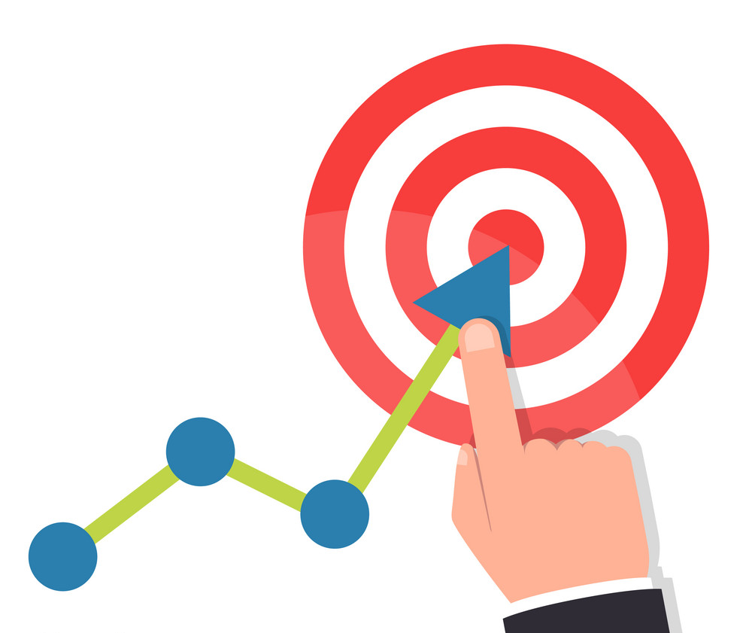
Report on your progress
Using ISRI’s reporting toolkit, track your progress quarterly, and report annually.
Notes:
Finally – its important to report on your progress regularly.
As we noted earlier, reporting fosters action. Once you’ve completed the ESG Strategic Planning process, You will have invested a lot of time and energy in the process. You owe it to your stakeholders to follow through with reporting on your progress to achieving your goals. Quarterly to your internal leadership and annually to your other stakeholders.
We’ll talk more about reporting in the fall, but it does play a key role in establishing accountability and driving action towards success.

Slide 30
ESG Strategy Process Summary
A Conversation with our Stakeholders
Establish 3-5 ESG goals, determining your ambition level
    Use your materiality benchmarking to identify goal topics
  2. Develop goal statements for each goal for internal discussion
    Use company data and reporting as foundation for new goals
    Analyze programmatic options for achieving each goal
  3. Create specific targeted goals
    Include SME on each topic for review
    Review with leadership team
    Benchmark peers
    Adjust as necessary
    Leadership approves
  4. Analyze performance gaps and adjust goals if necessary
Develop your strategy statements for your goals
Develop your tactics for implementing the actions you will take to achieve your goals
Track progress quarterly, and report annually.
Notes:
And Viola. You have all of the pieces of your ESG Strategy!
Your goals (established through research and analysis) + Your strategy statements for your goals + Your tactics = Your organization’s ESG Strategy.
And – it is not a complicated process. Sometimes the words make it sound more complicated than it is, but if you just follow the steps we’ve outlined here, you will have the tools to get there.

