Slide 1
Value Creation – September 2023 Workshop #4
Sustainability at the Core
Sustainability at the
Core
Financial Value Creation
Social & Environmental Value Creation
Sustainability Initiatives
Traditional Competitive Strategy
Triple Bottom Line
=
+
Adapted with permission from WholeWorks LLC
Sustainability Value Creation requires understanding how ESG initiatives can also strengthen your company’s competitive strategy to create financial value.
Notes:
Which brings me to our topic for this month: Value Creation. My job is to set the stage and to turn the program over to our speakers.
We just walked through an overview of several of the key concepts of ESG, bringing environmental, social, and governance together.
ESG is often equated with risk avoidance, since many investors and companies focus on addressing critical issues included in ESG that could cause disruptions to the business or lead to negative financial performance.
However, we wanted to highlight the potential for ESG to help drive business innovation and growth.
Today, we will bring financial value creation into the equation, by demonstrating how ESG initiatives can be shaped to accomplish the integration between ESG and financial value.
When integrated with business strategy, ESG has the potential to create much more value than simply reducing risk.

Slide 2
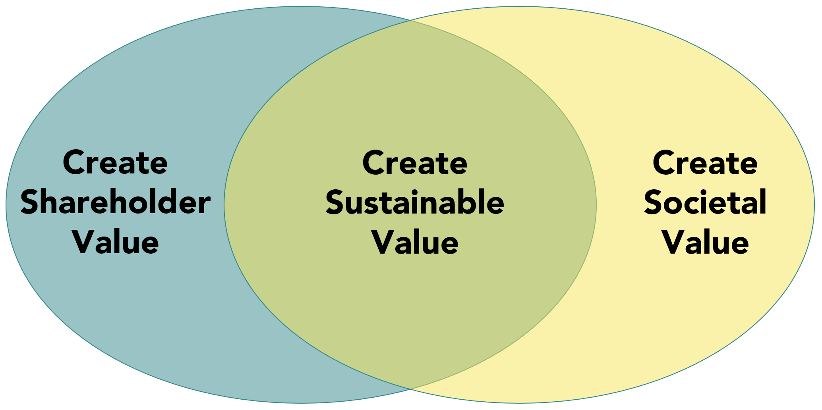
Previous Workshops in Context of Value Creation
A Conversation with our Stakeholders
Creating Sustainable Value requires creating BOTH creating societal value (Triple Bottom Line) AND shareholder value
Adapted with permission from WholeWorks LLC
ESG = Environmental, Social, Governance issues that are important (material) to the business
September 2023
Notes:
Early this year, when we first introduced ISRI’s ESG Tool kit, it felt like we were a little heavy on the risk reduction dialogue. Fortunately, ISRI member Kari Bliss spoke of the Whole Works program that she had recently completed.
After looking into it more closely, we thought it that it would be a great complement to ISRI’s ESG tool kit, to show how to use many of the elements we’ve been discussing, such as materiality, ESG strategy and goal-setting to create new value for your company.
WholeWorks LLC is a consultancy that has developed a tool to help companies find value creation opportunities through ESG strategies and program development.
ISRI is working with WholeWorks to offer their program to ISRI members who want to put their learning into action. The WholeWorks certificate program is designed to help connect the most important, or material, ESG issues in your organization with a return on investment and sustainable impact across the triple bottom line.

Slide 3
Mapping Materiality & Creating Sustainable Value An ISRI ESG Workshop Exclusively for Members September 14, 2023
Notes:
We’re excited to show you a new tool for ‘connecting the dots’ between ESG initiatives and how they can strengthen a company’s strategy and create financial value

Slide 4
Outline
Strategy-Driven Value Creation
The Sustainable Value Creation Map
Featuring CareCo Natural (Simulation Company)
Examples
Q&A
Strategic ESG: Creating Sustainable Value
Copyright WholeWorks LLC
Notes:
In this session we will:
We’ll start with a traditional view of strategy-driven value creation since it informs the basic layers of the map.
We’ll then construct the map, layer-by-layer, using our new simulation CareCo natural as an example.
We’ll also have time for Q&A along the way and at the end

Slide 5
Strategy-driven Value Creation or What your CFO/CEO wants you to know
Copyright WholeWorks LLC
Notes:
Let’s start with a traditional view of how competitive strategy drives value creation

Slide 6
Strategy-Driven Value Creation
To create value, a business needs to provide a rate of return on invested capital (ROIC) that exceeds what its investors (owners) could get elsewhere for the same risk (WACC)
Creating value requires more than making a profit
WACC=Weighted Average Cost of Capital
Copyright WholeWorks LLC
Notes:
Many businesspeople mistakenly believe that good financial performance for a business means making a profit. But it turns out that isn’t good enough, and it’s definitely not enough to create value for a company’s investors.
It’s important to keep in mind that investors have choices. They don’t have to invest in your company, there are alternatives out there.
For your company to create value for your investors, you need to provide a rate of return on the invested capital that exceeds what your investors could get elsewhere for the same level of risk.
That benchmark rate of return is the weighted average cost of capital, or WACC. So to create value you must generate a Return on Invested Capital that exceeds the WACC.

Slide 7
Strategy-Driven Value Creation
Value added
= Net operating profits – Capital charge
Creating value requires more than making a profit
Invested Capital x WACC
To create value, a business needs to provide a rate of return on invested capital that exceeds what its investors (owners) could get elsewhere for the same risk.
Copyright WholeWorks LLC
Notes:
This means you have to do better than just generate a profit.
The equation here is the fundamental equation for value creation. The Net Operating Profits (after taxes) is the return that your company generates for investors. The Capital charge is what your investors can earn elsewhere. It’s what they give up when they take their money out of alternative investments with the same risk to invest in your business. It’s the invested capital times the Weighted Average Cost of Capital (WACC)
To create value, then, your Net operating profits has to exceed the Capital charge. Then your investors are better off. That’s how you create shareholder value.

Slide 8
Strategy-Driven Value Creation
Value added
= Net operating profits – Capital charge
Four drivers of Value Creation
Revenue
Expenses
(profit)
Invested
Capital
Risk
Copyright WholeWorks LLC
Notes:
How can your company create value? There are four basic value drivers shown here.

Slide 9
Strategy-Driven Value Creation
Value added
= Net operating profits – Capital charge
Revenue
Expenses
(profit)
Invested
Capital
Risk
Competitive
Strategy
Grow sales
Reduce risk
Lower operating costs
Minimize capital
Copyright WholeWorks LLC
Notes:
The levers to drive value creation are easy to say, just tough to do!
Increase revenue by selling more or selling differently
Reduce expenses by lowering operating costs.
Minimizing or optimizing capital is something that often gets overlooked.
Finally, you can reduce risk. There are a variety of risks that can impact future profits, such as changing trends in consumer preferences, or new competitive threats. Investors are increasingly paying to a broader set of ESG risks that include climate change and potential reputation damage from supplier labor practices, for example. These can directly impact operations, for example when severe weather disrupts airline operations. Risks can also come from imposed government regulations, for example when a government bans the use of single-use plastics.
In addition to the direct impact on operating profits, the level of perceived risk by investors also impacts the cost of capital. Higher risk means investors expect a higher rate of return, and this increases the Capital charge.
Your company’s strategy in one way or another impacts these four drivers, so to create value you want to make sure you’re moving these in the right direction.

Slide 10
Strategy-Driven Value Creation
This ‘chain’ shows a simplified view of how strategy drives value creation.
Roger Martin, former Dean Rotman School of Management, University of Toronto https://rogerlmartin.com/
Value Creation
Competitive Advantage
reinvestment
Competitive
Strategy
Core Processes
Resources & Capabilities
Copyright WholeWorks LLC
Notes:
To show how strategy drives value creation, we’ll examine the chain of connections shown here. These will become layers in our Sustainable Value Creations Map. Each of these layers addresses a different set of strategic questions. These focusing questions are adapted from Roger Martin, former dean of the Rotman Business School in Toronto and strategy thought leader.
There are also larger strategy questions that relate to your organization’s purpose, vision, aspirations, and goals. Here we’re focusing on competitive strategy.

Slide 11
Strategy-Driven Value Creation
Value Creation
Competitive Advantage
Where will we choose to play? (markets)
How will we win? (market share)
Competitive
Strategy
Core Processes
Resources & Capabilities
Copyright WholeWorks LLC
Notes:
At the Competitive Advantage layer, the key questions are: Where will we play? And How will we win?
These are choices about which markets you will compete it, and how you will gain market share in those markets where you choose to compete.
Consider a hotel chain, for example. A key part of their strategy is deciding where to open up new properties. In addition, their strategy would include decisions about how they will differentiate themselves from the competition through their locations, brand image, or the guest experience, for example.

Slide 12
Strategy-Driven Value Creation
Value Creation
Competitive Advantage
Competitive
Strategy
Core Processes
At which core processes will we excel?
Resources & Capabilities
Copyright WholeWorks LLC
Notes:
The next level down is about the core processes in the business that are fundamental to delivering value. The business must excel at these core processes to create a competitive advantage. For example, for the hotel example, a core process might be a streamlined guest reservation and check-in process. Those are core to the guest experience and thus important to their competitive advantage.

Slide 13
Strategy-Driven Value Creation
Value Creation
Competitive Advantage
Competitive
Strategy
Core Processes
Resources & Capabilities
What capabilities do we need to build to support the above?
Copyright WholeWorks LLC
Notes:
Finally, the Resources & Capabilities layer asks: What capabilities do we need to build to support the above elements of our strategy.
These are fundamental building blocks that take time to develop, but also deliver sustained value once they have been developed.
For example, in the hotel example, key resources & capabilities might include engaged and effective employees and a service-oriented culture. Another key resource might be the information technologies they develop to support their hotel operations and guest experience.

Slide 14
Connecting ESG Initiatives to Impact and Value Creation
Traditional
Business View
Traditional
Sustainability View
(Triple Bottom Line)
Value Creation
Environmental Impact
Competitive
Advantage
ESG
Initiative
Social Impact
Competitive
Strategy
Core Processes
How can an ESG initiative help reinforce the core strategy of the business to create financial value AND impact?
Economic Impact
Resources & Capabilities
Copyright WholeWorks LLC
Notes:
With this view of strategy-driven value, we’re now in a position to bring together the two views shown here.
On the right is the sustainability view, focused on the TBL.
On the left is the traditional business view focused on strategy and value creations
In the middle are ESG initiatives that have connections to both sides
We’ll now introduce you to the SVCM and show how it can be used to make connections in both directions, but especially on the business side to strategy and value creation since those linkages are often missed.

Slide 15
Sustainable Value Creation Map
Copyright WholeWorks LLC
Notes:
To illustrate the SVCM, we’ll use our new simulation CareCo Natural. This is the simulation we’ve developed specifically for our new Strategic ESG program which we’re launching in May.

Slide 16
Simulation Company, Based on Reality
A Living Case for Learning
Notes:
CareCo Natural is a Fast Moving Consumer Goods company focused on hair and body care products, based in India. Here we’ll give you a very quick overview.

Slide 17
What we sell:
Pure, Natural Ingredients
60 different affordable hair and bath & body products, sourced naturally, and created to promote health and beauty.
We use ingredients that naturally boost the health and beauty of your skin and hair.
Hair
Shampoos
Conditioners
Hair oils
Bath & Body
Soaps
Scrubs
Lotions & creams
Body oils
Coconut-based products are our specialty. We source our coconuts from local farms in southern India.
Notes:
CareCo Natural products include shampoos, conditioners, hair oils, soaps, lotions, and more.
Their products are high quality, effective, and affordable for the average Indian consumer.
CareCo Natural use ingredients that naturally boost the health and beauty of skin and hair. Coconut-based products have been their specialty since the beginning.
One of their key objectives has always been to provide affordable products, so that all people might have access to high quality, natural products.

Slide 18
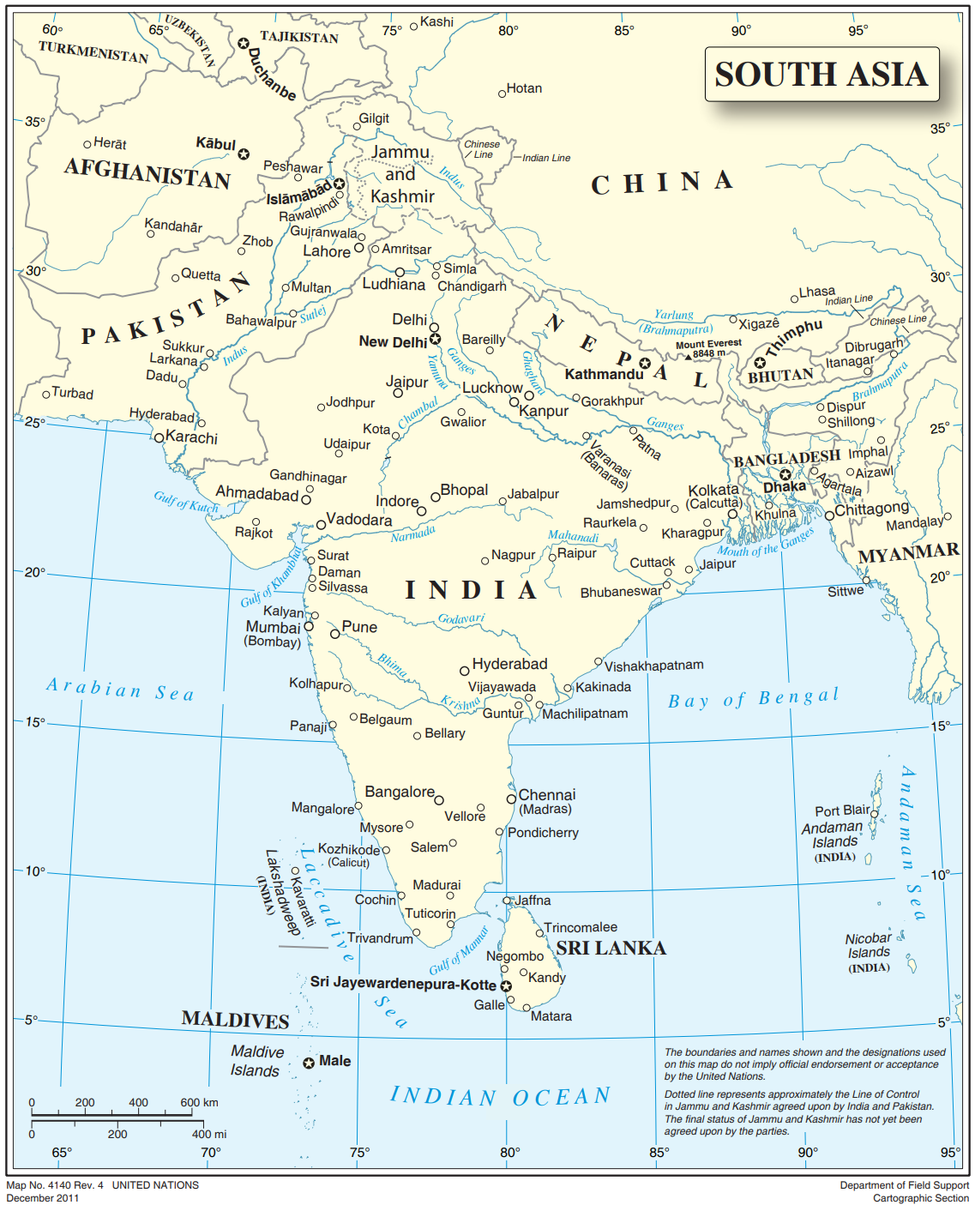
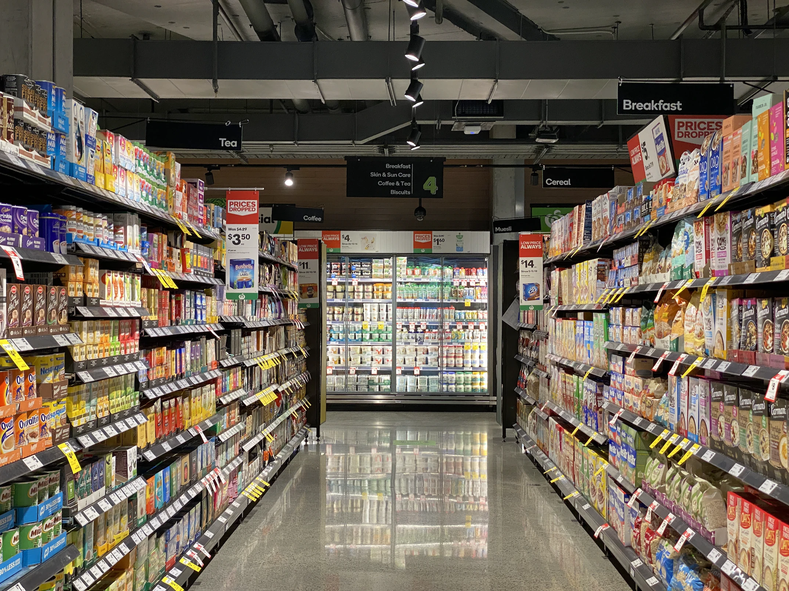
Where we sell:
Our Markets
Initially focused on Southern India, CareCo Natural is expanding throughout the Indian Subcontinent.
Our Sales Channels
Base of the Pyramid Kiranas (small mom-and-pop stores)
Mid-to End Market Larger grocery stores, drug stores, supermarkets
Online Sales
Notes:
Kiranas, which are small mom-and-pop stores located in both urban and rural areas. This is referred to as General Trade.
Larger grocery stores, drug stores, and supermarkets. This is referred to as Modern Trade.
And the web, which is the smallest, but fastest growing channel.

Slide 19
The Strategy Drivers of Value Creation
Value Creation
Competitive Advantage
Where will we choose to play? (markets)
How will we win? (market share)
Business Processes
Resources & Capabilities
Copyright WholeWorks LLC
Notes:
We’ll now use the Sustainable Value Creation Map to depict its strategy and how it creates value.
Let’s start with Competitive Advantage. And two key strategic decisions in this layer. Together these two questions inform the company’s Sales Growth Strategy.

Slide 20
Value Creation Map
Expenses
(profit)
Invested
Capital
Value Creation
RA Product
Revenue
Risk
RA Brand
Innovative
Products
Brand
Appeal
Competitive Advantage
RA Store
Affordable
Price
Retail Stores & Presentation
RA Price
Sales ($) = Market size ($) $×$ Market share (%)
Relative Attractiveness (RA): Product, Brand, Price, Channel
Copyright WholeWorks LLC
Notes:
The second element in a sales growth strategy is market share.
We use the term Relative Attractiveness (or RA) to indicate how appealing a company’s offering is to the consumer.
Different industries may have different RA factors that combine to determine overall relative attractiveness and market share.
In the case of CareCo, these four RA factors are Product, Brand, Price, and Store presentation. Together, these drive market share, and thus sales revenue.

Slide 21
Value Creation Map
Expenses
(profit)
Invested
Capital
Value Creation
Revenue
Risk
Innovative
Products
Brand
Appeal
Competitive Advantage
Affordable
Price
Retail Stores & Presentation
Core
Processes
At which core processes will we excel?
Copyright WholeWorks LLC
Notes:
We’ll now add the next layer Core Processes.
For CareCo Natural, this includes the key processes at which it must excel to deliver its competitive advantage.

Slide 22
Value Creation Map
Expenses
(profit)
Invested
Capital
Value Creation
Revenue
Risk
Innovative
Products
Brand
Appeal
Competitive Advantage
Affordable
Price
Retail Stores & Presentation
Channel Expansion & Support
Core
Processes
Supplier
Development
These activities determine how CareCo Natural sources, designs, produces, markets, delivers, and sells its products.
Marketing
Production & Distribution
Product
Development
Copyright WholeWorks LLC
Notes:
These include: (name the five processes).
These work together to determine how CareCo Natural sources, designs, produces, markets, delivers, and sells its products. These in turn enable the company to achieve its competitive advantage.

Slide 23
Value Creation Map
Expenses
(profit)
Invested
Capital
Value Creation
Revenue
Risk
Innovative
Products
Brand
Appeal
Competitive Advantage
Affordable
Price
Retail Stores & Presentation
Example:
Channel Support
Channel Expansion & Support
Core
Processes
Supplier
Development
Marketing
Production & Distribution
Product
Development
Copyright WholeWorks LLC
Notes:
For example, Channel Support works with retailers to enhance the presentation of CareCo Natural products in the stores where they sell (both physical and online).

Slide 24
Value Creation Map
Expenses
(profit)
Invested
Capital
Value Creation
Revenue
Risk
Innovative
Products
Brand
Appeal
Competitive Advantage
RA Store
Enhance
store
presentation
Affordable
Price
Retail Stores & Presentation
Channel Expansion & Support
Core
Processes
Supplier
Development
Marketing
Production & Distribution
Product
Development
Sales ($) = Available retail market ($) $×$ Market share (%)
RA Store
Channel support
(enhance store presentation)
Copyright WholeWorks LLC
Notes:
This in turn increases the retail market available to CareCo Natural. This increases retail sales, and thus generates Revenue. By growing revenue, Channel Expansion helps CareCo create value.

Slide 25
Understanding the business drivers of value creation
Value Creation
Competitive Advantage
Core
Processes
Resources & Capabilities
What we need to build to support the above?
Copyright WholeWorks LLC
Notes:
Finally lets add the final layer of strategy and look at CareCo’s resources & capabilities.

Slide 26
Value Creation Map
Expenses
(profit)
Invested
Capital
Value Creation
Revenue
Risk
Innovative
Products
Brand
Appeal
Competitive Advantage
Affordable
Price
Retail Stores & Presentation
Channel Expansion & Support
Core
Processes
Supplier
Development
Marketing
Production & Distribution
Product
Development
Process
Capability
Product Technology
Resources & Capabilities
Engaged & effective employees
Information
Technology
Copyright WholeWorks LLC
Notes:
These include the elements shown here:
As an example of how to connect this new layer to the layers above, let’s look at Product Technology.

Slide 27
Value Creation Map
Expenses
(profit)
Invested
Capital
Value Creation
Revenue
Risk
Innovative
Products
Brand
Appeal
Competitive Advantage
Affordable
Price
Retail Stores & Presentation
Channel Expansion & Support
Core
Processes
Supplier
Development
Marketing
Production & Distribution
Product
Development
Example:
Product R&D
Process
Capability
Product Technology
Resources & Capabilities
Engaged & effective employees
Information
Technology
Copyright WholeWorks LLC
Notes:
As this map shows Product R&D builds CareCo’s level of Product Technology by This capability creates value by enabling CareCo Natural to execute two key business processes more effectively.

Slide 28
Value Creation Map
Expenses
(profit)
Invested
Capital
lower risk of being out-competed
Value Creation
RA product
Revenue
Risk
new products
Innovative
Products
Brand
Appeal
Competitive Advantage
Affordable
Price
Retail Stores & Presentation
new ingredients & packaging
lower supply cost
Channel Expansion & Support
Core
Processes
Supplier
Development
new input material possibilities
Marketing
Production & Distribution
Product
Development
new product possibilities
Process
Capability
Product
Technology
Resources & Capabilities
Engaged & effective employees
Information
Technology
Copyright WholeWorks LLC
Notes:
We’ve used CareCo Natural to illustrate how the various layers of this map contribute to Value Creation.

Slide 29
Value Creation Map
Expenses
(profit)
Invested
Capital
Value Creation
Revenue
Risk
Competitive Advantage
Your company will have a different map, depending on your industry, business, and strategy. A key ‘take away’ for the Strategic ESG Program powered by WholeWorks is a customized map for your firm.
Core
Processes
Resources & Capabilities
Copyright WholeWorks LLC
Notes:
Your company will likely have a different set of elements in each layer and a different set of connections. The specific mechanisms for value creation depend on your industry, business model, and competitive strategy. However, the principles remain the same. Identifying the key resources and capabilities to build the critical business processes that set you up for a long-term competitive advantage is the source of value creation. [End of video. Hold here.]

Slide 30
Extend to Create Sustainable Value
Copyright WholeWorks LLC

Slide 31
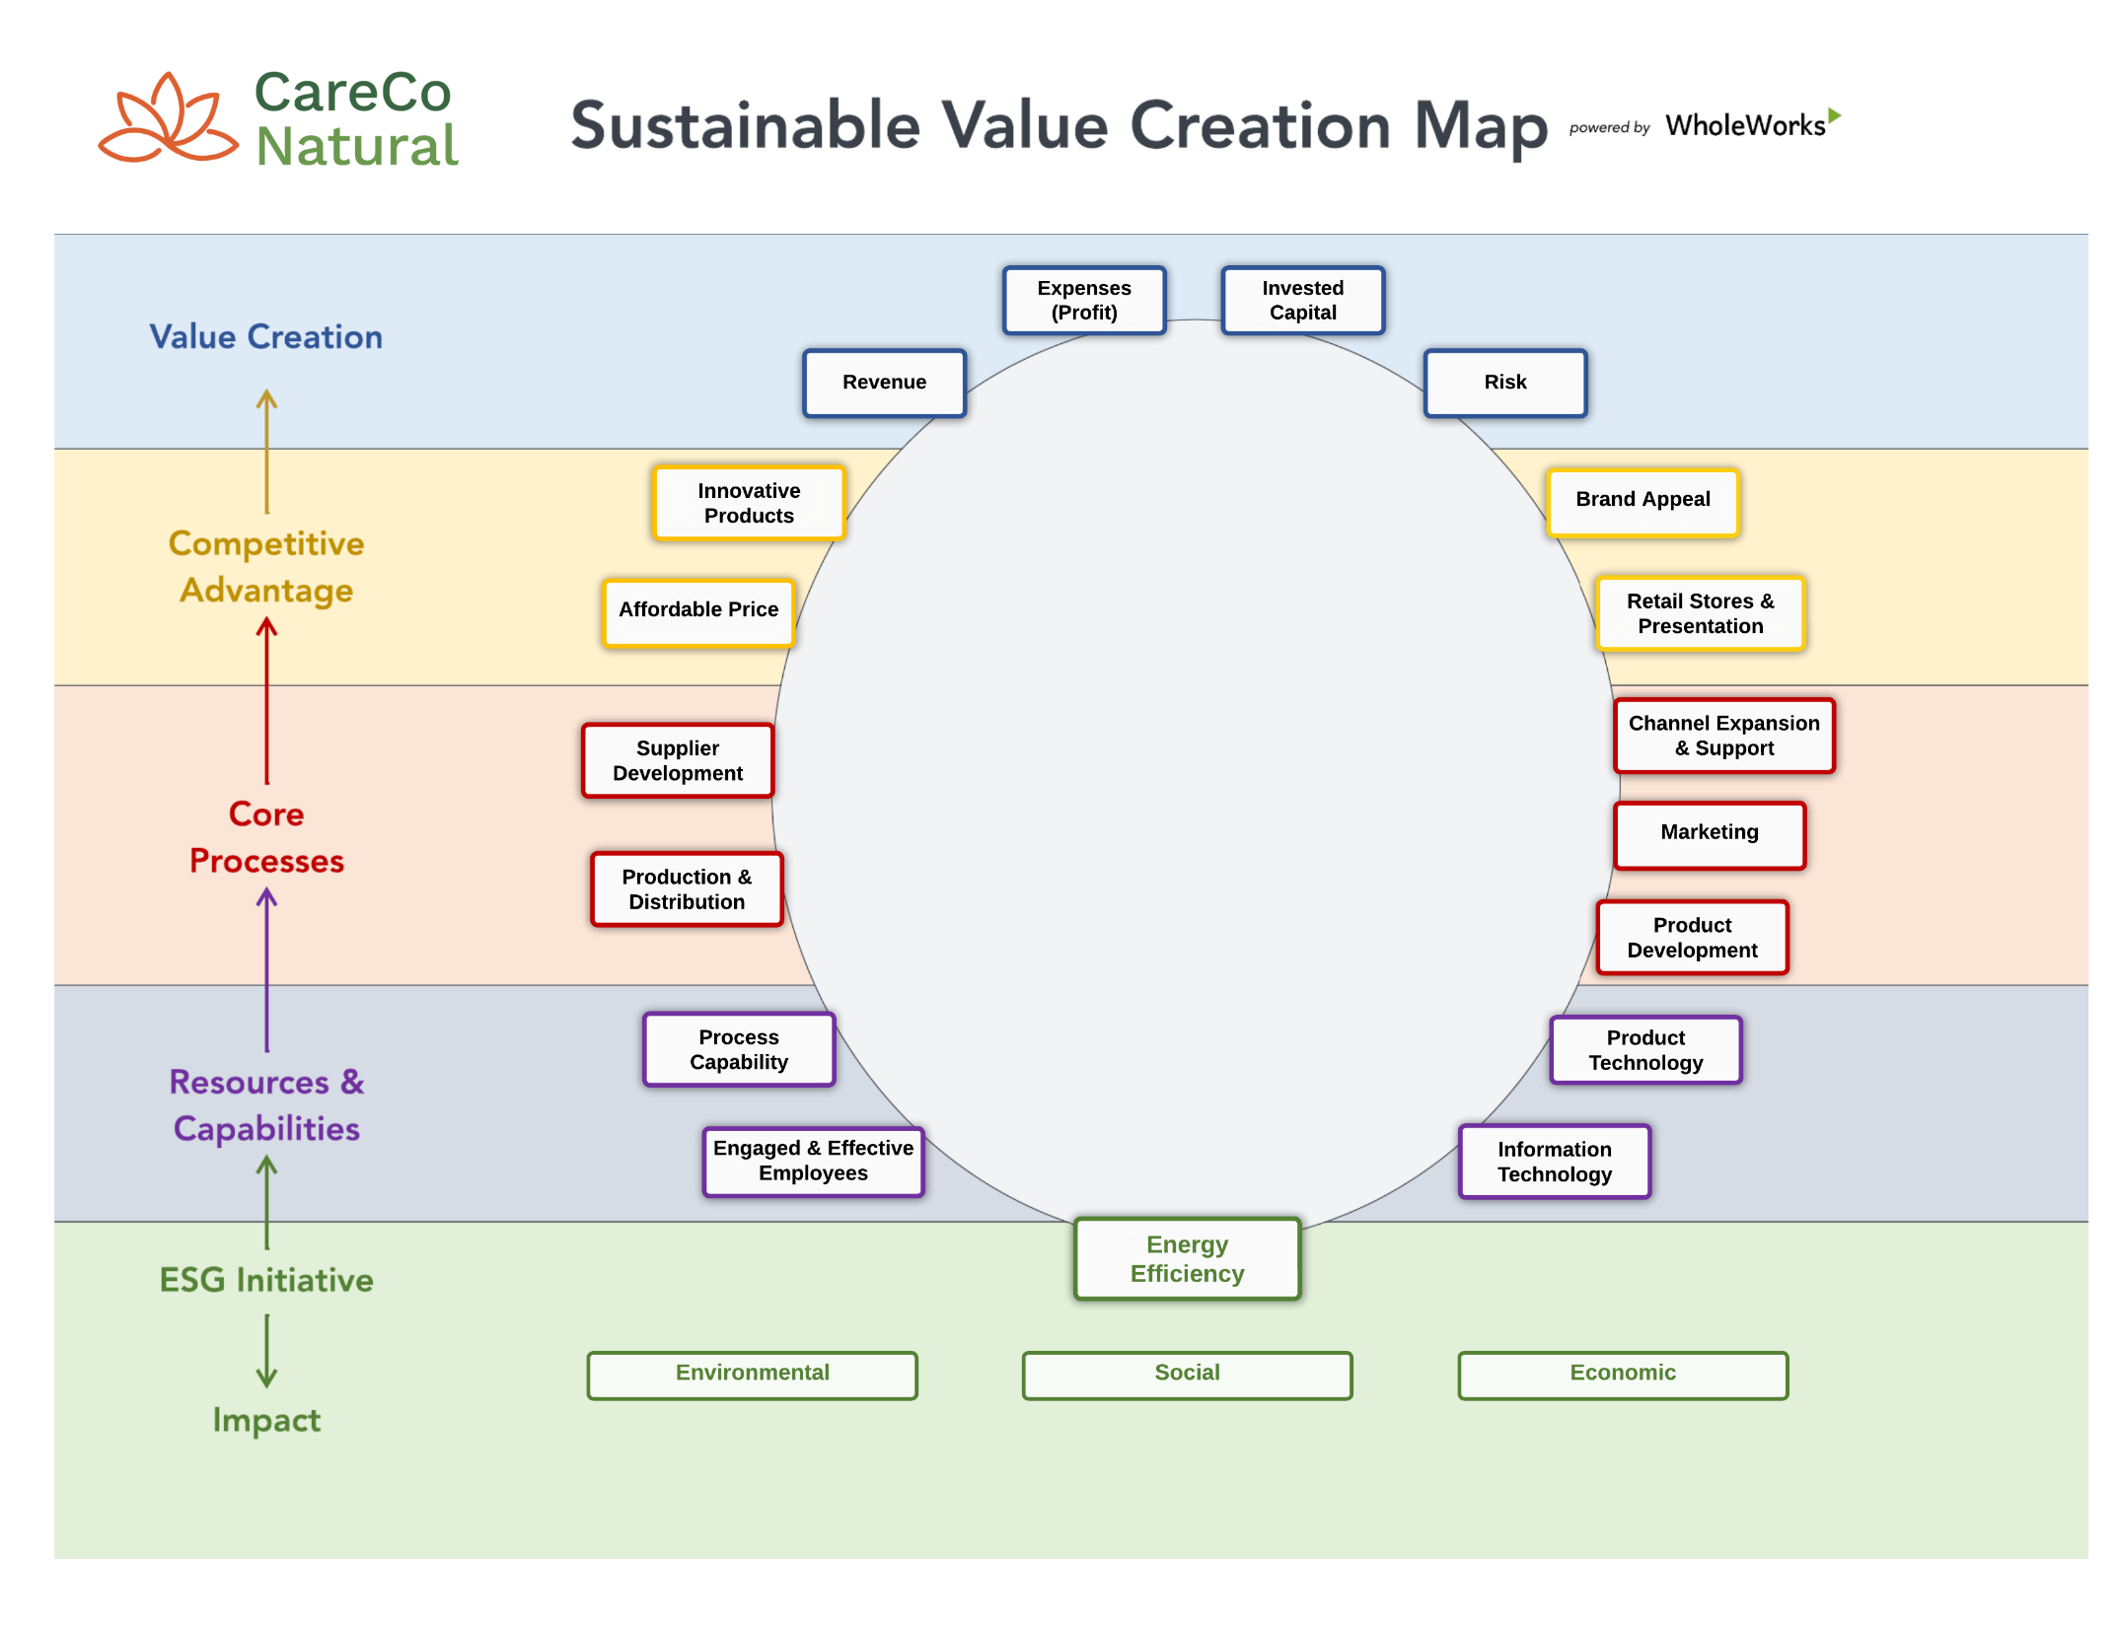
Copyright WholeWorks LLC
Notes:
We’re now going to bring ESG initiatives into the picture and add a new layer.
This version shows a proposed Energy Efficiency which is a material initiative for CareCo Natural. Let’s now connect the dots and show how this initiative might be used to create value.

Slide 32
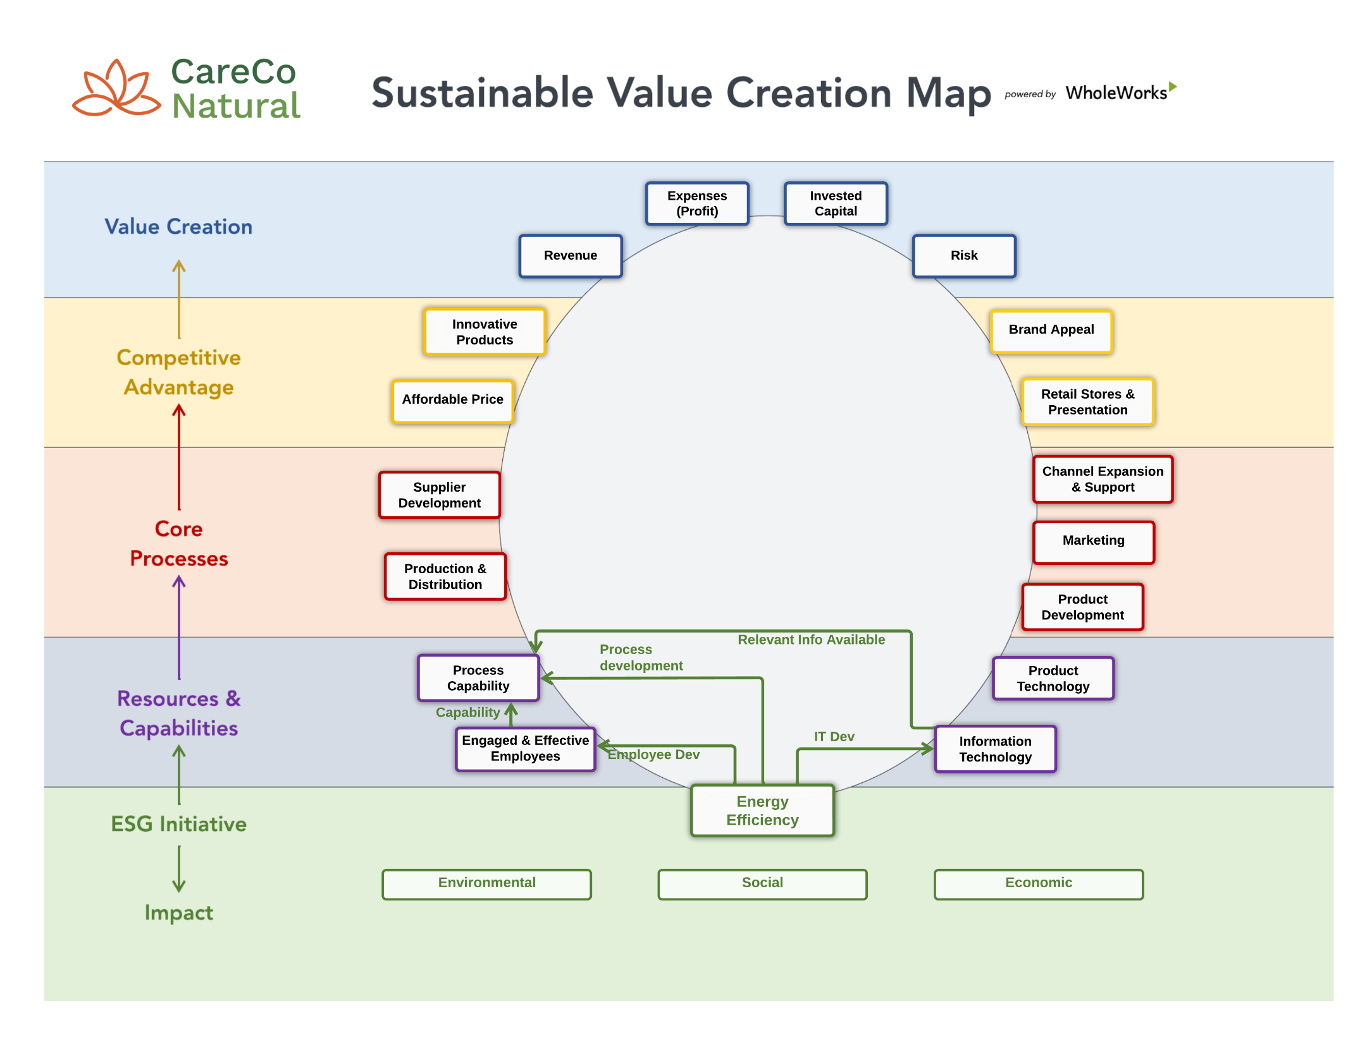
Copyright WholeWorks LLC

Slide 33
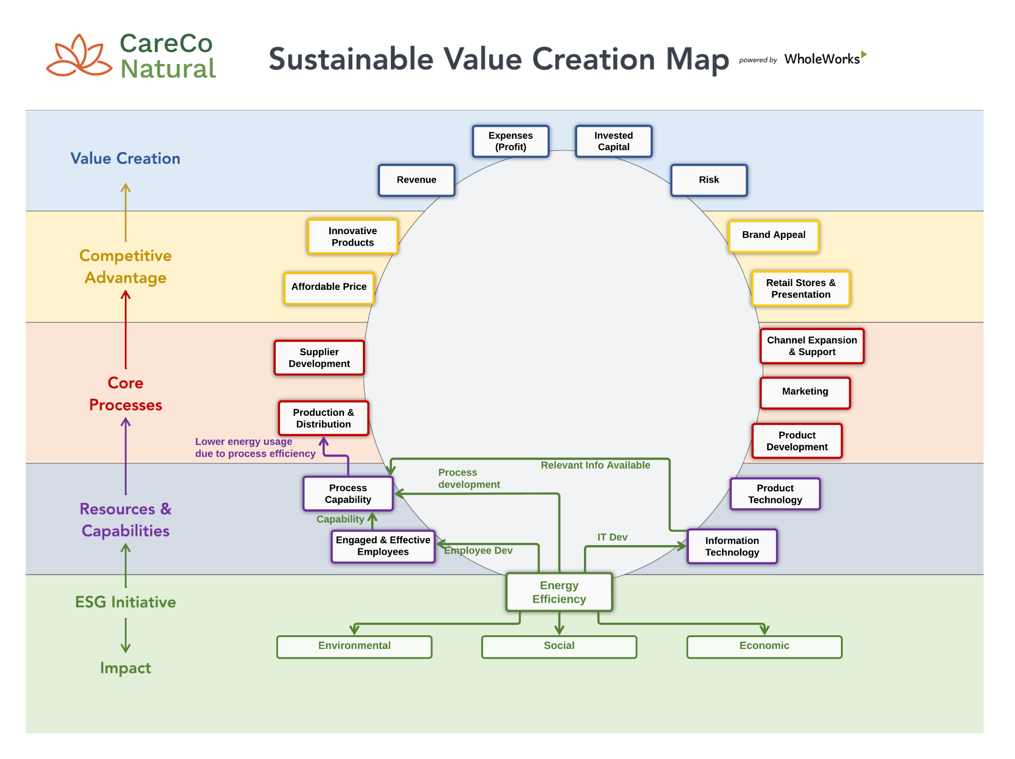
Copyright WholeWorks LLC

Slide 34
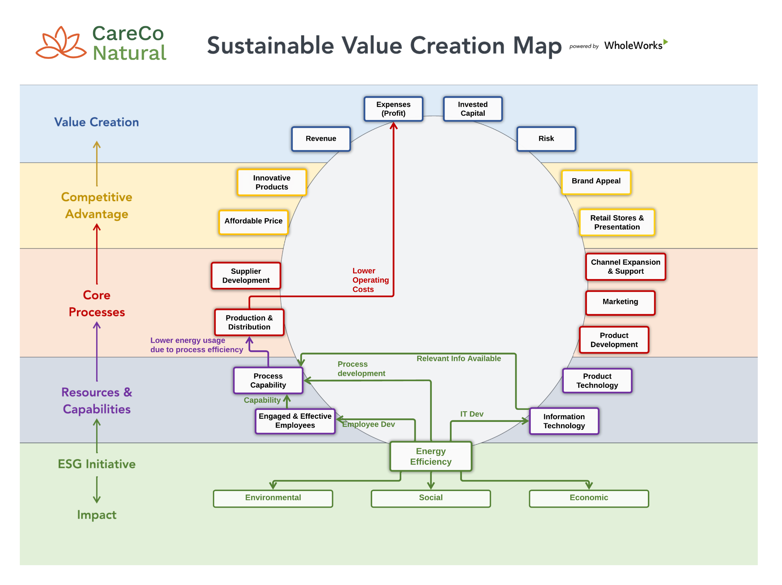
Copyright WholeWorks LLC

Slide 35
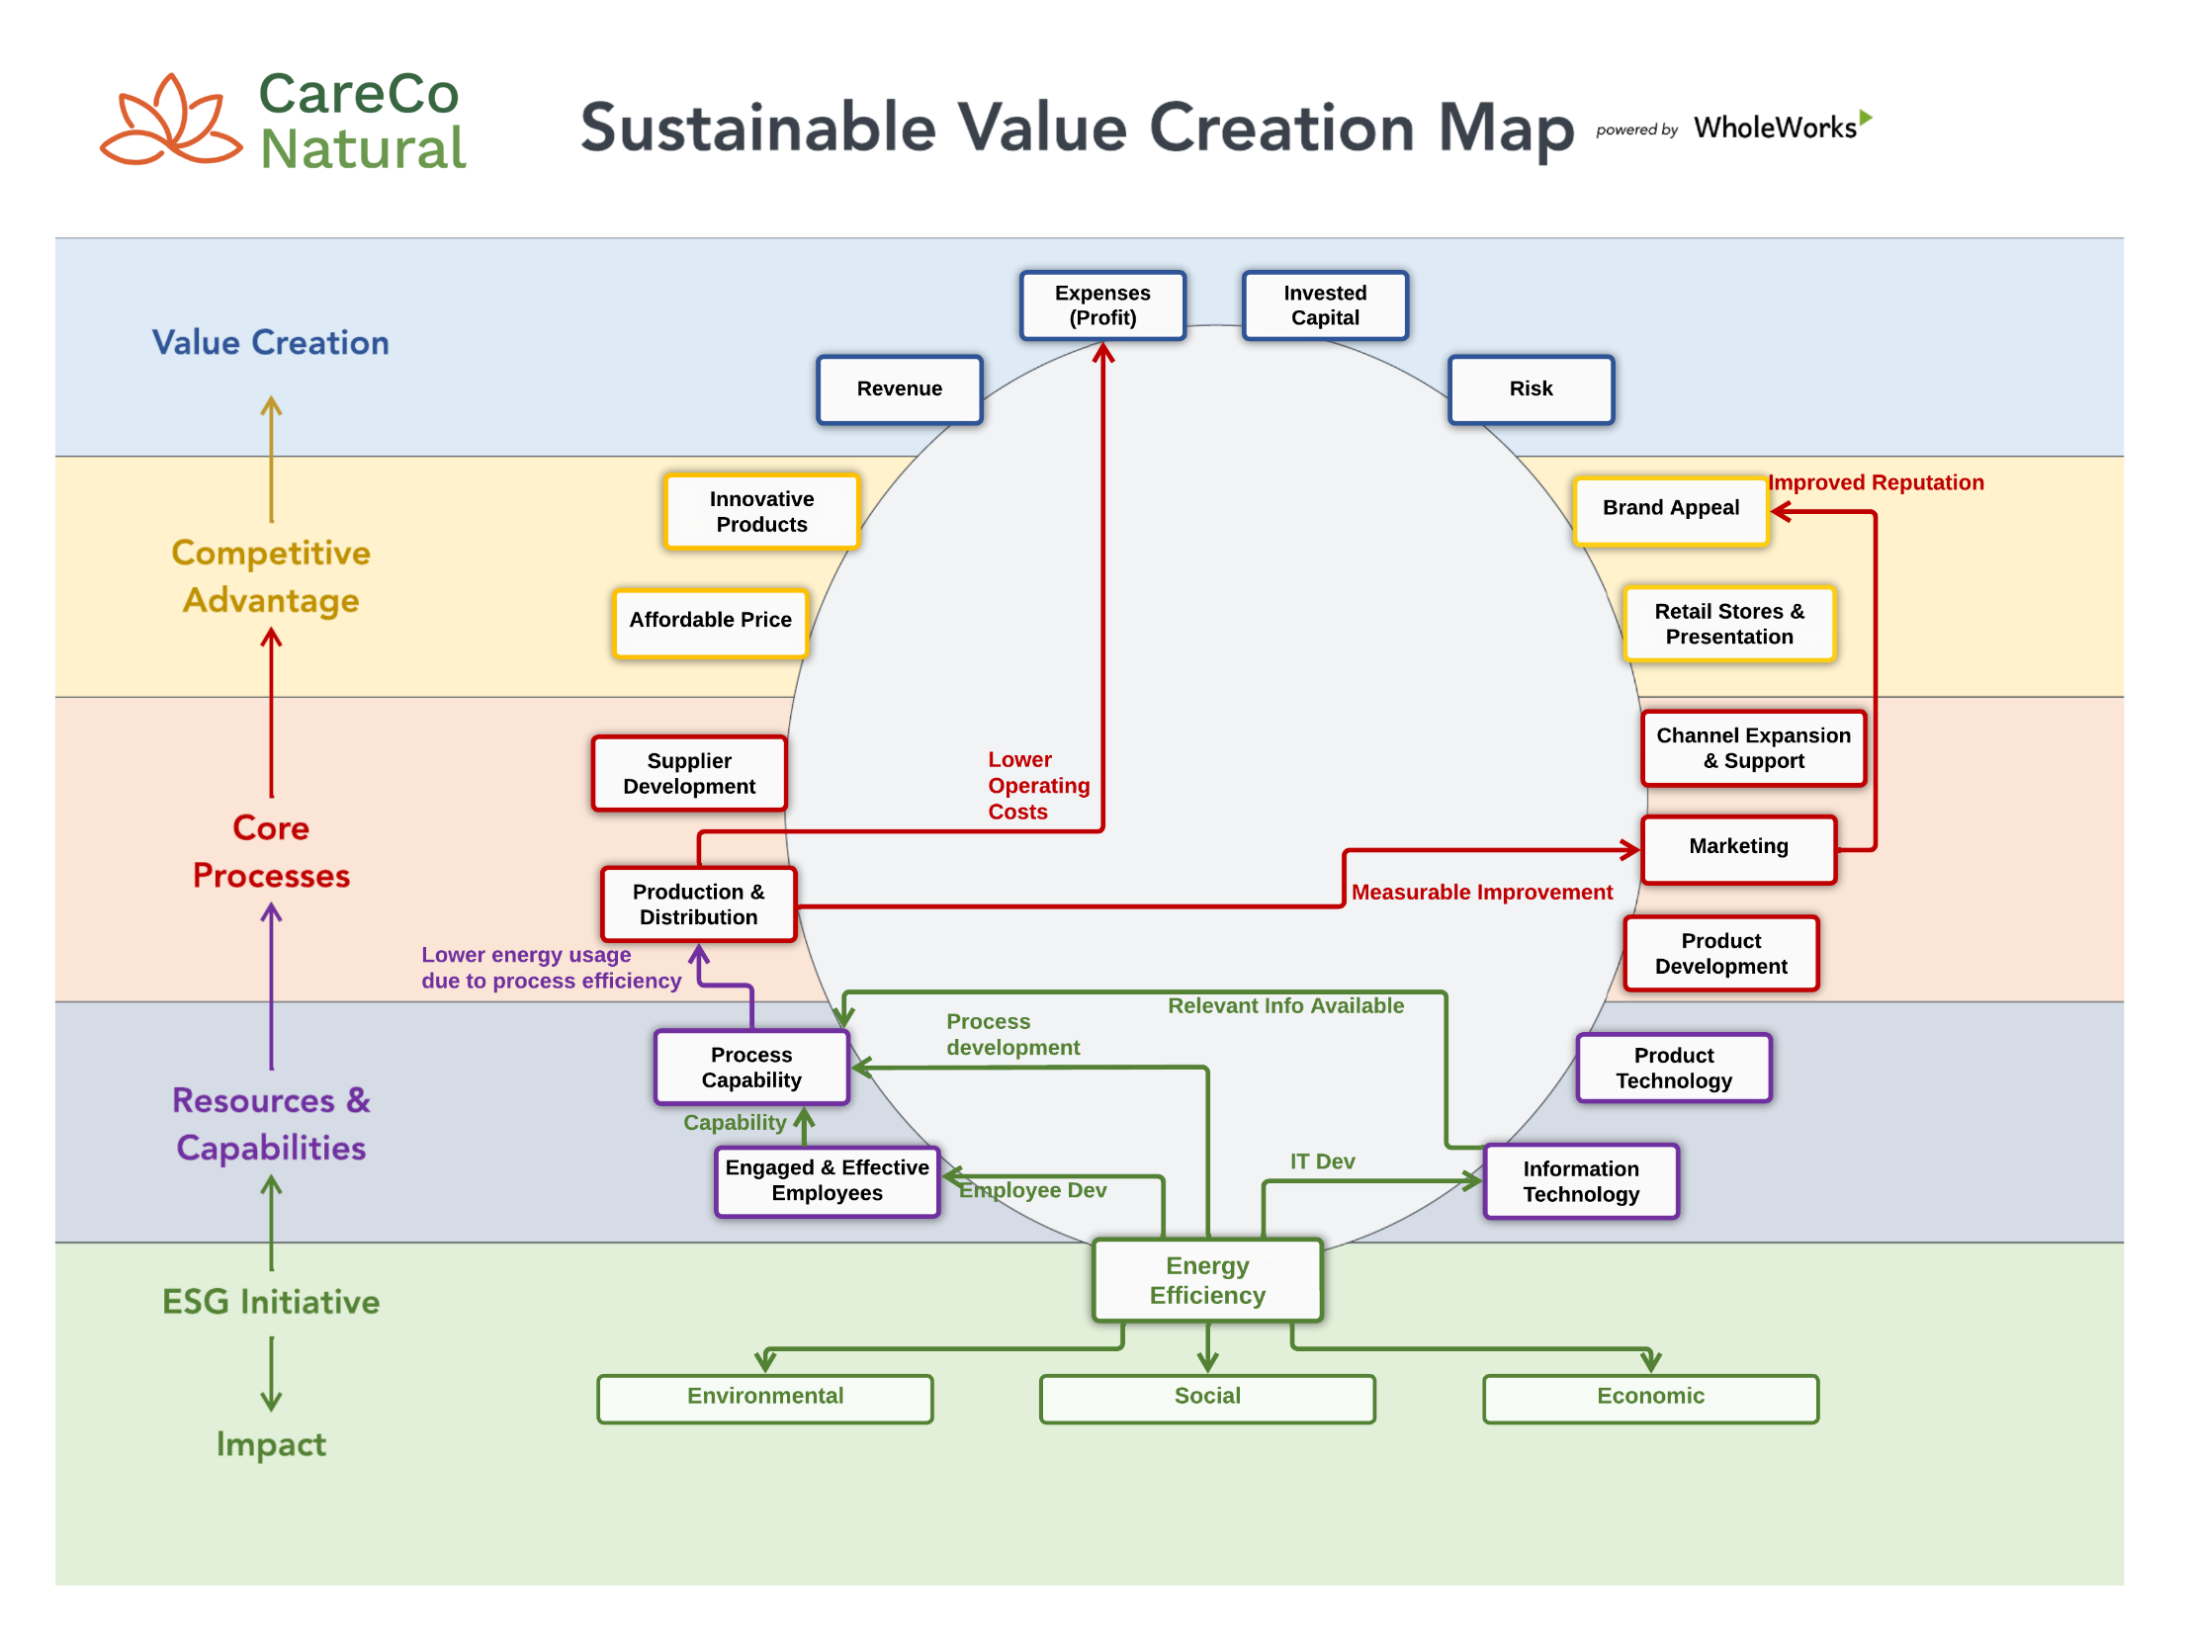
Copyright WholeWorks LLC

Slide 36
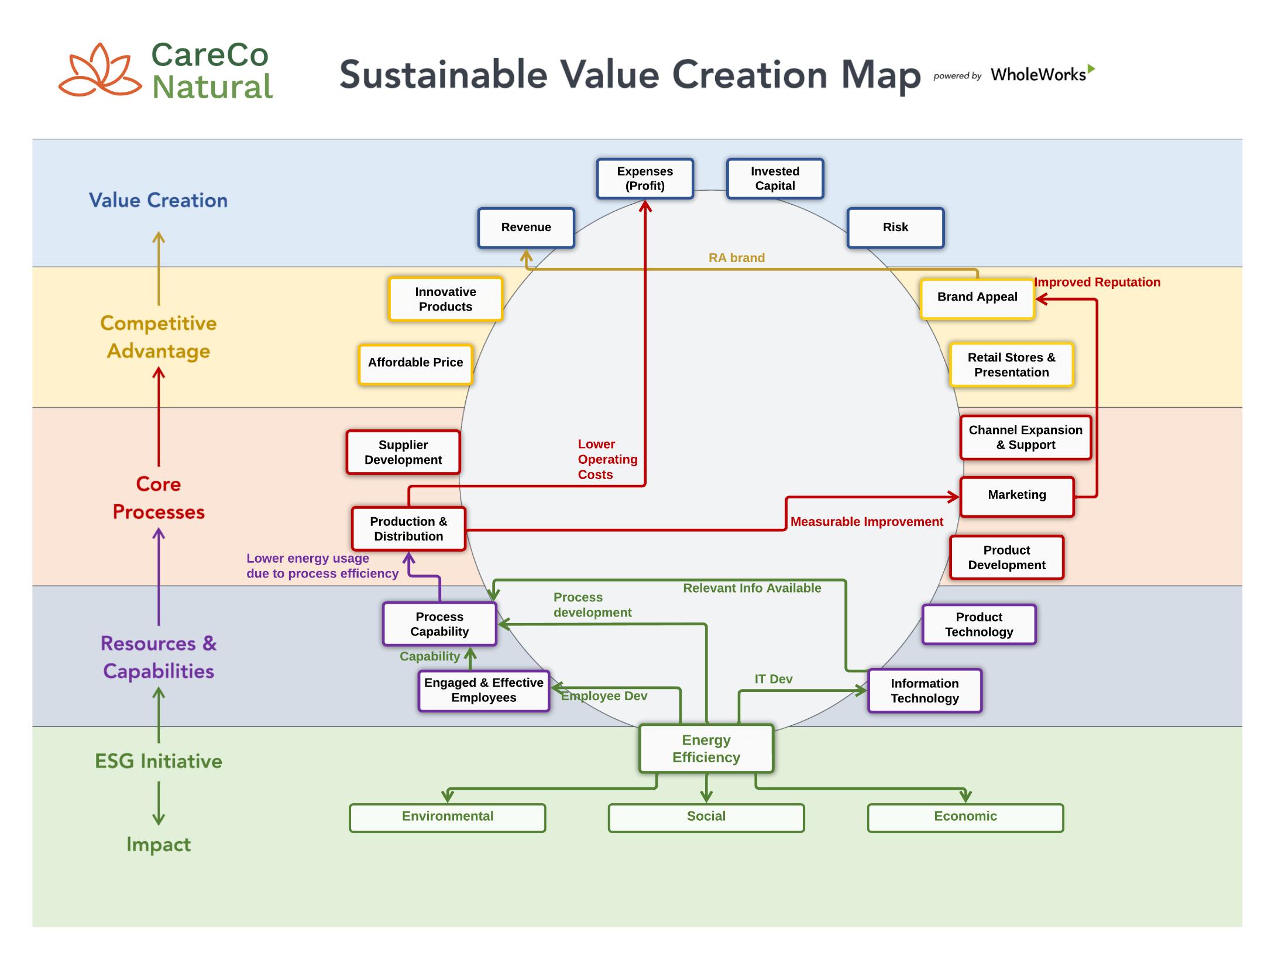
Copyright WholeWorks LLC

Slide 37
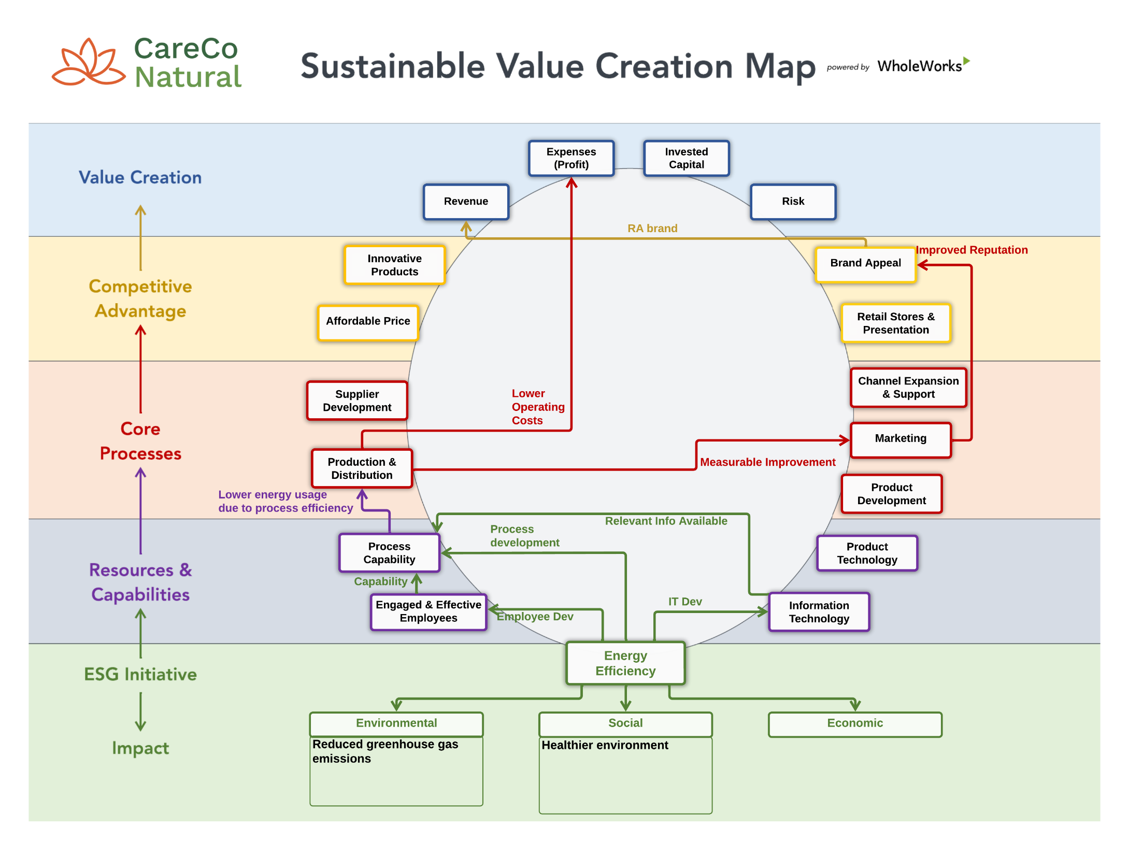
Copyright WholeWorks LLC

Slide 38
Copyright WholeWorks LLC

Slide 39
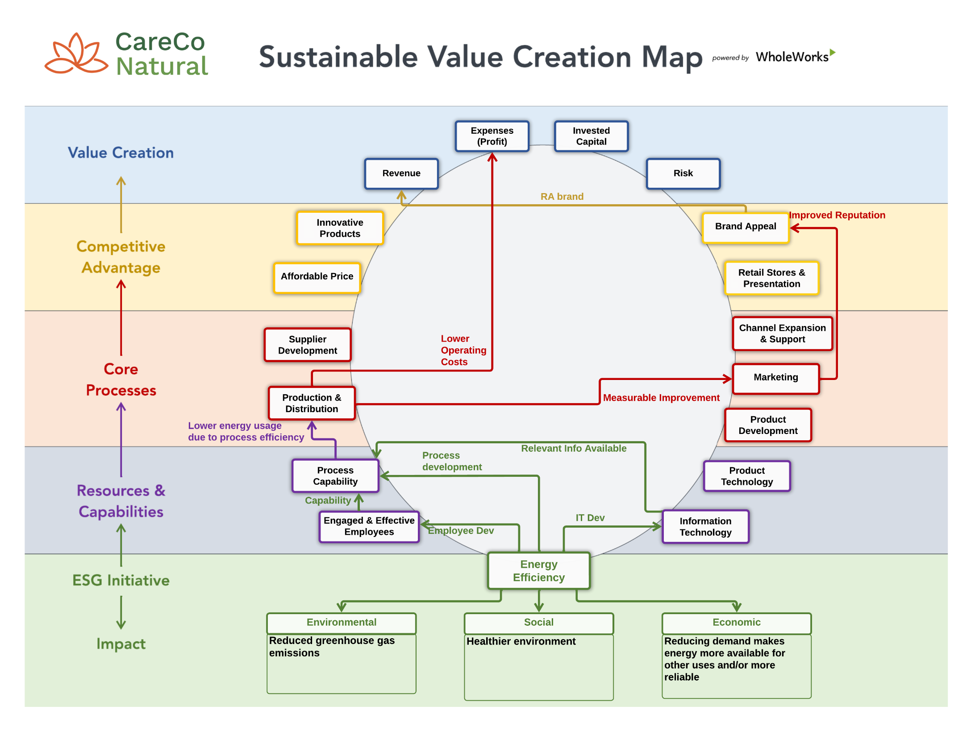
Copyright WholeWorks LLC

Slide 40
Business Value (ROIC)
Sustainable Impact
(Triple Bottom Line)
Copyright WholeWorks LLC
Notes:
While we’ve been emphasizing the connections on the business value creation side, we don’t want to lose sight of the larger TBL impact.
So the last section of the map is shown here. This makes explicit the sustainability value of the initiative in terms of its Environmental, Social and Economic impacts on the larger scale.
Environmental Impact: reduction of plastic waste and its impact on water systems, ecosystems and biodiversity
Social impact: This initiative creates interesting possibilities for creating inclusive employment opportunities, for example for those who today are doing the dirty work of waste picking collecting recyclables.
Economic impact: it’s important to keep in mind that circular packaging is a systems challenging requiring the cooperating around the elements of the closed loop of packaging. For this to work, it must be economically viable for all the players.

Slide 41
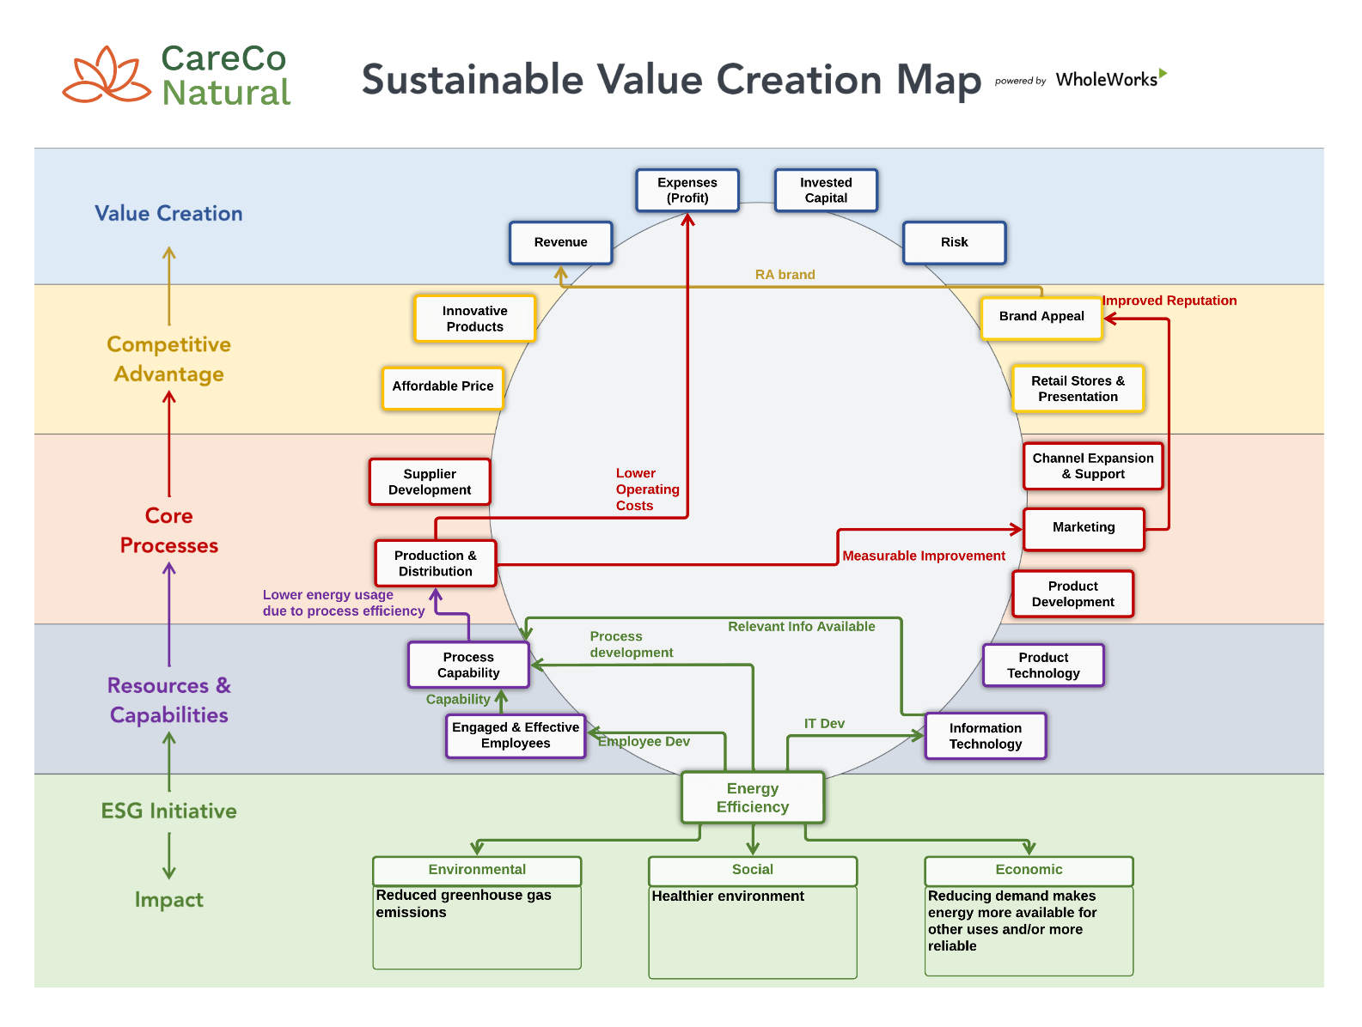
A New Tool for Connecting the Dots
The Sustainable Value Creation Map makes clear the cause-and-effect connections between ESG initiatives and Value Creation—creates understanding, collaboration, and commitment to action
Copyright WholeWorks LLC
Notes:
That’s why we developed the Sustainable Value Creation Map.
We’re beginning with the end in mind to show you what this map looks like. It’s a one page view of how systems can work together to create sustainable value.
If you’re thinking this looks a bit like a spaghetti diagram, fear not. In the next 30 minutes we’ll walk you through the layers of this map and build up to this example one step at a time.
By the end, what we hope you’ll see is how this tool can be used to “connect the dots” to generate a shared understanding, across the organization, of the full potential of sustainability address both the triple bottom line and to strengthen the business. And by doing this, help drive action and results.

Slide 42
Wrap Up
Participating in an exercise like Whole Works’ Value Mapping program may be an excellent way to bring an integrated ESG strategy to life at your company, creating excitement and energy:
Working with your leaders to convey the value of developing and executing an ESG Strategy, and the opportunity for more than risk reduction, but also to create new value for the company.
This starts with completing a materiality review to understand what your stakeholders think are material issues for your company.
Make sure that your house is in order: You’ll want to show evident that your company’s Governance, Social programs, your environmental footprint, and emission reduction goals are sound and show evident of continual improvement.
Using an ESG strategy to create value at your company requires that you are walking the talk.

