Slide 1
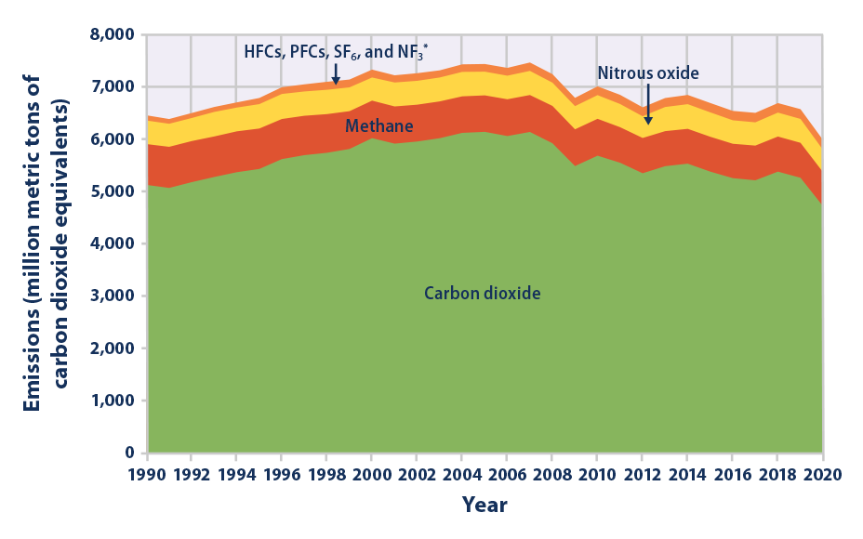

Taking Inventory & Tracking Emissions – August 2023 Workshop #3
US EPA
The Paris Climate Accord requires a reduction of emissions sufficient to keep global warming below 1.5 degree Celsius.
Measuring emissions plays a key role in that effort.
Notes:
Next, let’s spend a few minutes talking about taking an inventory and tracking GHG emissions.

Slide 2
The GHG Inventory Development Process
Getting Started:
Scope & Plan Inventory
- Review GHG accounting standards and methods for organizational reporting
- Determine organizational and operational boundaries
- Choose a Base Year
- Consider 3rd party verification
Collect Data:
Collect & Quantify Emissions
- Identify data requirements
- Compile and review facility data (e.g., electricity, natural gas)
- Estimate missing data to fill gaps
- Calculate emissions
Develop a Plan:
Develop an ESG Inventory Management Plan
- Develop data collection procedures and tools.
Document process/ guidance
Formalize procedures
Set a Target:
Track and Report Progress
- Finalize data
- Complete 3rd party verification
- Report data
- Prepare to set a publicly reported GHG target and track progress
August 2023
Notes:
Developing a GHG inventory process consists of 4 key steps to track emissions:
Start by reviewing accounting standards and methods. Determine your organizational boundaries and operational boundaries and choose a base year for your emissions. We’ll talk about setting a base year in a few minutes.
Collect data and quantify GHG emissions. Make sure you identify all data requirements before you begin to ask for it. Understand what you have, and what might be trickier to get. Then once you have your information – calculate your emissions. As part of ISRI’s toolkit, we’ll provide you with an excel file listing the information that you need to gather.
Document everything and develop procedures. I didn’t fully understand this until I led our reporting team. My company had well-developed manual for their processes and procedures which was the bible for our GHG accounting process.
This was valuable when the finance team became more involved as the SEC requirements dialogue increased and the accounting team had a lot of questions. Documentation is fundamental.
4. Set a GHG emission reduction target and track and report progress. We talked about this last month with our ESG Strategy discussion but will come back to it again today specifically regarding creating emissions goals.
Finally, it is important to enlist a 3rd party verifier to audit and verify data, and the process itself.

Slide 3
Data Quality Management
INVENTORY QUALITY MANAGEMENT SYSTEMS
1. Establish an Inventory Quality Team
7. Report, Document, Archive
DATA
METHODS
SYSTEMS
DOCUMENTATION
2. Develop a Quality Management Plan
6. Institutionalize Formal Feedback Loops
3. Perform Generic Quality Checks
4. Perform Source- Specific Quality Checks
5. Review Final Inventory Estimates & Reports
FEEDBACK
August 2023
Notes:
How do you gather the data?
There are 2 basic approaches to gathering data on GHG emissions from a company’s facilities:
Use either a centralized approach where individual facilities report all data to the corporate level, OR
Have your individual facilities collect the data in a decentralized fashion, and calculate their GHG emissions and report this to the corporate level.
Abbie will talk about how they evolved with at her company.
Either way – quality control procedures play a critical role in ensuring accurate and consistent reporting.
Here is a simple graphic to depict the development of a system to establish a data quality process, methods, systems and documentation. To do that:
Have a Team whose responsibility it is to gather and interpret the data
Create a plan
Perform quality checks
Review your final inventory estimate and reports
Develop a formal feedback loop
Report, document and archive
Using this same system every year will help with consistency in your process.

Slide 4
Setting a Target & Establishing a Base Year
A Conversation with our Stakeholders
Forward thinking organizations have recognized the benefits of setting public GHG reduction targets.
Setting aggressive GHG reduction targets can:
Lead to the identification of additional reduction opportunities.
Help garner senior management attention and increase funding for internal GHG reduction projects.
Encourage innovation, improve employee morale, and help in the recruiting and retention of qualified employees.
Choosing a Base Year for emission reduction efforts:
Once you have established your existing GHG emissions, you can set a reduction target.
The Base Year must be a year for which verifiable emissions data are available
The Base Year should be chosen such that the target has sufficient forward-looking ambition
Best Practice Base Year:
SBTi* uses the year the target is submitted to the initiate & assess forward-looking ambition.
* The Science Based Targets initiative (SBTi) is a collaboration between the CDP (was Carbon Disclosure Project), the United Nations Global Compact, World Resources Institute (WRI) and the World Wide Fund for Nature (WWF). Since 2015 more than 1,000 companies have joined the initiative to set a science-based climate target.
August 2023
Notes:
Okay, by now you have your GHG inventory and your systems in place. It’s time to set a reduction goal or target. To do that, you need a base year for your GHG emissions targets.
Similar to our discussion about other ESG goals, declaring a GHG emissions reduction goal publicly is considered a best practice. Publicly reported GHG goals provide transparency, accountability, and credibility.
It is recommended that GHG emissions reduction goals adhere to the following best practices:
They should include a base year and the target year. The base year is the year against which reductions are tracked.
The year in which the target, or goal, will be met should be 5 to 10 years from the base year.
They should be aggressive. An aggressive level of reduction is one that is beyond business as usual in an organization’s sector. A good rule of thumb is to align your goal with the criteria of the SBTi ( or a 2.5% reduction/year). *** Those criteria require emissions reductions of 2.5% per year for targets that cover scope 1 and 2 emissions and emissions reductions. ( or 1.23% per year for targets that cover scope 1, 2, and 3 emissions).***
Targets should be for an absolute reduction in GHG emissions. Targets should be a clearly defined, and achieved over a specified period of time. For example, a 25% reduction over 10 years.
They should cover global operations in their geographic boundaries, covering emissions generated at all locations in all countries that a company operates in.
Targets should address all scope 1 and 2 emissions and at least a portion of scope 3 emissions.
Finally, publicly declared targets should include all of the above information. For example, “ACME commits to a 35% absolute reduction of scope 1, 2, and 3 global emissions by 2030 from 2020 levels.”

Slide 5
Emissions/Carbon Offsets & Carbon Credits
How are Carbon Offsets and Credits alike:
Both are accounting mechanisms representing compensation for the reduction or removal of GHG emitted somewhere else.
Both represent the reduction or removal of one ton of carbon dioxide or its equivalent in other greenhouse gas.
How are Carbon Offsets and Carbon Credits different:
A carbon offset is the removal of GHG from the atmosphere (carbon sequestration). Often considered voluntary.
Carbon credit is a reduction in GHG released into the atmosphere. Often required by government policy (e.g. Cap-and-Trade programs).
Use of Carbon Offsets
A GHG target can theoretically be met entirely from internal reductions at sources included in the target boundary, or it can be met through additionally using offsets that are generated from GHG reduction projects that reduce emissions at sources external to the target boundary.
Forestry projects are becoming the fastest growing category: Renewable energy is another common type, and includes wind farms, biomass energy, biogas digesters, or hydroelectric dams.
Companies should work to reduce their emissions before using offsets from external sources
Microsoft Corporation. Microsoft has committed to one of the country’s most ambitious corporate carbon-cutting programs, aiming to reach net-zero emissions by 2030. But since curbing emissions outright will take years, Microsoft is investing in projects to pull 1.43 million tons of carbon dioxide from the sky. That included 265,000 tons of CO2 that Microsoft had paid Green Diamond to remove by increasing the growth of trees.
Notes:
The next couple of slides address commonly asked questions about GHG emissions.
First, I often hear companies ask if the can just buy credtis without taking steps to reduce their emission.
Technically, the answer may be “yes” but realistically - not really. If everyone did that, there would not be enough credits and we wouldn’t reduce enough emissions to achieve the Paris Climate Accord limits. In fact, raters and reporting agencies are tightening their acceptance of the use of credits. They expect companies to reduce their emissions as much as they can first, THEN use credits to offset their own remaining emissions.
In other words, WE cant buy our way out of this – we all have to do our part and THEN do more
And companies should specify how much of the target reduction was achieved using offsets.
Before we move on, I wanted to review what carbon credits and a carbon offsets are, and how they are similar – and different:
A carbon offset is the removal of GHG from the atmosphere (carbon sequestration). Carbon offsets are produced by independent companies that pull CO2 from the atmosphere, then sell the offsets to companies that emit CO2. GHG capture through tree planting schemes, renewable energy infrastructure, carbon capture programs, or community-based sustainable developments are examples. They are often called voluntary markets.
Carbon credits are a reduction in GHG released into the atmosphere. They are generally created by the government, which limits the amount of GHGs a company can emit by placing a cap on them. Emissions lower than the cap can be sold to businesses that are unable to or unwilling to cut their own emissions. Cap & Trade laws for fossil fuel is an example.
Offsets are often referred to as voluntary markets while credits are generally associated with regulatory requirements.
Again – a rule of thumb is to create a goal to reduce your absolute emissions as much as possible, before tapping into carbon markets.
__________________________________
Additional notes for this slide
CARBON OFFSETS VS CARBON CREDITS: WHAT is the difference?
A carbon offset describes the reduction, or removal, of carbon dioxide or other greenhouse gas using a process that measures, tracks, and captures GHG gases to compensate for an entity’s emissions exuded elsewhere. GHGs are captured using projects such as tree planting schemes, renewable energy infrastructure, carbon capture programs, or community-based sustainable developments.
Carbon offsetting works on the following principle: It doesn’t matter where GHG emissions are reduced or absorbed because GHGs mix globally in the atmosphere. Therefore, companies can partner/pay other companies to help minimize their impact on the environment.
Carbon offsetting can be done on an individual or at an organizational level. Many businesses choose to invest in carbon offsetting projects voluntarily, to lower their carbon footprint. To do so, organizations must be aware of their impact. Businesses can estimate total operational emissions themselves, or use online carbon footprint calculator tools.
What is a carbon credit?
A carbon credit is a tradeable asset issued by an official registry that represents a reduction or removal of one metric ton of carbon dioxide from the atmosphere. Carbon credits are bought and sold within an accredited marketplace. Carbon credits can be generated from carbon-storing activities such as the conservation and sustainable management of forests.
****key point to make is that carbon credits are generally transacted in the carbon compliance market while carbon offsets are generally transacted in the voluntary carbon market.
Mention trend is to minimize/eliminate offsets altogether
Any purchases or sales of offsets are required to be reported separately (see chapter 11). Any offsets used should be based on credible accounting standards (for more information, see the GHG Protocol for Project Accounting). Companies should avoid double counting of offsets by multiple entities or in multiple GHG targets, for example through contracts between buyers and sellers that transfer ownership of offsets. For additional guidance on avoiding double counting of offsets, see chapter 11 of the GHG Protocol Corporate Standard.

Slide 6
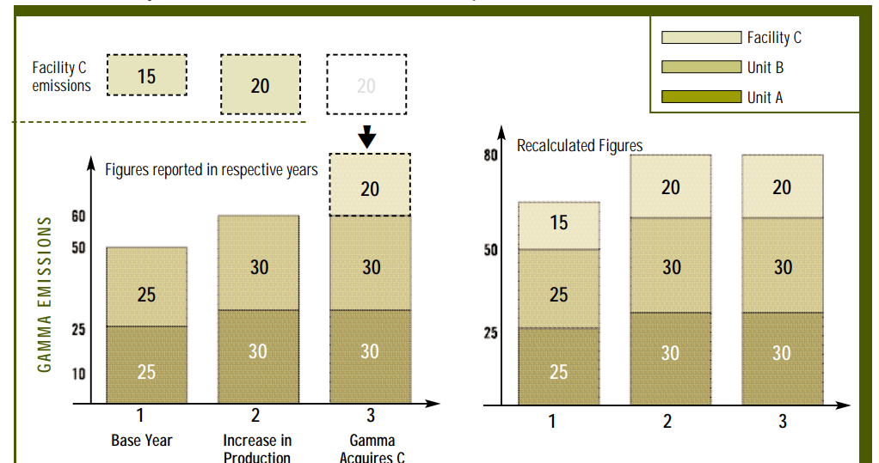
Changes to Company
A Conversation with our Stakeholders
Base Year Recalculated for an Acquisition
Thresholds for recalculating base year
Organic Growth – no reset
Small Acquisitions - <10%
Large Acquisitions > 10%
Divestitures
Example: Base Year (A+B) is recalculated with Facility C to 65 MT CO2e, then added organic growth increase.
August 2023
Notes:
Another questions that comes up often is how to report emissions if your company grows a lot, or if you buy another company?
Lets start with a scenario where your company is going gangbusters, and it grows by 25% in one year. First – Congratulations right? And those emissions are part of your inventory and need to be counted. You will be expected to reduce your emissions according to your goal, in spite of this growth. Your challenge is to find ways to reduce your emissions even with this growth. That is the entire end-game goal here, right?
But what if you purchase another company? To consistently track emissions over time, companies should recalculate base year emissions when a significant purchase occurs – resulting in increase of over 10% to the company’s size. Recalculating base year emissions may be necessary to enable meaningful comparisons of the inventory over time.
Companies are expected to recalculate base year emissions when structural changes – like an acquisition - have a significant impact on the company.
Let’s walk thorough the graph on this page which highlights the difference between organic growth and acquisition growth, and when a company should recalculate its base.
As an alternative to going back to recalculate your base year emissions in the event of a major structural change, companies may reestablish a new base year as a more recent year. _________________________________
Additional Notes:
Establishing a base year recalculation policy When setting a base year, companies shall develop a base year emissions recalculation policy and clearly articulate the basis and context for any recalculations. Whether base year emissions are recalculated depends on the significance of the changes. A significance threshold is a qualitative and/or quantitative criterion used to define any significant change to the data, inventory boundaries, methods, or any other relevant factors. For example, a significant change could be defined as one that alters base year emissions by at least ten percent. As part of the base year emissions recalculation policy, companies shall establish and disclose the significance threshold that triggers base year emissions recalculations. Companies shall apply the recalculation policy in a consistent manner

Slide 7
Absolute versus Intensity Metric
A Conversation with our Stakeholders
Absolute Target
Designed to achieve a reduction in a specified quantity of GHGs emitted.
Advantages: These are considered to be environmentally robust and more credible to stakeholders as it entails a commitment to reduce total GHGs by a specified amount.
Disadvantages: They do not distinguish between declines in production/output rather than performance.
Example: Reduce emissions by 10% from 2010 levels by 2015.
Intensity Target
Reflects GHG performance improvements independent of business growth or decline.
Advantages: An intensity target may increase the comparability of GHG emissions amount companies.
Disadvantages: They are less environmentally robust and less credible to stakeholders because absolute emissions may rise even if intensity decreases. Using a monetary metric (e.g. dollar of revenue may require recalculation due to changes in product prices and inflation.
Example: Reduce emissions per unit of revenue by 25% from 2021 levels by 2015.
August 2023
Notes:
And finally, how should you report your progress to achieving your goal? Should you report your absolute emissions numbers, or emissions intensity metrics?
Intensity Ratios as outlined in the righthand box, express GHG impact per unit of physical activity or unit of economic output.
Many companies historically tracked environmental performance with intensity ratios. However, they are considered to be less environmentally robust and less credible to stakeholders because absolute emissions may rise even if intensity increases For example, emissions per dollar of revenue may decrease simply due to product pricing changes or inflation, even if absolute emissions actually increased.
Conversely, Absolute Targets are actual, real reduction in emissions. Increasingly this is what is expected to be reported.
Absolute Emission Reductions is considered to be more environmentally credible.
Even if you also include an intensity target reporting, you will be increasingly asked to provide absolute emissions reduction information.
Remember – the goal is to reduce overall GHG emission to reduce global warming. Intensity is interesting but it may not be reflective of actual reductions.

