Slide 1
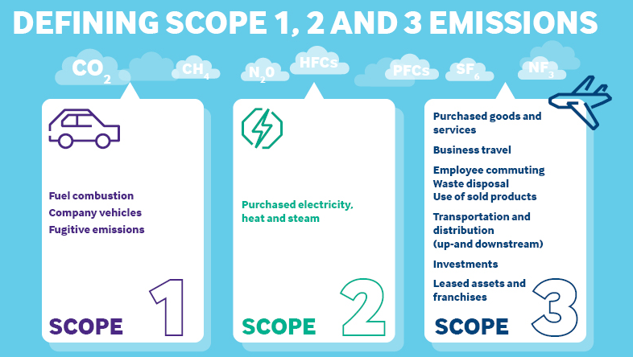
Scope 3 Emissions October 2023 Workshop #5
rpsgroup.com
Scope 3 emissions are indirect supply chain emissions (other than electricity) that are the consequence of the activities of the company but occur from sources not owned or controlled by the company.
October 2023
Notes:
This brings us to our workshop today.
We are going to look deeper into the topic of Scope 3 emissions and Avoided Emissions. Let’s go in order, starting with Scope 3 emissions.
Scope 3 emissions are indirect supply chain emissions (other then electricity purchases) that are the consequence of the activities of the company but occur from sources not owned or controlled by the company. Scope 3 emissions include all sources not within an organization’s scope 1 operating emissions or electricity purchases.
The scope 3 emissions for one organization are the scope 1 and 2 emissions of other organizations.
Today we’ll talk about how your organization may be able to impact the activities that result in Scope 3 emissions, even though they are not under your control. Your vendors or suppliers’ emission are important to your own since you may be able to affect them or choose which vendors to contract with based on their practices.
We are ALL part of someone’s else’s Scope 3 emissions, which is probably why your customers are asking you for information on yours. These requests are likely to increase.
If and when you do decide to report on Scope 3, you may find that there are only one or two major GHG-generating activities at your company to focus on.

Slide 2
Scope 3: Supply Chain/Other Indirect Emissions
A Conversation with our Stakeholders
Example: DHL Nordic Express: Accounting for outsourced transportation services
DHL provides transport and worldwide express package and document deliveries.
While accounting for their emissions, they discover that 98% of their emission are from 3rd party transportation partners.
They began working with these partners to account for their emissions, and now use this information to evaluate and reduce their emissions.
By including Scope 3 and promoting reduction throughout their value chain they have been able to reduce their emissions footprint.
Scope 3 emissions are called Supply Chain Emissions because the emissions are associated with a company’s supply chain but are from sources not owned or controlled by the company.
The Role of Scope 3 Emissions for Recyclers:
1. As a Vendor. The recycling industry is part of our customers’ Scope 3 emissions; and
2. As a Reporting Company. Our vendors are the recycling industry’s Scope 3 emissions
Scope | Emissions (CO2)
Scope 1 | 7,265 (2.%)
Scope 2 | 52 (0.015%)
Scope 3 | 327,634 (97.9%)
Total | 334,951
October 2023
Notes:
Scope 3 emissions, also referred to as value chain emissions may be a small portion of your company’s emissions but may represent the majority of some organization in your supply’s total greenhouse gas (GHG) emissions.
More organizations are reaching into their value chains to understand the full GHG impact of their operations.
For example, for companies like Walmart and Target, over 90% of their emissions are scope 3 emissions because they buy the products they sell from other companies.
Again - this is why you may be getting more requests form your customers for information on your emissions.
A great example is on this slide. Transportation company DHL found that 98% of their emission came from 3rd party transportation partners. Once they knew this, they began working with their partners to help them reduce their emissions.
Accounting for scope 3 emissions need not necessarily involve a full-blown GHG life cycle analysis of all products and operations

Slide 3
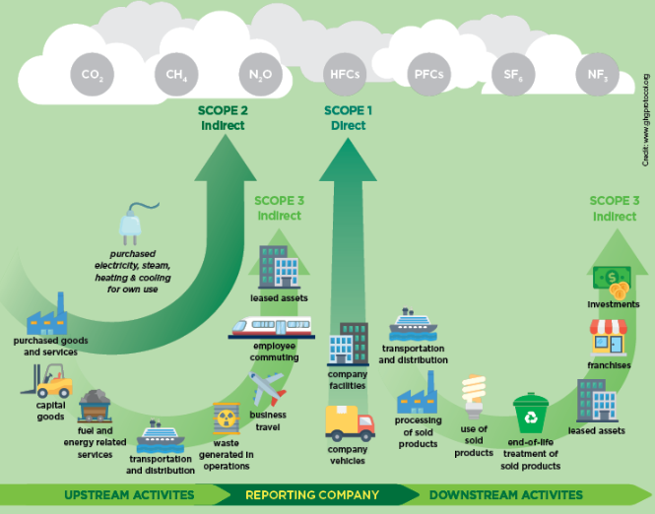
What are Scope 3 Emissions?
A Conversation with our Stakeholders
A company’s environmental impacts related to GHG emissions depends on both its upstream and downstream impacts, not only its direct operations:
Scope 1 = Emissions from fuel from a company’s fleet and combustion from its manufacturing processes.
Scope 2 = Purchased Electricity
Scope 3 = Everything thing else. These can be both upstream (purchased services and goods) and downstream (sold products)
Every company is part of another company’s supply chain
October 2023
Notes:
This slide offers a bit more color as to what Scope 3 emissions include:
The GHG Protocol’s Scope 3 Standard categorizes scope 3 emissions into 15 distinct categories to standardize the boundaries of each category and help companies understand which activities should be accounted for - and in which scope. The GHG Protocol provides companies with a framework to organize, understand, and report on the diversity of scope 3 activities within a corporate value chain.
Examples of Scope 3 emissions include Transportation using other company’s fleet, employee business travel, employee commuting to and from work, transportation of sold products, leased assets and outsourced activities, emissions associate with purchased goods – such as office supplies, and waste disposal.
Scope 3 emissions may come from material and service that your company purchases, or from vendors that you use when material leaves your company.
The point is intended to ensure that major activities are included in someone’s emissions inventory.

Slide 4
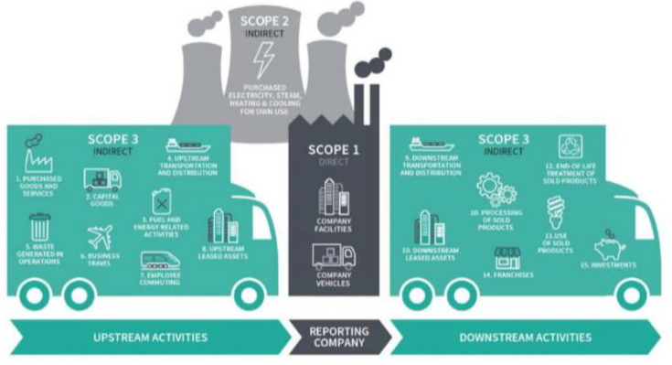
Fifteen Categories of Scope 3 Emissions
Upstream
Scope 3 Emissions
1. Purchased goods & services
Capital good
Fuels-and-energy- related activities (not included in scope 1 or scope 2)
Upstream transportation and distribution
Waste generated in operations
Business travel
Employee commuting
Upstream leased assets
Downstream
Scope 3 Emissions
Transportation and distribution of sold goods
Processing of sold products
Use of sold products
End-of-life treatment of sold products
Downstream leased assets
Franchises
Investments
October 2023
Notes:
The 15 Scope 3 categories are further organized into 8 upstream and 7 downstream emissions. The distinction is based on the financial transactions of the reporting company:
Upstream emissions are indirect GHG emissions related to purchased or acquired goods and services.
Downstream emissions are indirect GHG emissions related to sold goods and services.
The categories are designed to be mutually exclusive, such that, for any one reporting company, there is no double counting of emissions between categories.
Each scope 3 category is comprised of activities that individually result in emissions.
This system creates a reasonable way to included all relevant emissions. This helps to provide boundaries for reasonable expectations and consistency across all reporting entities.

Slide 5
Why are Scope 3 Emissions Important?
A Conversation with our Stakeholders
Enables the understanding of a company’s impact across its value chain.
Knowing where your emissions are (and the volume) allows for focus on the greatest impact.
Scope 3 often represents the largest source of emissions for companies. With an inventory of all 3 scopes, a company can take action to optimize its emissions reduction impact.
As more reporting companies follow the same reporting standards and categories, global emissions will be reported accurately – including reductions and additions.
Including Scope 3 emissions in a company’s GHG inventory presents a complete assessment of the opportunity for that company to influence its supply chain to reduce global GHG emission.
October 2023
Notes:
Why are Scope 3 emissions important?
A complete GHG inventory across scope 1, scope 2 and scope 3 is needed to enable companies to understand and manage climate-related impacts, risks and opportunities.
This enables a company to understand its full emissions impact across its value chain.
Knowing more about vendors emissions allows for a focused effort to make the greatest impact.
Since Scope 3 often represents the largest source of emissions for many companies, an inventory of all scopes, including Scope 3, allows a company to take action to optimize its emissions reduction impact along its supply chain.
As more reporting companies follow the same reporting standards and categories, global emissions will be reported accurately – including reductions and additions.

Slide 6
Scope 3 Reporting Requirements
A Conversation with our Stakeholders
In the past, reporting on Scopes 1 & 2 emissions was sufficient for many companies. Globally accepted guidance in the GHG Protocol Guidance does not require reporting or goal setting on Scope 3 emissions if they are less than 40% of a company’s overall emissions inventory.
* That is changing *
California’s SB 253 passed on 9/14/2023
It requires GHG emission reporting for companies with over $1million in revenue:
Bill Text - SB-253 Climate Corporate Data Accountability Act. (ca.gov)
What this means for ISRI members:
If you are a company with over $1 billion of revenue in California, you will be required to report your Scope 1, 2 and 3 emission by January 2027.*
If your company does business with a company with California operations, you will be required to provide your customers with information on your GHG emissions so they can meet their regulatory requirements.
Scope 3 reporting is required in the EU and in California for companies with >$1M revenue
*Although Gov Newsom signed SB 253, he stated that he expect a delay in the reporting requirement dates.
October 2023
Notes:
For many years, Companies were allowed to report Scope 1 & Scope 2 emissions only if their Scope 3 emissions were less than 40% of their total emissions.
That changed with the passing of California SB 253. This bill requires the state, on or before January 1, 2026, to develop and adopt regulations requiring specified partnerships, corporations, limited liability companies, and other business entities with total annual revenues in excess of $1 billion and that do business in California, defined as “reporting entities,” to publicly disclose to the emissions reporting organization, as defined, and obtain an assurance engagement.
One note, when Governor Newsom signed the bill into law last week, said that he will work with the bill authors to address the timing of the bills requirements since it will be impossible to meet its deadlines. ____________________________________
Additional Notes: (10/9/2023) As passed in the Assembly, SB 253’s disclosure obligations would begin in 2026 for Scope 1 and 2 emissions, and in 2027 for Scope 3 emissions, with measurement and reporting to be performed according to the Greenhouse Gas Protocol standards. The law would also require companies to obtain third party assurance for their emissions reporting, starting with a limited assurance level beginning in 2026 for Scope 1 and 2 emissions, and at a more stringent reasonable assurance level in 2030, and at a limited assurance level for Scope 3 in 2030.
The bill would require the state board to review during 2029, and update as necessary on or before January 1, 2030, these deadlines to evaluate trends in scope 3 emissions reporting and to consider changes to the deadlines, as provided. The bill would require a reporting entity to obtain an assurance engagement, performed by an independent third-party assurance provider, of the entity’s public disclosure as provided. The bill would require the state board, in developing these regulations, to consult with the Attorney General, other government stakeholders, investors, stakeholders representing consumer and environmental justice interests, and reporting entities that have demonstrated leadership in full-scope greenhouse gas emissions accounting and public disclosure and greenhouse gas emissions reductions. The bill would also require the state board to ensure that the assurance process minimizes the need for reporting entities to engage multiple assurance providers and ensures sufficient assurance provider capacity, as well as timely reporting implementation, as required. The bill would further require the state board to contract with an emissions reporting organization to develop a reporting program to receive and make publicly available the required disclosures. The bill would authorize the state board, starting in 2033 and every 5 years thereafter, to assess the global greenhouse gas accounting and reporting standards and to adopt an alternative standard if it determines that using the alternative standard would more effectively further the goals of the bill.

Slide 7
Scope 3 Reporting Realities
Scope 3 reporting is not easy and is likely to take multiple years to evolve into a complete report.
So – why bother at all?
Upstream Pressure from Stakeholders
Downstream Opportunities
Scope 3 is increasingly expected from stakeholders
There is a trickle down from customers’ upstream requirements
Getting ahead of the curve may provide a competitive edge
Attention on suppliers/vendors emissions data can reduce own emissions
Gain insight into vendors’ processes and materials.
Potentially reduce supply chain costs.
October 2023
Notes:
California’s Governor Newsom’s acknowledgement of the difficult of reporting Scope 3 emissions highlight how tricky this topic is.
So why even bother?
There are several good reasons to think about starting to tackle Scope 3 emissions:
Upstream - Your customers and other stakeholders may be asking for more information. Working with them may provide a competitive advantage for your company.
Downstream – Through the reporting process, you may be able to identify some ways to reduce emissions from your vendors – and even supply chain costs as you learn more about your vendors.
It actually makes sense – once you get comfortable with the concept.
Scope 3 reporting is likely to take some work with your vendors. And You may not be ready.
But you also might be surprised that you have some risk and some opportunities related to Scope 3 emissions – and it may not be as difficult as it seems to get information once you get into it –depending the size and complexity of your company.
This is a bit like taking bites of the elephant.. Start with key vendors and do a bit more, going deeper every year.

Slide 8
Getting Started
Identify Risk
Identify Opportunities
Engage the Value Chain
Report
- Reputational risk
- Regulatory risk
- Supply chain cost & reliability
- Evolution of products & technology (e.g., increasing demand for low-emitting products & services)
- Efficiency
- Innovative products & services
- Increase sales and customer loyalty
- Improved stakeholder relations
- Customer loyalty
- Work with suppliers for data
- Identify highest emitting partners
- Create supplier tiers to prioritize efforts
- Gather data
- Fill gaps over time
- Begin to add Scope 3 information to annual reports
- Add information over time
- Work with suppliers for improved performance
October 2023
Notes:
Here the key steps in starting down the path of Scope 3 reporting:
- identify risk
- identify opportunities
- Engage the value chain
- Include Scope 3 information in your reporting.
For large complex companies, obtaining the emissions information from their suppliers is not easy. (note CA delay)In the meantime, Amazon was recently kicked off the SBTi goal evaluation list because they could not/did not report on their supply chain emission inventory. They subsequently announced a new program to provide their supply chain partners with tools to create their own GHG inventory. They learned the hard way, or at least the very public way), that saying “it’s too hard” doesn’t fly any more.
Fortunately, for our industry, this likely isn’t as hard as many others. We have a lot fewer moving parts allowing for some estimation over like types of activities.
Additional notes

Slide 9
Prioritize Activities & Suppliers
Prioritizing suppliers and activities requires making estimates.
Prioritize Based on GHG estimates
Prioritize based on Financial Impact
Use GHG emissions calculation estimates to determine which suppliers may have significant Scope 3 emissions.
A quantitative approach provides relative magnitudes of various scope 3 activities
Rank all Scope 3 activities from largest to smallest according to their estimated GHG emissions.
Prioritize based on a financial spend analysis to rank purchased and sold products.
Include activities with a high market value but low emissions.
Include activities with a low market value but high emissions.
This includes activities that may have a high GHG impact, even if financial spend is low.
October 2023
Notes:
There are a couple of ways to go about estimating Scope 3 emissions from your suppliers.
Here are some tricks:
First- estimate GHG emissions. You can do this by estimating emissions based on specific activities. For example, GHG from estimated fuel use by transportation companies.
Alternatively, you can prioritize your vendors by your financial spend with them. You may want to start by looking at the companies that make up the top 80% of your spend. Chances are, they will contribute the highest portion of your Scope 3 emissions. However, since revenue and emissions do not always correlate, the GHG protocol recommends that you also look at any company with 1% of your financial spend, or that you think might generate a significant amount of GHGs.
Over time, you can expand beyond your largest vendors to the rest of your supply chain.
________________________________________________
Additional notes ….
The most rigorous approach to identifying priority activities is to use initial GHG estimation methods to determine which scope 3 activities are expected to be most significant in size.
A quantitative approach gives the most accurate understanding of the relative magnitudes of various scope 3 activities:
Use initial GHG estimation (or screening) methods to estimate the emissions from each scope 3 activity; and
Rank all Scope 3 activities from largest to smallest according to their estimated GHG emissions to determine which Scope 3 activities have the most significant impact.
Priority Based on Financial Impact
Many companies prioritize Scope 3 activities based on their relative financial significance, using a financial spend analysis to rank purchased and sold products by their financial contribution.
However, spend and revenue does not always correlate with emissions.
Some activities have a high market value but have relatively low emissions.
Conversely, some activities have a low market value, but have relatively high emissions.
As a result, companies should also prioritize activities that do not contribute significantly to financial spend or revenue but are expected to have a significant GHG impact.

Slide 10
Collecting Data: Engage the Supply Chain
*
*
*
*
Prioritize data collection efforts on the Scope 3 activities that:
Are expected to have the most significant GHG emissions
Offer the most significant GHG reduction opportunities
Are most relevant to the company’s business goals.
Collecting higher quality data for priority activities allows companies to focus resources on:
The areas with the greatest GHG emissions
Setting reduction targets; and
Tracking and demonstrating GHG reductions over time.
* Sections referenced are from the GHG Protocol Scope 3 Standard: https://ghgprotocol.org/corporate-value-chain-scope-3-standard
October 2023
Notes:
In addition to prioritizing companies, companies use a combination of approaches and criteria to identify priority activities.
For example, companies may seek higher quality data for all activities that clearly produce significant emissions, thus presenting the most significant risks and opportunities in the value chain. Or they may prioritize area where more accurate data can be easily obtained.
Conversely, companies may choose to rely on relatively less accurate data for activities that are expected to have insignificant emissions or where accurate data is difficult to obtain.
Recommendations for prioritizing data collection on the Scope 3 activities include focusing on:
Those that are expected to have the most significant GHG emissions
Those that offer the most significant GHG reduction opportunities
Those that are most relevant to the company’s business goals.
This will allow companies to focus their resources on setting reduction targets, targeting areas with the greatest emissions reduction potential, and tracking and reducing emissions over time.

Slide 11
Types of Data to Use
Primary Data: Supplier Specific
Secondary Data: Industry Specific
Meter readings
Purchase records
Utility bills,
Engineering models
Direct monitoring
Mass balance
Stoichiometry
Other methods for obtaining data from specific activities in the company’s value chain
Secondary data can be used to fill data gaps.
Use industry specific averages.
Select secondary data that are the most representative to the company’s activities in terms of technology, time, and geography, and that are the most complete and reliable.
Secondary data sources is available at https://ghgprotocol.org/life-cycle-databases.
Scope 3 data depends on the quality of data used to calculate emissions
Notes:
This is a good practical slide for thinking about what your customers are asking from YOU in regards to data.
They are probably looking to you for data on mostly tons recycled and disposed, but perhaps other energy-related information.
They may be looking for primary data as well as secondary data. The quality of these can vary:
Primary Data: High quality. Primary data collected from suppliers and other value chain partners for Scope 3 activities includes specific information such as utility bills, purchasing invoices, meter reading ,etc.
Secondary Data: In some cases, primary data isn’t available or may not be good quality. In these instances, secondary data may be used. This includes databases and publications that are internationally recognized, provided by national governments, or peer-reviewed.

Slide 12
Create Supplier Tiers: Cascading Reporting
Tier 1:
80% of GHG or financial spend
Tier 2:
Other suppliers
Cascading Reporting through the Supply Chain
Tier 2
Tier 2
Tier 1
(Company A)
Tier 1
Tier 2
Tier 2
Reporting Company
Reporting Company
(Tier 1 Company B)
Tier 1
(Company B)
Tier 2
Tier 1
Tier 2
Tier 2
Tier 2
Tier 1
(Company C)
Tier 1
Tier 2
Tier 2
As companies cascade reporting requirements to their supply chain, a global inventory develops
October 2023
Notes:
Before we wrap up this section, it might be helpful to explain an “aha” moment that I had while working on this topic.
Basically, the current push for Scope 3 emission reporting is the fact that as more companies report emissions, more companies will manage their emissions, leading to more effort to reduce emissions throughout the value chain and the globe. We’ve mentioned this previously… companies that report emissions tend to take steps to reduce them. Thus, reporting leads to emissions reductions whether its Scopes 1, 2 or 3, or all of them.
The intention is to eventually include every company in the reporting process.
Companies should first engage their top tier suppliers. I consider tier 1 suppliers as those top suppliers that make up 80% of your emissions. However, collectively, significant value chain GHG impacts often lie farther along the supply chain. Outsourced manufacturing impacts may be several layers removed from a company’s direct operations.
As a result, companies may want to promote further GHG management through the supply chain by encouraging their tier 1 suppliers to encourage their own tier one suppliers to report the GHG inventories.
Eventually, as tier 2 suppliers to require their tier 1 suppliers to do the same we’ll start to see a cascade affect of GHG accounting and reporting throughout supply chains, expanding the number of companies directly involved in managing GHG emissions.
Ultimately, this translates into more companies taking action to manage their emissions.

Slide 13
Reporting: Putting the Pieces Together
More reporting means that more companies will be accountable for their emissions. Accounting of Scope 3 emissions recognizes that a broad range of actions impact emissions and play a role in reducing global emissions reporting over time.
Customers, policy makers and regulators are calling for increased efforts around Scope 3 reporting.
Scope 3 data can be tricky to obtain – especially for large complex companies. However, companies are expected to start this process with an understanding that the quantity and quality of the data will improve over time.
Companies may need to start with low quality data due to limited data availability In the initial years of Scope 3 data collection.
Work to improve the data quality of their Scope 3 inventory each year by filling data gaps, and replacing lower quality data with higher quality data as it becomes available.
Collecting data, assessing data quality, and improving data quality is an iterative process.
Quality will improve over time.
As more companies take inventory and report on emissions, they are more likely to implement efforts to reduce them, leading to a reduction in global emissions.
October 2023
Notes:
Finally – to wrap up our discussion on Scope 3 Emissions.
Reductions in corporate emissions are calculated by comparing changes in the company’s actual emissions inventory over time relative to a base year. This allows companies to track the aggregate effect of their activities on total corporate GHG emissions on a yearly basis.
Collecting data, assessing data quality, and improving data quality is an iterative process. Companies should first assess data quality when selecting data sources, then review the quality of data used.
In the initial years of scope 3 data collection, companies may need to use data of relatively low quality due to limited data availability. Over time, companies should seek to improve the data quality of the inventory by replacing lower quality data with higher quality data as it becomes available.
_______________________
Additional notes.
Accounting for actual reductions in indirect emissions (i.e., scope 2 or scope 3 emissions) to the atmosphere is more complex than accounting for actual reductions in direct emissions (i.e., scope 1). Changes in a company’s scope 2 or scope 3 inventory over time may not always correspond to actual changes in GHG emissions to the atmosphere, since there is not always a direct cause-and-effect relationship between the reporting company’s activities and the resulting GHG emissions. For example, a reduction in business travel would reduce a company’s scope 3 emissions from business travel (since the reduction is usually quantified based on an average emission factor of fuel use per passenger). However, how a reduction in business travel actually translates into a change in GHG emissions to the atmosphere depends on several factors, including whether another person takes the “empty seat” or whether the unused seat contributes to reduced air traffic over the longer term.

