Slide 1


Materiality
June 2023
Workshop #1
What are the issues and services that a company provides that are most relevant to its stakeholders?
Relevance
Impact
Priority
Notes:
First - Materiality.
When I first was asked to complete a Materiality review, I didn’t understand what was meant by “materiality”. Material, or materiality in this context, is a term often used by accountants to identify relevant, or material, topics.
According to the Global Reporting Initiative, when applied to sustainability, materiality is an organization's significant economic, environmental and social impacts, or issues, that substantively influence the assessments and decisions of stakeholders.
Why is a Materiality Review important?
In order to effectively develop an ESG strategy and program, a company needs to identify and prioritize the issues and services that it provides that are most material, or relevant & significant to its stakeholders.
In other words, a materiality assessment identifies what is important about your company to not only your team, but to your customers, employees, regulators, communities, and shareholders.
So – How do we do this?

Slide 2

Materiality Review Process
Part 1: Context
  Identify your stakeholders
  Consider business relationships
  Engage on impacts
Part 2: Assess & Prioritize
  Use diverse information sources
  Consider your impact on the economy, environment, people, and human rights.
  Include both positive and negative impacts
  Assess each impact’s significance: consider severity & likelihood
  Prioritize
Part 3: Approval
Materiality is not about what your company believes is important.
It’s about the concerns of all your stakeholder groups.
Notes:
Lets’ start with “context”. What do we mean by this?
The basic idea is to identify activities and business relationships and the sustainability context in which these occur.
Start by considering the business relationships the organization has, and the nature of these relationships.
Then identify the company’s stakeholders across its activities and business relationships and engage with them on its impacts. Draw a full list of individuals and groups whose interests are affected or could be affected by the organization’s activities, including employees, customers, regulators, investors, and community stakeholders.
Make sure to include individuals or groups without direct relationships with but who could be affected by the organization’s activities.
There is no need to make it complicated!
It all boils down to using information from diverse sources to consider the company’s impact on the economy, environment, people, and communities. The point is for the company to understand the concerns of its stakeholders:
Part 1 : Engage with relevant stakeholders and identifying the impact of the company – both positive and negations.
Part 2: Assess the significance of the impacts and prioritizing the most significant topics. This prioritization process is key for developing a robust, ESG strategy that is relevant to your company and your stakeholders.

Slide 3
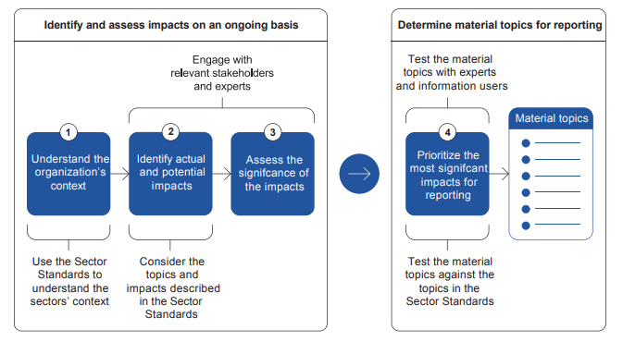
Materiality Review Process
Notes:
Here is a diagram outlining the Process:
1. Understand the organizations context. What are your activities and business relationship as relevant to sustainability
Then, by engaging with stakeholders and experts, consider your organization’s actual and potential impacts and assess their significance.
Once you have this information, you can determine your company’s material topics for reporting, and/or to use for this information to develop sustainability goals and a strategy for achieving your goals.
For example, an organization might determine that ‘water and effluents’ is a material topic based on the impacts its water use has on the ecosystem and local communities’ access to water.
Various impacts are grouped into categories.

Slide 4
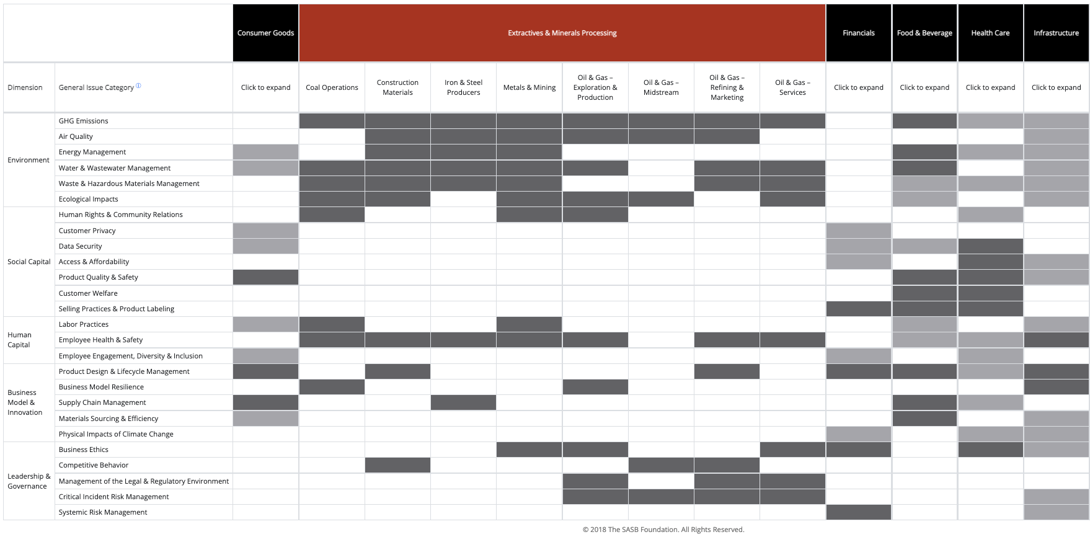
SASB Materiality Map - Sample
Notes:
SASB is a very influential global reporting framework organization that works with other organizations and focuses on reporting details by specific types of industries –
This sample materiality map from SASB helps identify the topics that apply to various sectors.
Note the Infrastructure sector - most of us fall into that column. It identifies the topics that are important for our industry.
Examples range from GHG emissions to energy management, to data security, labor practices, Health and Safety, Business Ethis Risk, etc…… This list goes on.

Slide 5
Our Industry’s Material Topics
Relevant Issues
Environment | Social Capital | Human Capital | Business Model & Innovation | Leadership & Governance
GHG Emissions | Human Rights & Community Relations | Employee Health & Safety | Product Design & Lifecycle Management | Systemic Risk Management
Air Quality | Customer Privacy | Labor Practices | Business Model Resilience | Critical Incidence Risk Management
Water & Wastewater Management | Product Quality & Safety | Employee Engagement, Diversity & Inclusion | Physical Impacts of Climate Change | Management of the Legal & Regulatory Environment
Energy Management | Access & Affordability | Customer Welfare | Supply Chain Management
Ecological Impacts | Data Security |  | Materials Sourcing & Efficiency
 | Selling Practices & Product Labelling |  | Business Ethics
 |  |  | Competitive Behavior
Notes:
https://www.sasb.org/standards/materiality-finder/find/?industry%5B0%5D=IF-WM
Here are those topics identified for the waste and recycling industry. This will look different for equipment manufacturers and it is not meant to be a complete list. You very will thing of other issues that are relevant to your business.
________________________________________________________________
NOTES:
SASB’s definition of The Waste Management industry. It includes companies that collect, store, dispose of, recycle, or treat various forms of waste from residential, commercial, and industrial clients.
Types of waste include municipal solid waste, hazardous waste, recyclable materials, and compostable or organic materials. Major companies are commonly vertically integrated, providing a range of services from waste collection to landfilling and recycling, while others provide specialized services such as treating medical and industrial wastes. Waste-to-energy operations are a distinct industry segment. Certain industry players also provide environmental engineering and consulting services, mostly to large industrial clients.

Slide 6
Material Topics: Company Examples
SIMS
Environment
Climate Change
Resilience
Promotion and Advocacy for Circular Economy
Actions on GHG Emissions
Environmental Compliance
Social
Value Human Capital
Diversity, Equity and Inclusion
Human Rights and Modern Slavery
Community Relations
Employee Health and Safety
Governance
Ethical Business Practices
Corporate Governance
ESG Transparency, Reporting and Communications
Value Chain Engagement
Innovation and Technology for Circular Economy
WM
Environment
Climate Impact
Energy Efficiency
Internal Waste Generated
Local Environment
Recycling Reporting
Sustainable Procurement
Water Use
Social
Community Engagement
Community Investment
Customer Relationships
Employee Training
Health & Safety
Human Rights & Diversity
Sustainable Development Goals
Vendor Screening
Vendor Training
Governance
Business Ethics
Climate Strategy
Environmental Management System
Environmental Penalties
Leadership Accountability
Stakeholder Engagement
Supply Chain Policy
Technology Innovations
Schnitzer
Environment
Environmental Management
Carbon Neutrality
Air Quality
Local Environmental Impacts
Social
Employee Safety
Talent Recruitment and Retention
Training & Development
Local Community Relations & Trust
Governance
Climate Change Management
Ethics
ESG Governance
Customer Satisfaction
Product
Recycled Metals and Recycling Services
Technological Innovation
Material Quality
Circular Economy
Notes:
Here are the material issues that there ISRI companies identified in their materiality review. You’ll notice that the words may vary, but the concepts are very similar across the 3 companies.
WM’s list is longer due to its broader service offering.
But what does a company do with this? How is the list used?
__________________________________________________________
FOR THE TOOLKIT ONLY NOTES from GRI 3 Material Topics 2021 (8).pdf
These notes provide more detailed information materiality reporting. Please use the link above for a full reference.
Step 1. Understand the organization’s context In this step, the organization creates an initial high-level overview of its activities and business relationships, the sustainability context in which these occur, and an overview of its stakeholders. this provides the organization with critical information for identifying its actual and potential impacts. The organization should consider the activities, business relationships, stakeholders, and sustainability context of all the entities it controls or has an interest in (e.g., subsidiaries, joint ventures, affiliates), including minority interests.
Activities. The organization should consider the following in relation to its activities: Business relationships The organization’s business relationships include relationships with business partners, entities in its value chain (including entities beyond the first tier), and any other entities directly linked to its operations, products, or services. The organization should consider the following in relation to its business relationships: • The organization’s purpose, value or mission statements, business model, and strategies. The types of activities it carries out (e.g., sales, marketing, manufacturing, distribution) and the geographic locations of these activities. • The types of products and services it offers and the markets it serves (i.e., the types of customers and beneficiaries targeted, and the geographic locations where products and services are offered). • The sectors in which the organization is active and their characteristics (e.g., whether they involve informal work, whether they are labor or resource intensive). • The number of employees, including whether they are full-time, part-time, non-guaranteed hours, permanent or temporary, and their demographic characteristics (e.g., age, gender, geographic location). • The number of workers who are not employees and whose work is controlled by the organization, including the types of worker (e.g., agency workers, contractors, self-employed persons, volunteers), their contractual relationship with the organization (i.e., whether the organization engages these workers directly or indirectly through a third party), and the work they perform. • • The types of business relationships it has (e.g., joint ventures, suppliers, franchisees).
• The nature of the business relationships (e.g., whether they are based on a long-term or short-term contract, whether they are based on a specific project or event). • • The geographic locations where the activities of the business relationships take place. Economic, environmental, human rights, and other societal challenges at local, regional, and global levels related to the organization’s sectors and the geographic location of its activities and business relationships (e.g., climate change, lack of law enforcement, poverty, political conflict, water stress). • The organization’s responsibility regarding the authoritative intergovernmental instruments with which it is expected to comply. Examples include the International Labour Organization (ILO) Tripartite Declaration of Principles concerning Multinational Enterprises and Social Policy [1]; the Organisation for Economic Co-operation and Development (OECD) Guidelines for Multinational Enterprises [3]; the United Nations (UN) Framework Convention on Climate Change (FCCC) Paris Agreement [4]; the UN Guiding Principles on Business and Human Rights [5]; and the UN International Bill of Human Rights [6]. • • The organization’s responsibility regarding the laws and regulations with which it is expected to comply
Stakeholders The organization should identify who its stakeholders are across its activities and business relationships and engage with them to help identify its impacts. The organization should draw a full list of individuals and groups whose interests are affected or could be affected by the organization’s activities. Common categories of stakeholders for organizations are business partners, civil society organizations, consumers, customers, employees and other workers, governments, local communities, nongovernmental organizations, shareholders and other investors, suppliers, trade unions, and vulnerable groups. The organization can further distinguish between individuals and g
Step 2. Identify actual and potential impacts In this step, the organization identifies its actual and potential impacts on the economy, environment, and people, including impacts on their human rights, across the organization’s activities and business relationships. Actual impacts are those that have already occurred, and potential impacts are those that could occur but have not yet occurred. These impacts include negative and positive impacts, short-term and long-term impacts, intended and unintended impacts, and reversible and irreversible impacts. To identify its impacts, the organization can use information from diverse sources. It can use information from its own or third-party assessments of impacts on the economy, environment, and people, including impacts on their human rights. It can also use information from legal reviews, anti-corruption compliance management systems, financial audits, occupational health and safety inspections, and shareholder filings. It can also use information from any other relevant assessments of business relationships carried out by the organization or by industry or multi-stakeholder initiatives
Step 3. Assess the significance of the impacts The organization may identify many actual and potential impacts. In this step, the organization assesses the significance of its identified impacts to prioritize them. Prioritization enables the organization to take action to address the impacts and also to determine its material topics for reporting. Prioritizing impacts for action is relevant where it is not feasible to address all impacts at once. Assessing the significance of the impacts involves quantitative and qualitative analysis. How significant an impact is will be specific to the organization and will be influenced by the sectors in which it operates, and its business relationships, among other factors. In some instances, this may need a subjective decision. The organization should consult with relevant stakeholders (see Box 2 in this Standard) and business relationships to assess the significance of its impacts. The organization should also consult relevant internal or external exp
The combination of the severity and the likelihood of a negative impact can be referred to as ‘risk’. The assessment of the significance of the impacts can be included within broader enterprise risk management systems, provided that these systems assess the impacts the organization has on the economy, the environment, and people, in addition to assessing risks for the organization itself.

Slide 7

Stakeholder Survey & Assessment
Create preliminary list of material topics
Survey stakeholders
Quantitative rating – for feedback from a large number of stakeholders
Qualitative interviews –more nuanced feedback, smaller group of stakeholders
Weight topics based on expert feedback.
A well-done materiality assessment links the business of the company to its significant ESG impacts.
Notes:
Once you have your preliminary list of material topics and your list of stakeholders, you will survey your stakeholders as to their view of the importance of each material topic to the company.
You’ll need to determine your feedback methodology:
Quantitative rating – for feedback from a large number of stakeholders (survey monkey)
Qualitative interviews – for more nuanced feedback from a smaller group of stakeholders
The combination of both can help in the prioritization process. At WM, we used a combination of both numeric ratings and some in depth interview for qualitative feedback, as well.
Then, you might decide to assign weights to the topics based on expert feedback. Your team may decide that safety rates higher than vendor training. Or that air emissions is more important that water use in your business. They can be assigned different weights which will influence their position on the final matrix.
A well-done materiality assessment is critical for the development of a company’s ESG strategy and program because it links the business of the company to the significant ESG impacts of the organization.
The ideas is to enlist your stakeholders in identifying what is important to THEM about your company from this list.
Assessing and prioritizing these impacts will help in the development of your ESG strategy, goals, and programs, as well as how and what it reports on its ESG progress.

Slide 8
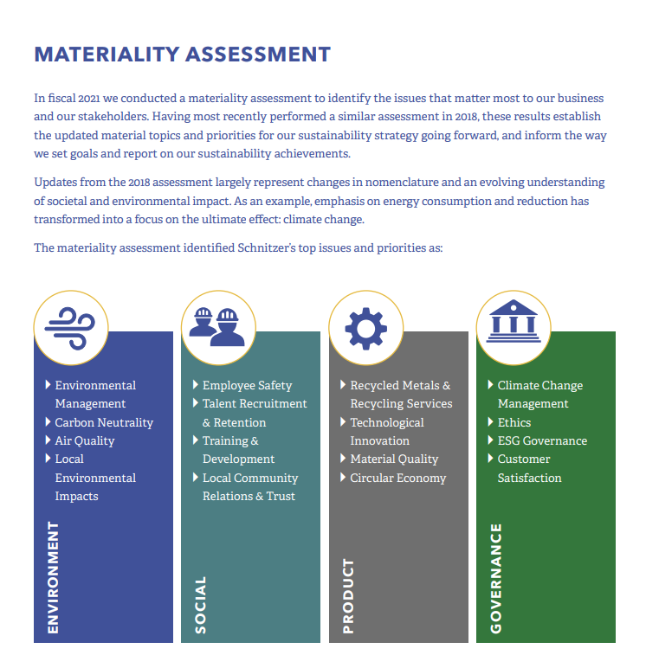
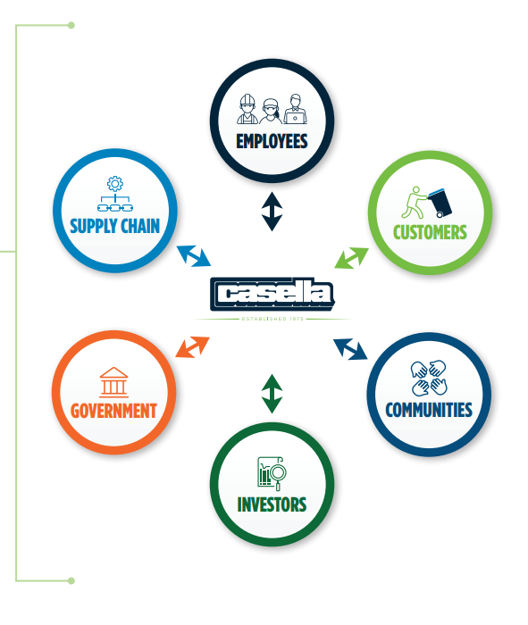
Materiality Examples: Casella and Schnitzer
A Conversation with our Stakeholders
Casella
Schnitzer Steel
Sustainability reporting enables the company to tell its story in a clear and credible way
It provides a framework for considering various non-financial impacts of their business
Their audience: Six key stakeholder groups (employees, customers, communities, investors, government, supply chain)
Notes:
Here are some examples from ISRI members:
Casella’s materiality work is very high level but was is used to identify key areas of focus for its stakeholders, which ultimately translated into new sustainability goals, which drivers the company’s strategy.
Schnitzer is more details in their materiality assessment, which a large list of issues that they used to priority topics from their stakeholders.

Slide 9
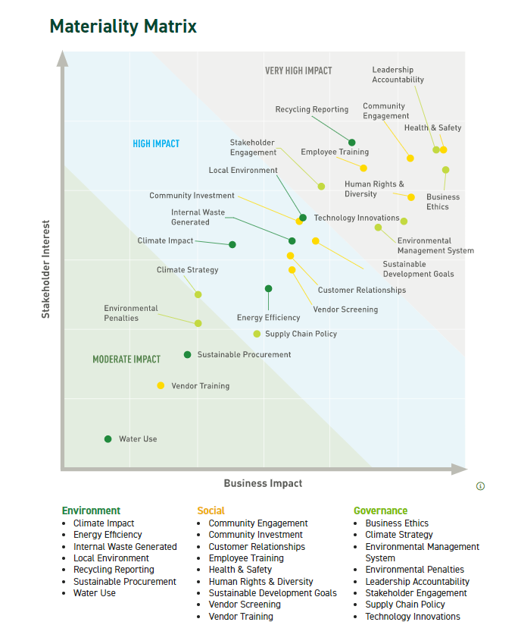
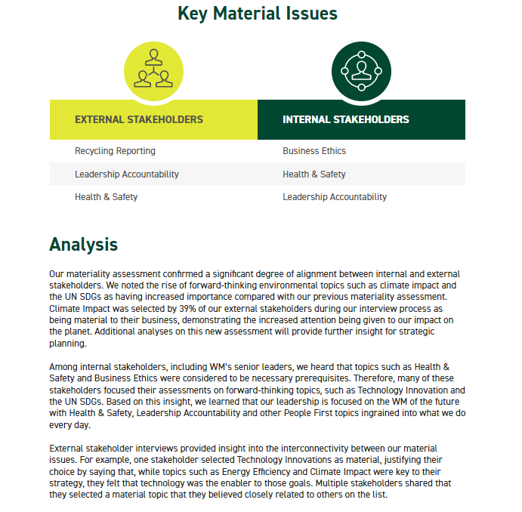
Materiality Matrix: WM
A Conversation with our Stakeholders
Notes:
WM includes their materiality analysis on their sustainability reporting website.
You can see that WM looked at their external stakeholders and internal stakeholders on the x and y axis here.
They found that the was overlap by both in highlighting the importance of Health and Safety, and Leadership Accountability. But their external stakeholder rated Recycling Strategy as most important while their internal stakeholders rated Business Ethics highly.
The company is on its 3rd generation of materiality reporting, so it has evolved into a full matrix with weighting and analysis of the results. Ultimately, this drives the type of information that the company talks about and considers for its sustainability strategy.

Slide 10
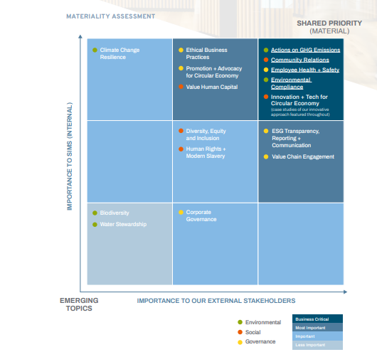
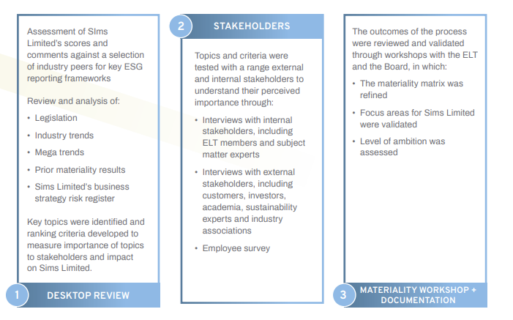
Materiality Process: SIMS
A Conversation with our Stakeholders
Notes:
SIMS includes their stakeholder work and their Materiality matrix, highlighting their highest priorities for material issues.
I like how this is a snapshot from their sustainability report, includes their process for research, surveying and uniquely they notes that their Senior Leadership Team and Board had held a workshop to review the results and discuss how to use them.

Slide 11
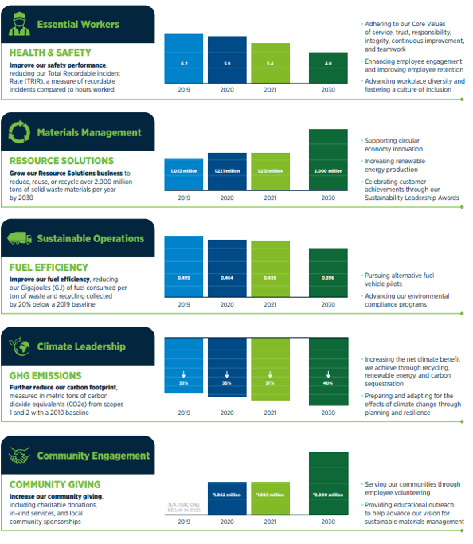
Goal Development: Casella
A Conversation with our Stakeholders
Casella’s sustainability program is built around 5 primary goals for the year 2030
Each was selected via their Materiality Assessment process and is aligned with the Company’s core business strengths and financial goals
They are all consistent with the goals of their customers and communities.
Notes:
Back to Casella:
This snapshot from Casella’s sustainability report makes the connection between Materiality, goals and the development of their sustainability strategy.
We will talk more about the connection between Materiality, goals and strategy. in July, but hopefully this is a starting point to think about before then.
It all starts with what issues are material, or important, about your company to your stakeholders.

Slide 12
ESG Strategy is an Ongoing Journey
Commitment
Leadership Commits to ESG Strategy
Information Collection
Strategy Development
Materiality
Goals Setting
Reporting
Transparency
Continuous Improvement
Accountability
Materiality provides information for goal development
Goal setting creates roadmap for strategy development and action
Reporting drives improvement
When combined, these actions reduce risk, improve resiliency and add value
June 2023
Notes:
To wrap up this section, this conceptual diagram helps put materiality into context for the entire process.
A materiality assessment helps with an understanding of what your stakeholders consider to be material topics for your company. This should be helpful in the development of sustainability goals, and for strategy development.
And, finally, because reporting helps drive improvement, when this is all combined, the process can ultimately help reduce risk, improve resilience and add value.

