Slide 1
ESG Overview
June 2023- Workshop #1

Slide 2


Background/Context
\
The ESG initiative is ISRI’s response to a changing world affecting all types and sizes of organizations and companies.
The initiative is being offered to members to help maneuver through the maze of sustainability issues, focusing on creating opportunities to drive business value by shaping resilient and profitable companies for years to come.

Slide 3
Setting the Stage
Setting the Stage
History and the Evolution of Sustainability Reporting
Today’s expectations
Tomorrow’s roadmap
History
Evolution of reporting
Current
Today’s expectations
Tomorrow
Roadmap for the future
Notes:
Welcome to the inaugural ISRI sustainability workshop. We are glad that you are here!
I suspect that there are as many reasons for each of you who are participating in this workshop today as there are people logged in. And when it comes to sustainability – that is okay.
One of the most important points to make as we start on this journey is that there is no single right way to do this. Which is one of the really beautiful things about sustainability.
Are you looking for a sustainability strategy and opportunities to grow your business?
Are you looking to creating a reporting structure to answer stakeholder questions?
Are you looking to create environmental goals to reduce your company’s environmental impact?
Maybe it is one of these, all of the above, or something else altogether. Our goal is to provide you with the tools to take what you need and apply it to your company.
This workshop series is designed to leave a lot of room for each of you to shape your own path for your company.
We will provide an overview of what sustainability strategies look like and will provide tools to get started. If is something that a company wants to implement, it will have the tools to choose its own pathway.
I’ll start with a bit about my journey with sustainability reporting and strategy, which mirrors some of the history of the industry. We talk about expectation for today will ultimately dig deeply into possible roadmaps for the future for different companies.

Slide 4

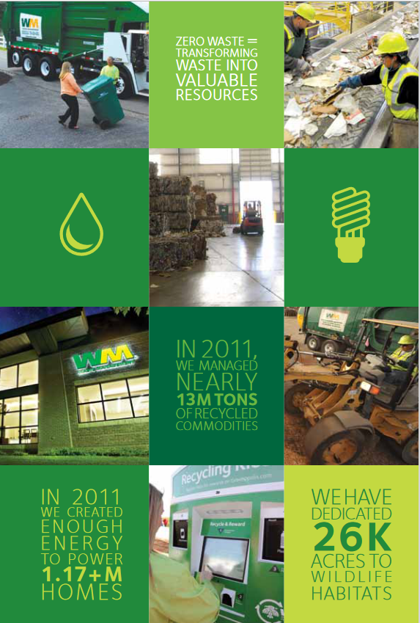

History of Reporting
2022
ESG Reporting
Environmental Report
Sustainability Report
Notes:
Again, my background provides a pretty good view into the evolution of sustainability.
I started working for Waste Management almost a quarter of a century ago. Although my background is environmental planning, in 1999, I’m not sure that I could have told you what sustainability was.
WM began preparing an Environmental Report 30 years ago - in 1993. It was limited to landfill data and some compliance information. Period.
By the time I joined the team that worked on the report in 2011, WM was just starting to expand it’s environmental reporting to a broader “sustainability” report, and the company had developed an early version of sustainability goals. These were very early in the world of corporate goal setting and were certainly the first for our industry.
These first goals were pretty simple:
Recycle more tons;
Reduce emissions from diesel trucks; and
Increase community engagement.

Slide 5
Evolution of Reporting over the Years
Reporting Frameworks Develop
Europe Enacts Requirements
Sustainability Ratings Proliferate
Investor Attention Increases
June 2023
Notes:
Sustainability reporting has been a bit of the Wild Wild West. There were few rules and very little understanding by many people of the value and process of sustainability reporting and programs.
I worked for a meticulous boss who brought her law degree, her PhD in English, her research expertise, and her attention to details to the task. She worked for decades with little to no corporate support to ensure that WM produced a high-quality product that incorporated changing expectations in the field each year.
By the time I took over the management of the process in 2018, the world of sustainability reporting had evolved with a lot more focus on not only reporting, but on goals and strategies.
The expectations for what information to report on had developed and matured. Reporting frameworks such as the Global Research Initiative (GRI) had developed globally-accepted information to be included and investors were using computer programs to scan reports for specific information. GRI’s framework is now used by 75% of companies that report on sustainability.
Europe had begun to require corporations to report, which means that global corporations were accustomed to providing a great detail of information in publicly available, transparent formats.
The number entities that rated companies according to their responses had proliferated. Reporting companies were increasingly expected to answer the questions developed by organizations that reviewed and rated companies on their responses. From CDP, to Dow Jones, to ISS, and MSCI – these organizations review sustainability reports, rate them and provide the ratings to their stakeholders, in this case investors. They create their own ratings of companies based on these scans..
Then it got more interesting…. Investors and the financial world began to pay more attention to sustainability. The stakes got higher. For example: WM has a lot of large funds as investors who pay attention to sustainability. Soon, CEO’s and CFO’s were paying attention.
Investors were scanning reports and interpreting the information themselves, so companies began to create data hubs so they could control how the information is displayed and used.
Because there are no regulatory requirements in the US for sustainability reporting, this evolution of information expectations by investors impacted publicly traded companies in particular.

Slide 6
What are ESG Expectations?
Publicly Held Corporations | Privately Owned Companies | Investor-Owned Companies
Stakeholders expect publicly held companies to provide ESG information on-line for transparency. Investors use this information to evaluate the risk and opportunities associated with their investors; Customers and vendors may make purchasing decisions based on publicly available reporting Employees and prospective employees so often start their research with online sustainability report . Community groups expect on-line information about their corporate neighbors. | Few privately held companies issues public-facing ESG reports. However, increasingly, companies are being asked to provide ESG information to vendors and customers as part of their own reporting protocols. Vendor surveys request increasing amounts of information from their service providers Customers include ESG information in Bid documents Community groups will look for information about their neighbors on-line. | Increasingly, investor organizations are purchasing companies in the waste & recycling space. These investor groups track ESG information from their portfolios, requesting the same information from the companies that they own in full, as from the companies that they are partially invested in. They expect quarterly reports from their portfolio companies on a range of ESG topics.
Notes:
While the pressure on publicly held companies was growing, few privately held companies have felt the need to spend time creating sustainability reports.
However, that is changing.
Stakeholders ranging from customers and suppliers, to employees and communities are asking for - and even demanding more from public and privately, large and small companies.
This slide highlights some of the interest from various stakeholders on public, private and investor-owned companies.

Slide 7
Key ESG Categories
Environmental (E)
Governance
Social
Social (S)
Governance (G)
Equipment & Fuel | Electricity
Safety | Products & Services
Community Programs | Partnerships
Demographic | Other Programs
Company Activities | Financial | Structure & Employees
Sustainability Strategy | Stakeholder Engagement | Compliance
* The finance community coined the term ESG, as an easy way to reference the breadth of topics they were analyzing
Notes:
Another interesting evolution of the past few years is the focus on the notion of ESG.
What is this now- ubiquitous word and where it come from? It is from the financial industry.
So - we’ve long described sustainability as a 3-legged stool, incorporating “people, planet and profit”.
Well, as the finance community started to focus more on sustainability, modified this vernacular this to the terms “environmental, social and governance.”
As they were really leaning into sustainability, they organized their questions into Environmental, Social and Government or ESG categories. Of course, they needed a way to reference this quickly, and - voila- it was the financial industry that coined the term ESG.
In other words, the term ESG is simply the acronym for the organizational description of the broad topics that we’ve been talk about for decades. Nothing more. Nothing less.
The finance industry was referring to them so much, they started use the term ESG…..
Paying attention to each of these categories and working to improve performance regarding them, is now considered to be good hygiene for a company and a good indicator of future success.

Slide 8




Where are we today?
1990s
2000s
2010s
2020s
Notes:
At Waste Management, I watched sustainability evolve:
From a simple environmental report in the 1990’s;
To a Public Relations -focused sustainability report highlighting the sustainable things that the company was doing in the 2010’s;
To a brand focus initiative in the late teens (2019)
And finally, in 2022, to a forward-looking strategy for the company’s growth with well-developed goals for each area of ESG.
It took almost 30 years to get there.
Change doesn’t happen overnight. It doesn’t happen in one or two evolutions. But – you have to start in order to get there. And it will look different for each of you.
There are still no regulations or requirements in the U.S. for sustainability reporting. However, there is certainly a lot more attention to it, and a lot more expectations about it.

Slide 9

What is Tomorrow’s ESG Roadmap?
Uncertain regulatory requirements
More requests for information from customers, regulators and investors
Opportunity to proactively address issues cropping up with your stakeholders
ISRI’s toolkit, staff, and member community are here to support you achieving your goals
Notes:
As they say – who knows what tomorrow will hold…
However, we continue to see more requests for information from customers, vendors, and regulators about corporate goals and performance on a range of issues. Because of the extensive reporting that many companies do, using the Global Reporting Initiative, we know what question generally area, and can be prepared to answer them.
In other words, it’s probably a fair guess that your stakeholders will be asking for more information, rather than less. In some cases, making the decision about what information to provide may be the price of doing business with a customer.
We also know that public reporting tends to drive action – thus, it is increasingly expected that more of the information being requested be posted online.
The good news is that companies still have the ability to decide what to report. It is not required by law – but may be required by your customers and vendors as the price of doing business.

Slide 10
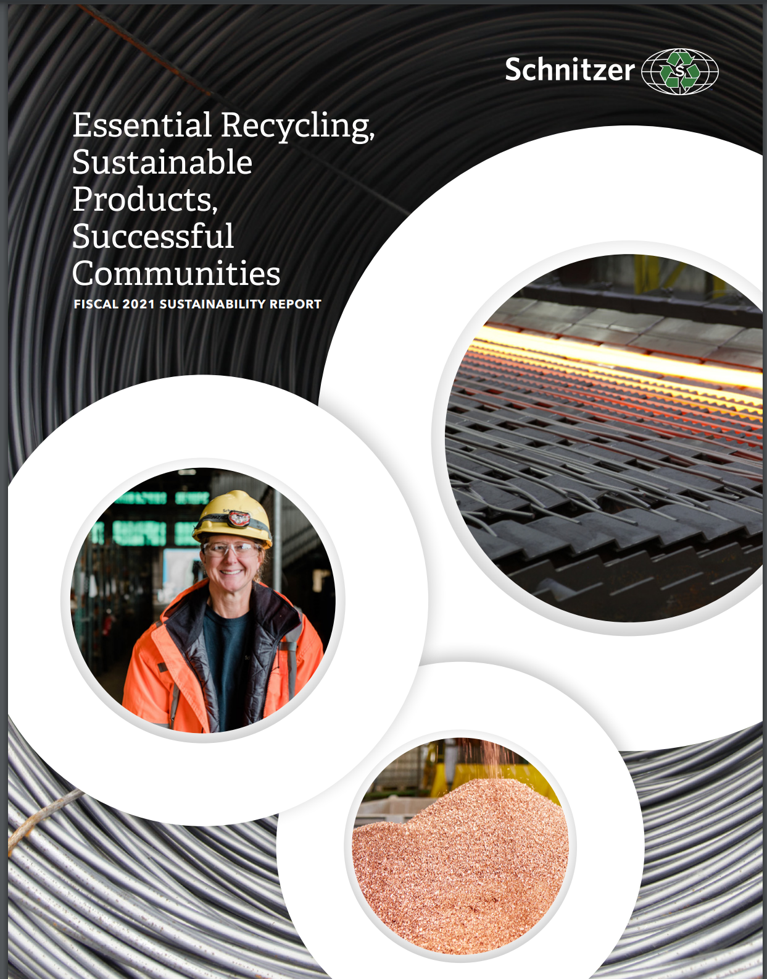
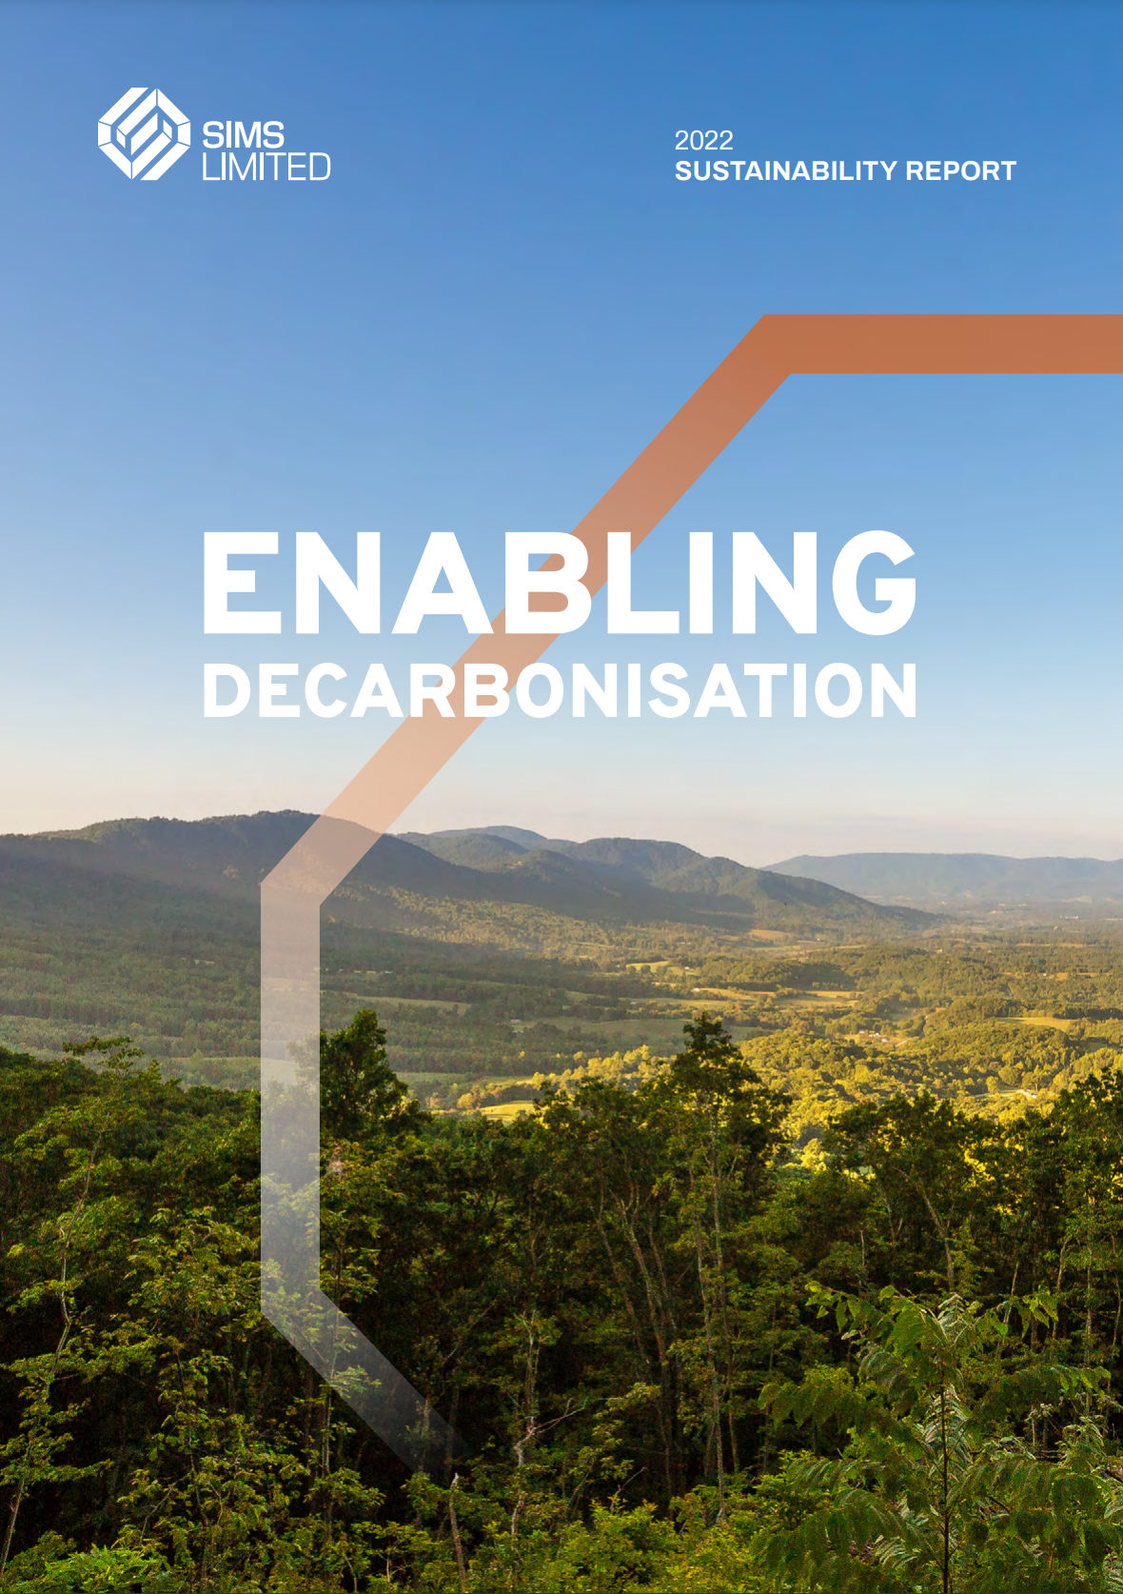
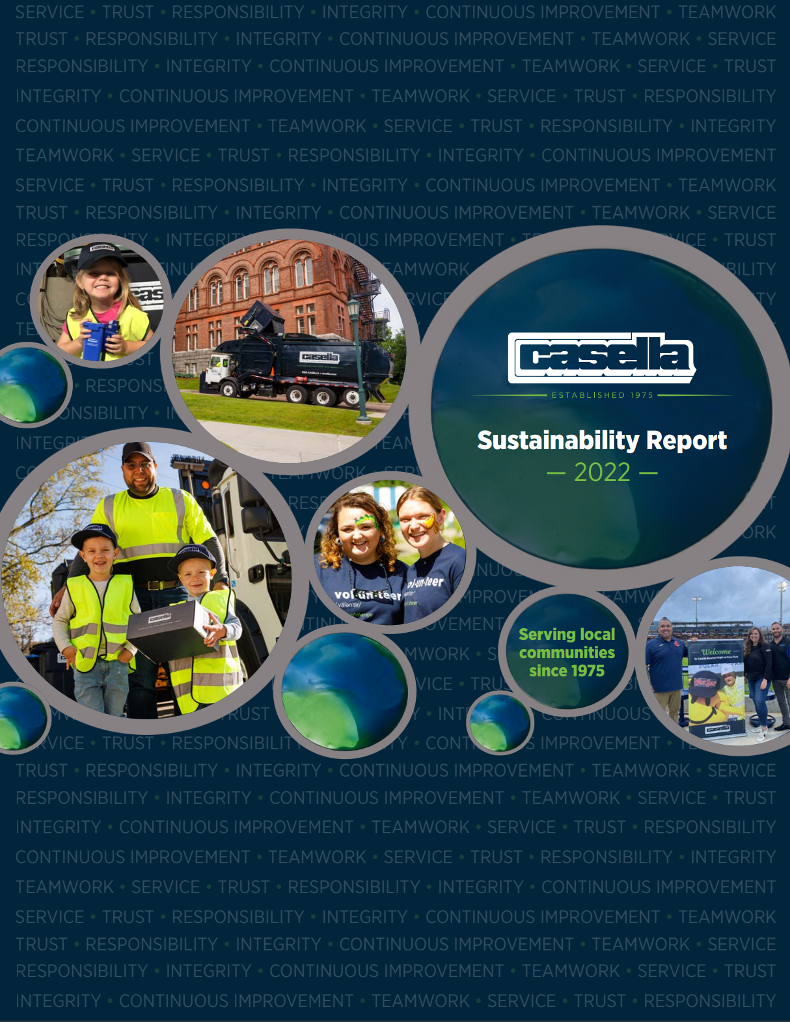
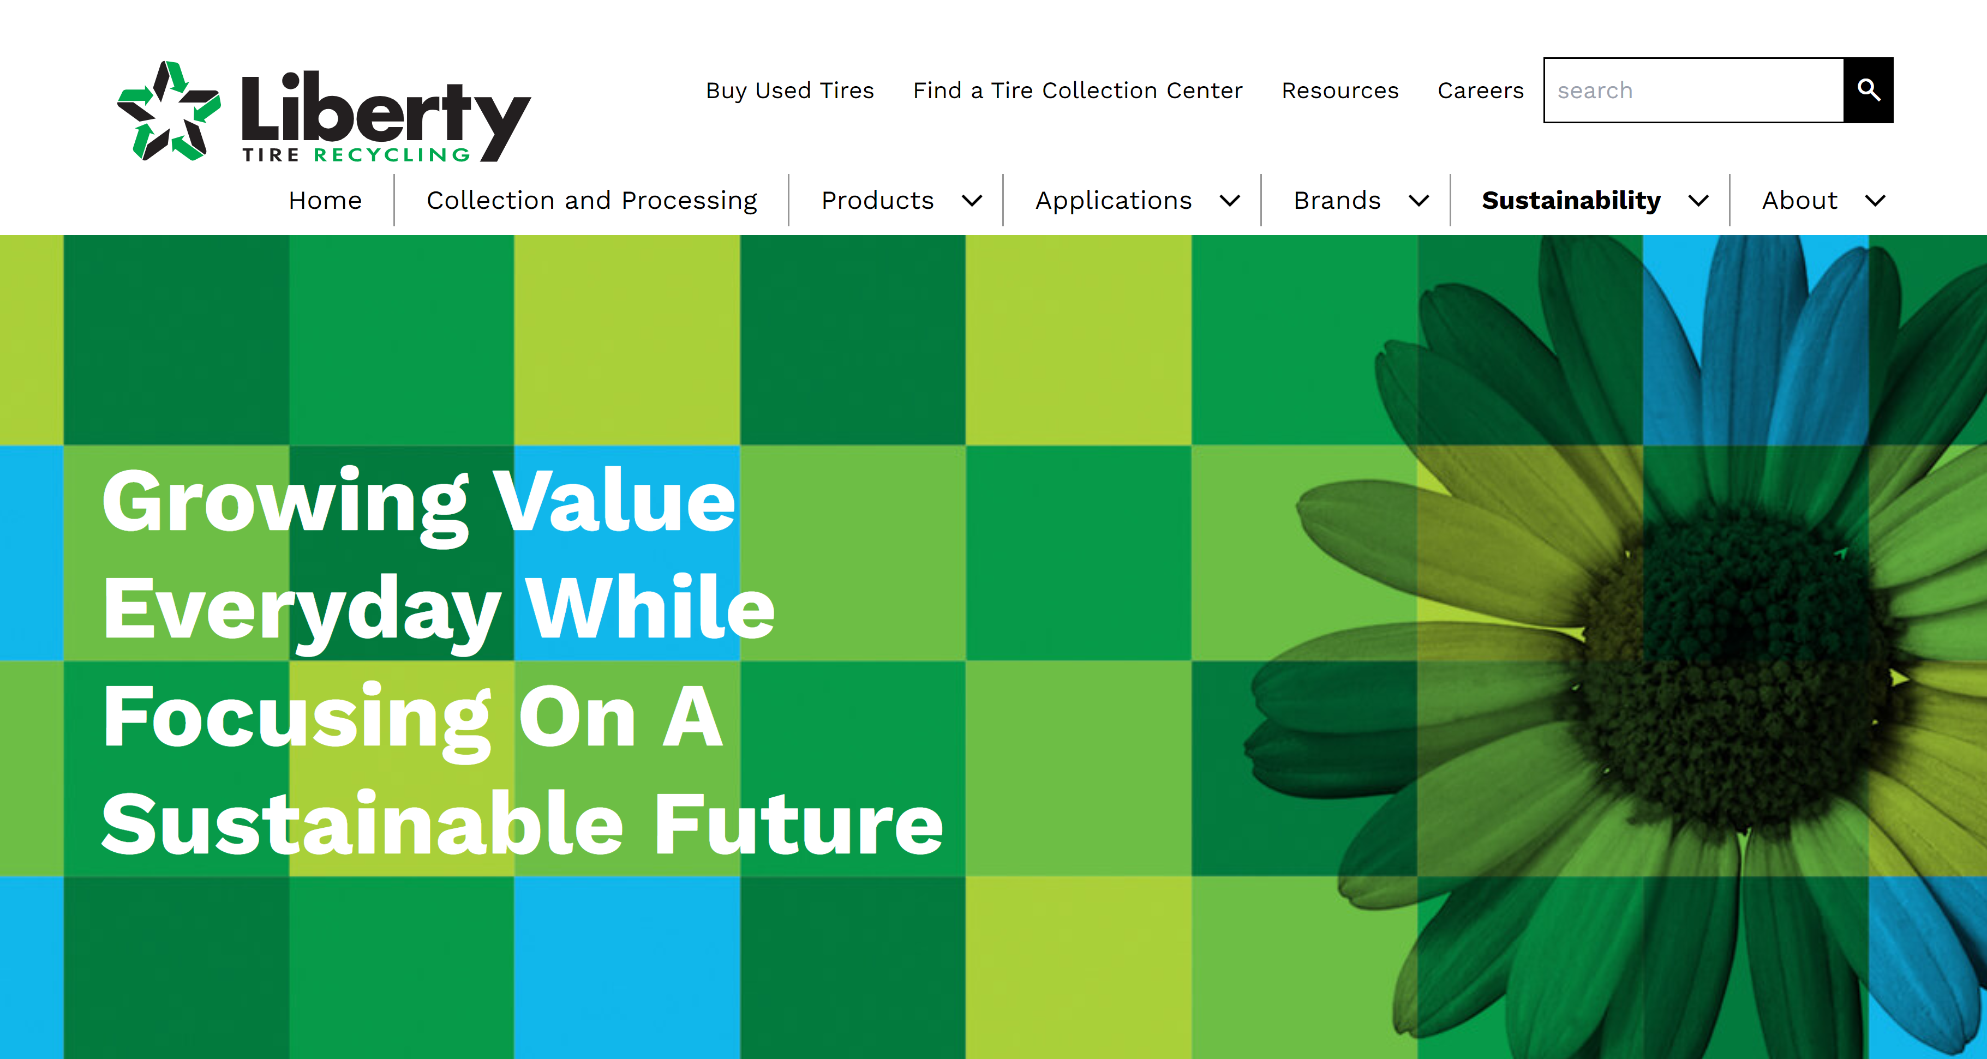


Sample ISRI Member Sustainability Reports
https://sustainability.schnitzersteel.com/
https://www.simsltd.com/press-releases/sims-limited-releases-fiscal-year-2021-sustainability-report/
https://sustainability.casella.com/
https://libertytire.com/sustainability/
https://indd.adobe.com/view/e35d4c57-9b26-4186-8115-6c95cb4c2f4b
Always Working For A Sustainable Tomorrow | WM 2022 Sustainability Report
Notes:
For this Workshop we’ve chosen to highlight several of our members sustainability reports. They each offer snapshots into the type of information that we are talking about. . We will be referencing a few sections from some of the reports today as examples, but we encourage you to review them for ideas as they are all very good.

