Slide 1
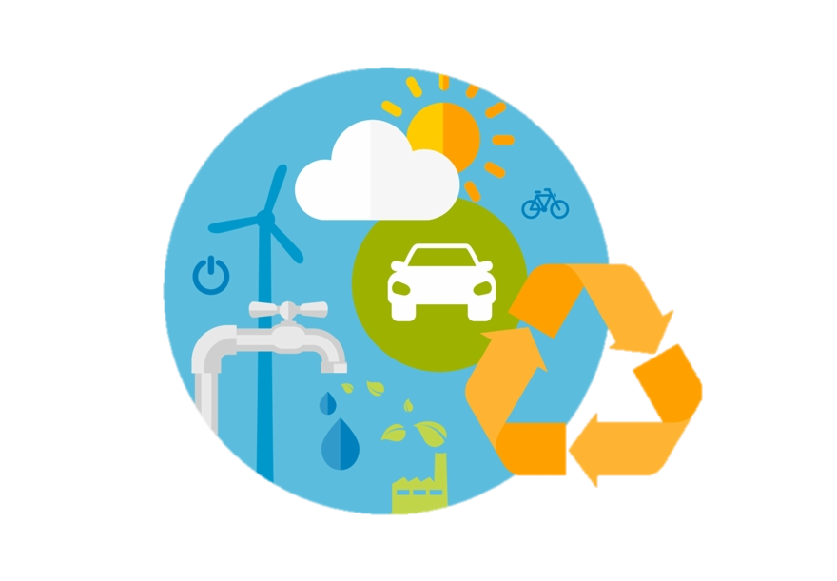

The “E” -
Environment in ESG
August 2023
Workshop #3
Graphic here
Pinclipart.com
The “E” in ESG considers how a company performs as a steward of the natural or physical environment. It takes into account a company’s utilization of natural resources and the effect of its operations on the environment, both in its direct operations and across its supply chains.
Notes:
The topic for this month is the E for Environment in ESG.
The “E” in ESG covers all aspects of the environment and takes into account how a company performs as a steward of the natural or physical environment, and the effect of its operations on the environment, both in its direct operations and across its supply chains.
.

Slide 2
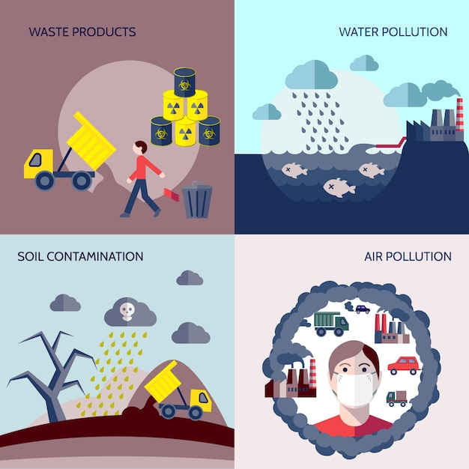
Environment is more than GHG
The “E” in Environment is about more than GHG emissions. Other environmental impacts are important and are interconnected:
Water: Including water use, management, and stormwater management
Air: Beyond the listed GHG emissions, including Particulate Matter, (NOx) and (SOx), etc.
Soil health: The impact of soil health on biodiversity is a growing area of focus.
Noise: For our business, this can be an important environmental and health issue
These impacts are touched by our local operations and most reporting inventories about them.
Science Photo Library
Notes:
While we are focusing on GHG emissions in this workshop, other environmental impacts area also critically important for their impact on climate change and overall global health, and they are all interconnected.
For example, let’s start with water – how much is used, and how is it handled? How is stormwater treated and discharged?
What about Particulates in the air? What is a company’s impact on air quality?
Soil health is a certainly something our industry has had to address regarding toxics leaching into the soil. However, there is now also increasing focus on the impact of soil health on biodiversity.
And Noise – while this one can be a tough one to manage, it is real, and definitely plays a role in our operations: whether its truck noise on the street, or the noise associated with our facility’s operations as communities change, noise pollution can play a significant role in our environmental and health impacts.
More details are being asked about all of these.

Slide 3

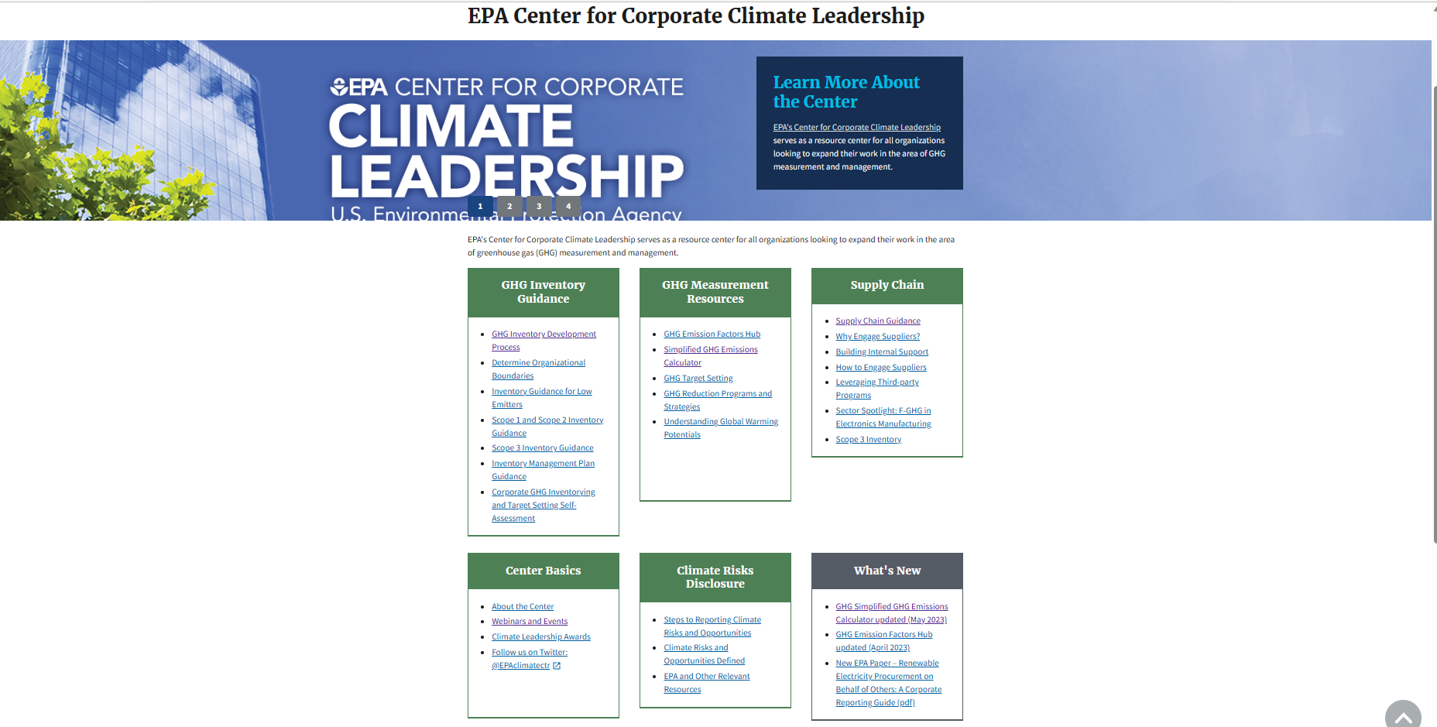
GHG Emissions: Overview
Primary Sources used for GHG reporting and calculation are:
The Greenhouse Gas Protocol - Provides background, definitions, boundaries, and standards
U.S. EPA GHG emission calculator - Online tool for simple calculation of emissions.
August 2023
Notes:
All of these environmental impacts are important. We will include information in the toolkit explaining what date is expected on them for reporting.
However, today we are going to focus specifically on GHG emissions and calculations.
For this chapter of the toolkit, we’ve relied on two primary sources: The Greenhouse Gas Protocol, and US EPA’s Center for Corporate Climate Leadership. They are linked in that they refer to each other. And – we are lucky to have Eric Christensen from WSP, EPA’s contractor, on our call provide information to answer questions that may arise.
The GHG Protocol is a corporate accounting and reporting standard that has been developed and updated over several decades. It is THE global standard for emissions reporting. As you may remember, we are using the Global Reporting (GRI) Initiative for our framework for ESG reporting,. GRI references the GHG Protocol for emissions inventory work as part of their reporting structure. In other words – we are circling the wagons by using frameworks that work together.
We are also using US EPA’s GHG Emissions Calculator. It was updated earlier this year. It is also referenced by the GHG Protocol as a preferred emissions calculation tool. Abbie Webb, sustainability director at Casella Waste Systems - and chair of ISRI’s Sustainability Network, will take us through a sample calculation for a recycling facility later in this presentation.
But first, lets start with some basic information about GHG emissions and why we measure and report them.

Slide 4
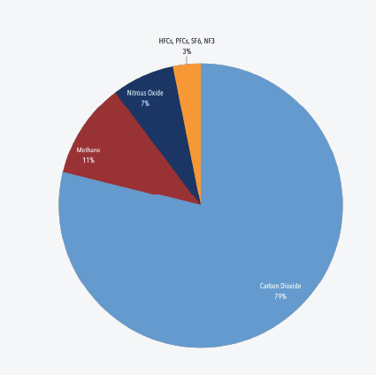

What Are Greenhouse Gases?
A Conversation with our Stakeholders
Gases that trap heat in the atmosphere are called greenhouse gases.
Carbon dioxide (CO₂): CO2 comes from burning fossil fuels (coal, natural gas, and oil), solid waste, trees and other biological materials. It also is result of chemical reactions, such as cement production.
Methane (CH₄): Methane is emitted during the production and transport of coal, natural gas, and oil. Methane emissions also come from livestock and other agricultural practices, and the decay of organic waste in municipal solid waste landfills.
Nitrous oxide (N₂O): Nitrous oxide is emitted during agricultural, land use, industrial activities; and the combustion of fossil fuels and waste.
Four Synthetic, Fluorinated gases:
  Hydrofluorocarbons (HFCs)
  Perfluorocarbons (PFCs)
  Sulfur hexafluoride (SF6)
  Nitrogen trifluoride (NF3)
  These are emitted from a variety of household, commercial, and industrial applications and processes.
Overview of Greenhouse Gas Emission in 2020
August 2023
Notes:
WHAT ARE GREENHOUSE GASES?
There are six greenhouse gases covered by the GHG Protocol —
carbon dioxide (CO2),
methane (CH4),
nitrous oxide (N2O),
hydrofluorocarbons (HFCs),
perfluorocarbons (PFCs), and
sulphur hexafluoride (SF6).
These six gases trap heat in the atmosphere.
There are other types of air emissions that are not considered GHG because they to not react to trap heat in the atmosphere. Examples include:
Nitrogen, Oxygen, Argon, NEON, HYDROGEN AND CARBON MONOXIDE. There are NOT GHG gases.
For those of you who understand chemistry better that I do, ONLY GASES WITH MOLECULES WHOSE SYMMETRY CHANGES to trap heat in the atmospjhere CAN BE CLASSIFIED AS GREENHOUSE GASES.
The GHG protocol only accounts for GHG emissions.

Slide 5

GHG Reporting
A Conversation with our Stakeholders
Why should your company inventory GHG emissions?
A well-designed and maintained corporate GHG inventory can serve several business goals, including:
Managing GHG risks and identifying reduction opportunities
Public reporting and participation in voluntary GHG programs
Participating in mandatory reporting programs
Participating in GHG markets
Recognition for early voluntary action.
What gets measured gets managed.
Accounting for emissions have help identify the most effective reduction opportunities. This can drive increased materials and energy efficiency, as well as the development tof new products and services for customers and suppliers.
Notes:
Why why should companies account for their GHG emissions?
Well, for starters, the topics of global warming and climate change are not likely to go away. And many governments, both national and state, or provincial, are taking steps to reduce GHG emissions through policies. As a result, companies need to understand their own risks in order to stay competitive, and to be prepared for future regulations.
A well designed and maintained corporate GHG emissions inventory can serve several business purposes:
First, knowing your emissions can help our company manage its GHG risks and identify reduction opportunities
Next, public reporting and participation in voluntary GHG programs will position a company well for future required and voluntary reporting.
And a GHG inventory will also facilitate participating in cap and trade, or carbon trading programs that can be financially beneficial, or even required; and
Finally, early voluntary action may help support “baseline protection” and /or credit for early action.
Conversely, a limited focus on your company’s direct emissions may result in missing risks AND opportunities, and may lead to a misinterpretation of the company’s actual GHG exposure.
At the risk of sounding like a broken record, what gets measured gets managed. The process of accounting for your emissions can help identify the most effective reduction opportunities – which can drive efficiencies and even the development of new products and services that can help differentiate the company or its suppliers.
In other words, there are a lot of good business reasons to building your understanding of your company’s GHG emissions.

Slide 6
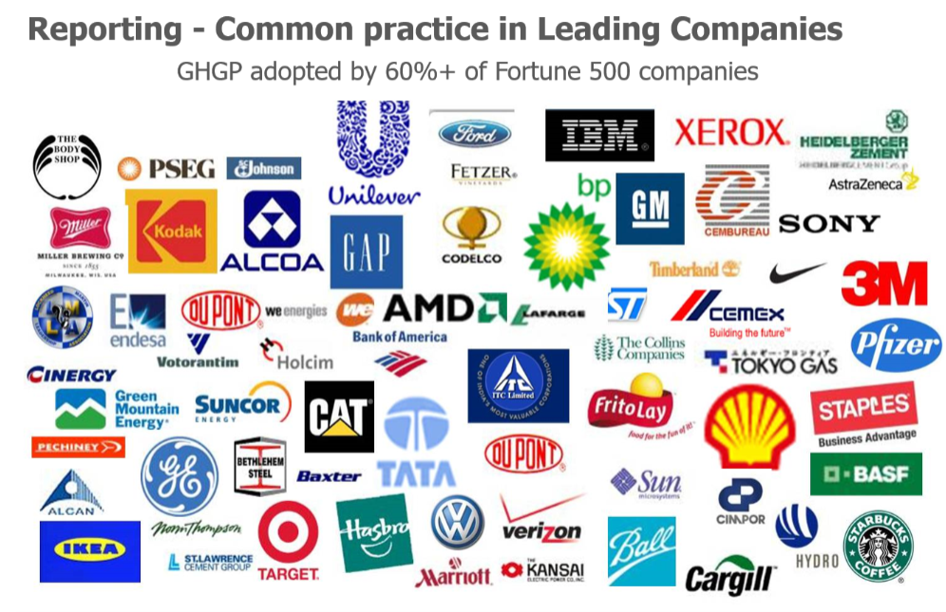
GHG Protocol is the Business Standard
Notes:
In fact, the GHG Protocol has been adopted by 60% of Fortune 500 Companies.

Slide 7
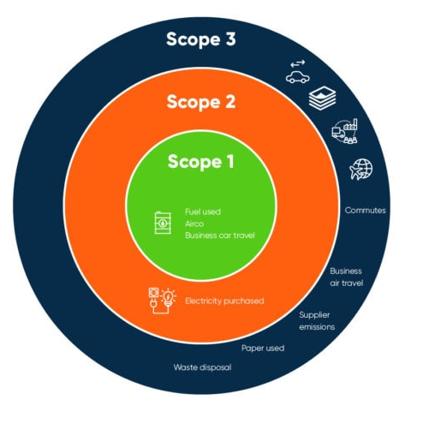
Scopes of Emissions
graphic: echochain
Notes:
Let’s start to shift to the more tactical aspects of GHG emissions.

Slide 8
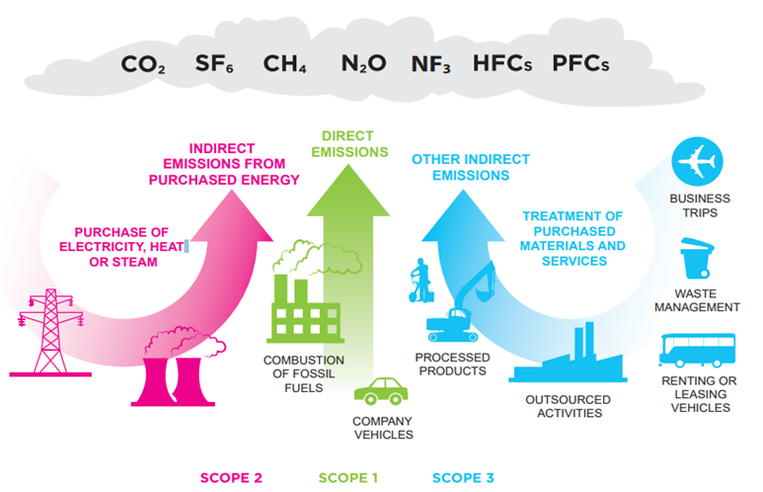
Categories of Emissions: “Scopes”
A Conversation with our Stakeholders
Three categories of Emissions are used for accounting and reporting.
Scopes 1 and 2 are carefully defined in this standard to ensure that two or more companies will not account for emissions in the same scope.
Scope 3 emission are indirect emissions that are part of a company’s supply chain.
There is increasing attention on Scope 3 Emissions. We anticipate further discussions on these emissions at a later date.
graphic:
savemoneycutcarbon
Because reporting companies are expected to separately account for and report on scopes 1 and 2 at a minimum, we will focus on these two today.
August 2023
Notes:
As a reminder, The GHG Protocol is a corporate accounting and reporting standard that has been developed and updated over several decades. It establishes 3 different types of GHG emissions categories.
Scope 1 emissions are all direct emissions from the operations of the company. If you look at the green arrow in the middle of this graphic, you can see that Scope 1 emissions cover the activities directly controlled by the company such as fuel combustion in their equipment and vehicles.
Scope 2 emissions, in pink on the left, are indirect emissions and are specifically from electricity purchased and used by a company.
Scope 3 are other indirect emissions that are part of a company’s supply chain (blue arrow on the right), but are from sources that they do not own or control. They may be associated with procurement, transportation and distribution performed by 3rd party vendors or corporate travel.
As we work through this, you’ll see that these scopes are designed very specifically to avoid double counting emissions. That is really the purpose of having 3 separate scopes.
You’ll also see the variations of emissions across business types.
For some companies, their emissions are mostly from Scope 1 operations – heavy industry, for example.
Others use a lot of electricity – like Microsoft with their Cloud Farms.
And for others – their emissions are from their supply chain – such as retailers like Walmart or Target who purchase almost everything they sell from other companies.
This system has been devised to capture them all, with out counting them multiple times.

Slide 9

Scope 1: Direct Emissions
A Conversation with our Stakeholders
Scope 1 emissions are a Company’s direct greenhouse gas emissions
Direct greenhouse gas emissions occur from sources that are owned or controlled by the company.
Examples:
Emissions from combustion in owned or controlled boilers and furnaces
Emission from vehicles
Emissions from chemical production in owned or controlled process equipment.
Note: Direct CO2 emissions from the combustion of biomass shall not be included in scope 1 but reported separately.
Greenhouse gas emissions not covered by the Kyoto Protocol (e.g. CFCs, NOx, etc.) shall not be included in scope 1, but may be reported separately.
graphic: Vectorstock
August 2023
Notes:
Let’s dig into each scope, starting with Scope 1 – Direct emissions.
Companies report GHG emissions from sources they own or control as scope 1. I’ve also heard them referred to operating emissions.
Direct GHG emissions are principally the result of the following types of activities undertaken by the company:
Emissions from combustion of fuels in stationary sources, e.g., boilers, furnaces, turbines
Emissions from the combustion of fuels used in company owned/controlled vehicles. This includes trucks, trains, ships, airplanes, buses, and cars.
Emissions from manufacture or processing of chemicals and materials, like a cement factory.
And Fugitive emissions. These emissions result from intentional or unintentional releases, e.g., equipment leaks from joints, seals, and gaskets; methane emissions from coal mines and venting; and emissions from refrigeration and air conditioning equipment.
_________________________________
Background for my notes only:
The combustion of fuels produces emissions of the following greenhouse gases: carbon dioxide (CO2), methane (CH4) and nitrous oxide (N2O). The focus of this guidance is on direct emissions of CO2 from fossil fuel combustion.
Carbon dioxide accounts for the majority of greenhouse gas emissions from most stationary combustion units.
When weighted by their Global Warming Potentials (GWPs), CO2 typically represent over 99 percent of the greenhouse gas emissions from the stationary combustion of fossil fuels.4 T
Definitions A facility includes all buildings, equipment, structures, and other stationary items which are located on a single site or on contiguous or adjacent sites and which are owned or operated by the same person or entity (or by any person or entity which controls, is controlled by, or is under common control, with such person or entity). Facilities are also referred to as installations. Several distinct types of business activities may occur at a single facility, each of which may operate one or more combustion units. A combustion unit is an individual fuel-fired combustion device (e.g., boiler). For example, a facility owned and operated by an electric power company can house two business activities. The primary activity will likely be electricity generation and may include several combustion units (as well as generators, pollution control equipment, etc.). The same facility could also contain a maintenance shop for the company’s transmission line equipment, which may be classified as a separate business activity. The maintenance shop may itself include a combustion unit such as an emergency diesel generator or compressor engine.

Slide 10
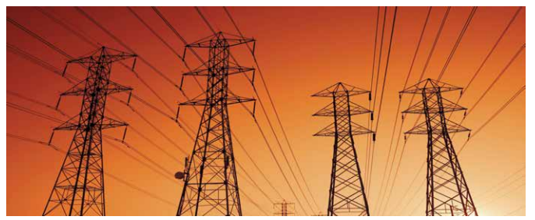
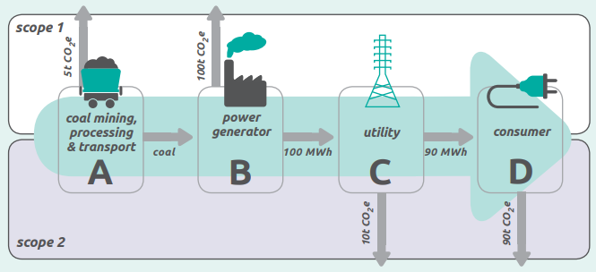
Scope 2: Indirect Electricity Emissions
A Conversation with our Stakeholders
Scope 2 are emissions from the generation of purchased electricity that is consumed by a company in its own equipment or in the operations that it controls.
Graphics: GHGP
August 2023
Notes:
Scope 2 emissions is the electricity used at your company. For many companies, the electricity they purchase from their local power utilities represents the most significant opportunity to reduce their emissions.
Accounting for emissions from electricity use allows companies to assess the risks, opportunities and cost associated with changing electricity to renewable sources.
For the company I worked for previously, its Scope 2 emissions were a very small portion of their overall emissions inventory. Based on their analysis, they determined that they could commit to moving to 100% renewable electricity use at a reasonable cost. Assessing their Scope 2 emissions played an important role in making this commitment.
Explanation of the diagram above:
The diagram on this slide illustrates the emissions from an electricity system value chain.
Let’s start at the beginning. In this case scenario, the electricity being used is from coal. A coal mining and processing company (A) directly emits 5 metric tons of CO2 per year from its operations then sells its coal to a power generator (B)/ This company burns coal to generates 100 MWh of electricity - directly emits 100 metric tons of CO2 per year. These first two companies generate direct emissions from their operations–which they report as Scope 1.
Next, Utility (C) that owns and operates a Distribution system purchases all of the generator’s electricity. The utility consumes 10 MWh due to distribution line losses. This corresponds to 10 metric tons CO2 of scope 2 indirect emissions per year. The remaining 90 MWh are delivered to and used by end user (D). The end consumer reports 90 metric tons CO2 of scope 2 emissions.
The table explains how each company accounts for GHG emissions. In this example, the coal mine and the power generator create direct Scope 1 emissions, while the utility and the end users emissions are indirect scope 2 emissions. All numbers are illustrative only but show how the emissions are accounted for without double counting in a mass balance equation.

Slide 11

Scope 3: Other Indirect Emissions
A Conversation with our Stakeholders
Example: DHL Nordic Express: Accounting for outsourced transportation services
DHL provides transport and worldwide express package and document deliveries.
While accounting for their emissions, they discover that 98% of their emission are from 3rd party transportation partners.
They began working with these partners to account for their emissions, and now use this information to evaluate and reduce their emissions.
By including Scope 3 and promoting reduction throughout their value chain they have been able to reduce their emissions footprint.
Scope 3 emissions are indirect supply chain emissions (other than electricity) that are the consequence of the activities of the company but occur from sources not owned or controlled by the company.
Examples:
Extraction and production of purchased materials;
Transportation of purchased fuels; and
Use of sold products and services.
Scope | Emissions (CO2)
Scope 1 | 7,265 (2.%)
Scope 2 | 52 (0.015%)
Scope 3 | 327,634 (97.9%)
Total | 334,951
We are part of our customers’ Scope 3 emissions
Notes:
Finally, Scope 3. Scope 3 emissions are indirect supply chain emissions (other than electricity) that are the consequence of the activities of the company but occur from sources not owned or controlled by the company.
For companies reporting on their emissions, Scope 3 reporting is considered optional – but that is changing. Also, if a company’s Scope 3 emissions are estimated to be more than 40% of its total emissions, it is expected to at least estimate them. Either way, Companies currently have a lot of discretion over reporting their Scope 3 emissions.
There are 15 categories of Scope 3 emissions. Examples include Transportation using other company’s fleet, employee business travel, employee commuting to and from work, transportation of sold products, leased assets and outsourced activities and emissions associate with purchased goods – such as office supplies.
If and when you do decide to report on Scope 3, you may find that there are only one or two major GHG-generating activities at your company to focus on.
A great example is on this slide. DHL found that 98% of their emission came from 3rd party transportation partners. Once they knew this, they began working with their partners to help them reduce their emissions.
Full List for Reference Only
Extraction and production of purchased materials and fuels
Transport-related activities
Transportation of purchased materials or goods
Transportation of purchased fuels
Employee business travel
Employees commuting to and from wor
Transportation of sold products
Transportation of waste
Electricity-related activities not included in scope 2 (see Appendix A)
Extraction, production, and transportation of fuels consumed in the generation of electricity (either purchased or own generated by the reporting company)
Purchase of electricity that is sold to an end user (reported by utility company)
Generation of electricity that is consumed in a T&D system (reported by end-user)
Leased assets, franchises, and outsourced activities— emissions from such contractual arrangements are only classified as scope 3 if the selected consolidation approach (equity or control) does not apply to them. Clarification on the classification of leased assets should be obtained from the company accountant (see section on leases below).
Use of sold products and services
Waste disposal
Disposal of waste generated in operations
Disposal of waste generated in the production of purchased materials and fuels
Disposal of sold products at the end of their life

Slide 12
Note on Scope 3 Emissions
A Conversation with our Stakeholders
Scope 3: In the past, estimating Scope 3 emissions has been sufficient. GHG Protocol Guidance did not required reporting or goal setting on Scope 3 emissions if they were less than 40% of a company’s overall emissions inventory.
That is changing. Scope 3 will be required reporting by most reporting bodies in future years.
We are part of other companies, and our customers Scope 3 emission. This is why we receive requests from our customers.
Makes sense to look at it. Your Scope 3 may make up over 40% of your emissions. You probably have 1-2 major supplier that make up most of your Scope 3 emissions, such as subcontracted transportation to end markets.
U.S. EPA’s Scope 3 Guidance is an excellent resource: Scope 3 Inventory Guidance | US EPA
Amazon’s Scope 3 Emissions
Amazon recently released an 84-page report highlighting their commitment to identifying and reporting on their Scope 3 emissions. They will then work with their suppliers to reduce them.
Scope 3 reporting is not required by part of most major reporting now. And due to its complexity, we are not focusing on it today.
However, we will spend more time on Scope 3 emissions during our October Workshop.
August 2023
Notes:
One final slide on Scope 3 emissions:
Scope 3 emissions basically include all sources not within an organization’s scope 1 and 2 boundary.
And, the scope 3 emissions for one organization are the scope 1 and 2 emissions of another organization.
Scope 3 emissions, also referred to as value chain emissions, may represent the majority of some organization’s total greenhouse gas (GHG) emissions. For companies like Walmart and Target, over 90% of their emissions are scope 3 emissions because they buy the products they sell form other companies.
More organizations are reaching into their value chains to understand the full GHG impact of their operations.
This is why you may be getting more requests form your customers for information on your emissions.
Although Scope 3 emissions are not under the organization’s control, the organization may be able to affect the activities that result in the emissions. They may be able to influence its suppliers or choose which vendors to contract with based on their practices.
We’ll spend more time on this during our October Workshop.

Slide 13
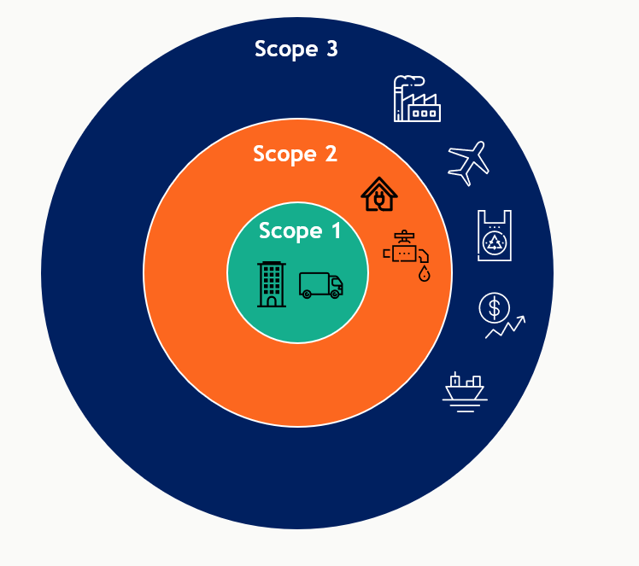
Avoided Emissions
A Conversation with our Stakeholders
In some cases, GHG emission reduction opportunities lie beyond a company’s scope 1, scope 2, and scope 3 inventories.
For example, some companies may track not only the emissions that arise from the use of their products, but also the avoided emissions in society that result from the use of their products and solutions compared to alternative products and solutions. These are sometimes referred to as Scope 4 Emissions.
Avoided emissions may also arise when accounting for the emissions impacts of using recycled rather than virgin materials, or from activities in other scope 3 categories.
Accounting for avoided emissions that occur outside of a company’s scope 1, scope 2, and scope 3 inventories requires a project accounting methodology.
Scope 4 is not included in a company’s direct or indirect emissions.
Estimates of avoided emissions are reported separately from a company’s scope 1, scope 2, and scope 3 emissions. They are not included or deducted from the emissions inventory.
August 2023
Notes:
Let’s spend a few minutes talking about Avoided Emissions. We know that this is an area of focus for many ISRI members, so we will dedicate more time for it during our October workshop. But – we wanted to touch on this today to put it Avoided Emission in context of this emissions discussion.
Avoided emissions are exactly what the words say – emissions that didn’t get generated. The GHG protocol reports emissions. It doesn’t report avoided emissions. In fact, if a company that purchased materials with recycled content AND sells products which are recyclable accounted for the emissions from both of these actions, they would be double counting.
So – to avoid double counting of emissions, companies are expected to ONLY report their direct and indirect emissions from their company’s operations such as fuel use or electricity used in their recycling operations
This comes up in other industries - not just the recycling industry. An example is condensed laundry detergent that doesn’t require hot water. (less water, less packaging, less energy heating the water). These avoided emissions are not reported as part of that manufacturers GHG emissions but can be reference separately.
In our industry, recyclers often use EPA’s WARM model to calculate the benefits of the tons they manage for recycling. They may use statements like “our company’s recycling saved the equivalent of planting 100 trees each year. It is absolutely fine to do this! A lot of companies do this kind of storytelling to bring attention to the value of the services that they provide. Although they don’t get the actual emissions credit for it, their company plays an invaluable role in facilitating the environmental benefits of recycling.
Again, this is all great information – AND it is separate from your companies GHG emissions inventory.
It is important to note the distinction as we talk about scopes and GHG inventories.

Slide 14
Example: Emissions Inventory
Scope 1
- Collection truck fuel
- On-site equipment fuel
Scope 2
- Electricity purchased from the regional power company
Scope 3
- 3rd party transportation fleet to end markets/port
- Purchased goods (trucks, parts, uniforms, office supplies)
- Travel, commuting, waste disposal
Company A’s Emission Inventory
A Conversation with our Stakeholders
Company A provides recycling collection and sorting services.
Through their GHG emissions inventory process, the company identified the following primary emissions:
Avoided Emissions (Scope 4):
Reported separately as part of this company’s Sustainability Report
Company A’s emission inventory includes emissions only. It does not include the environmental benefits associated with the tons they recycle.
Avoided Emissions. The benefits of recycling are called Avoided Emissions since they reduce emissions outside of the boundary of this company. Other companies in the supply chain will report the benefits of recycling as part of their emission inventory.
If Recycling Company A incorporated these benefits, this would result in double counting of emissions benefits.
August 2023
Notes:
We thought it might help to highlight Avoided Emissions with this example.
This is a hypothetical company with environmental benefits associated with the avoided emissions from tons they handle for recycling.
- This recycling company generates Scope 1 emissions from their collection trucks and the energy used in their on-site equipment
- The electricity they use for lights and processing equipment is their Scope 2 emissions
- Their Scope 3 emissions are their office supplies, employee commuting, travel and waste disposal, as well as for their 3rd part vendor used to transport their product to end markets.
This is their company’s GHG inventory.
Recycling also has the following emissions impacts that are not in this company’s Scope 1, 2 or 3 emissions inventory:
- The Company that mines raw materials will have less emissions and will report less scope 1 emissions
- The mills using post consumer content may use less electricity processing material with post consumer content, reducing their Scope 2 emissions.
There will be less waste goes to landfill creating less emissions there – reducing Scope 1 emissions for the landfill, and Scope 3 emissions for the waste generator.
As you can see, the emissions reductions associated with recycling get captured by other players in the value chain.
Recyclers play a key role in enabling this activity, but we don’t get to take credit for those emissions or we would be double counting the benefits that mining companies and manufacturing companies report as part of their scope 1 and 2 emissions.
It is acceptable to reporting these emissions separately as Avoided Emissions, but not as part of your emissions inventory.

